Slide 1
UNIT-V
Electrical Actuators, Electron-
Mechanical Actuators 07 Hours
Electrical-Actuation system: Selection criteria and specifications of stepper motors
Solenoid valves
Relays (Solid State relays and Electromechanical relays).
Selection Criterion of control valve
Single acting and Double acting Cylinders.
Electro-Pneumatic: Pneumatic Motors
Valves: Electro Hydraulic: 3/2 Valves, 4/2 Valves, 5/3 Valves Cables: Power cable and Signal cables

Slide 2
Electrical-Actuation system
An electric actuator is a mechanical device used to convert electricity into kinetic energy in either a single linear or rotary motion.
Actuation systems are the elements of control systems which are responsible for transforming the output of a microprocessor or control system into a controlling action on a machine or device.

Slide 3
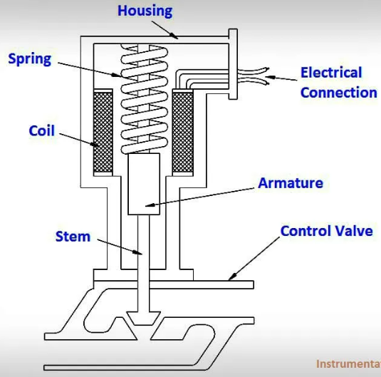
The coil is connected to an external current supply.
The spring rests on the armature to force it downward.
The armature moves vertically inside the coil and transmits its motion through the stem to the valve.

Slide 4
Case 1. When current flows through the coil, a magnetic field forms around the coil.
The magnetic field attracts the armature toward the center of the coil.
As the armature moves upward, the spring compresses and the valve opens.
Case 2. When the circuit is opened and current stops flowing to the coil, the magnetic field collapses. This allows the spring to expand and shut the valve.

Slide 5
Advantage:
1. Quick operation.
2. Much easier to install than pneumatic or hydraulic actuators.
Disadvantages:
1. They have only two positions: fully open and fully closed.
2. They don’t produce much force, so they usually only operate relatively small valves.
3. Stepper Motors have low torque to inertia ratio, which means they cannot accelerate loads very rapidly and the motor can get very hot in
high performance configurations. Stepper Motor can be audibly very noisy
at moderate to high speeds and have low output power for size and weight.

Slide 6
The elements in electrical actuating system
Each electric motor consists of two main components which are:
Stator – a permanent magnet that is stationary
Rotor – sits in the center of the stator and is forced to undergo the magnetic field generated by the stator, thereby causing a spin in motion of the rotor.
The basic principle of the energizing one or more of the stator phases, a magnetic field is generated by the current flowing in the coil and the rotor aligns with this field.
What is better servo or stepper?
In general, servo motors are more sophisticated than stepper motors.
They run significantly faster than stepper motors, with speeds on the order of several thousand RPMs.
This enables servo motors to be used with gearboxes to deliver much higher torque at useful speeds.

Slide 7
Real-World Applications for Electric Linear Actuators
Material handling.
For every type of manufacturing operation.
Robotics. ...
Food and beverage manufacturing. ...
Window automation. ...
Agricultural machinery. ...
Solar panel operation. ...
Valve operation.

Slide 8
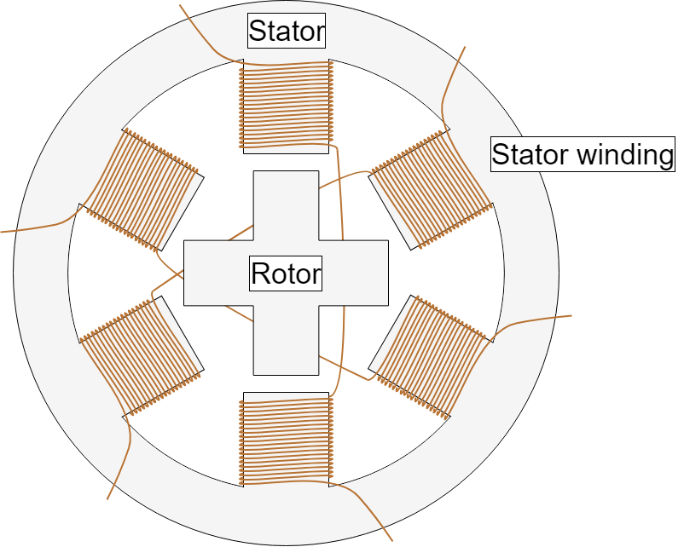
Selection criteria and specifications of stepper motors
Stepper motors are DC motors that move in discrete steps.
They have multiple coils that are organized in groups called "phases".
By energizing each phase in sequence, the motor will rotate, one step at a time.
With a computer controlled stepping you can achieve very precise positioning and/or speed control.
.

Slide 9
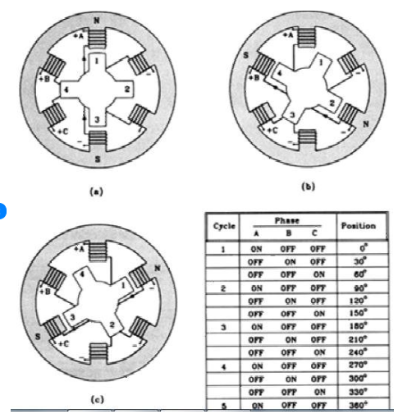

Slide 10
The step angle depends on the method of construction and is generally in the range 0.9-5°.
The most popular step angle is 1.8°.
Stepper motor is a brushless motor.
Stepper motors require some voltage but they really depend on current, you can supply them with 3, 6, 12, 24.36,48 as long as you don't exceed the current capability of the stepper.
You can use most steppers that work at 12v on 24v as long as you set the current limits correctly.
The principle of operation of a stepper motor can be illustrated with reference to a variable-reluctance, four-phase machine.
https://www.youtube.com/watch?v=eyqwLiowZiU

Slide 11
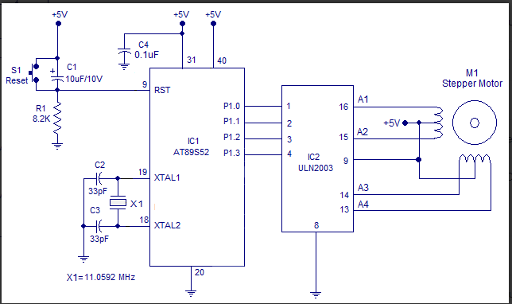
Stepper motors are controlled by a driver, which sends the pulses into the motor causing it to turn.

Slide 12
Solenoid valves
A solenoid valve is an electromechanically operated valve.
Solenoid valves are the most frequently used control elements in fluidics i. e. it controls the flow of liquid or gas through a system.
They are commonly used to shut off, release, dose, distribute or mix fluids. For that reason, they are found in many application areas.
Solenoid valves can also be normally closed.
Normally closed solenoid valves include a plunger that remains in a closed position when the system is running smoothly, like pressure relief valves.

Slide 13
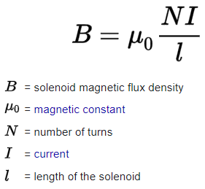
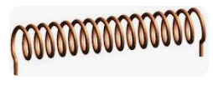
Working:
A solenoid is a type of electromagnet formed by a helical coil of wire (whose length is substantially greater than its diameter,) which generates a controlled magnetic field.
The coil can produce a uniform magnetic field in a volume of space when an electric current is passed through it.
A solenoid works by producing an electromagnetic field around a movable core, called an armature. When compelled to move by the electromagnetic field, the motion of that armature opens and closes valves or switches and turns electrical energy into mechanical motion and force.

Slide 14
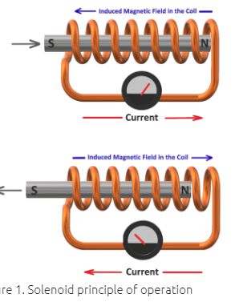
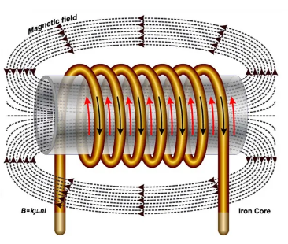
Solenoids are basically, electromechanical devices that converts AC or DC electrical energy into linear motion

Slide 15
Solenoid valves differ in the characteristics like …
the electric current they use,
the strength of the magnetic field they generate,
the mechanism they use to regulate the fluid, and
the type and characteristics of fluid they control.
The mechanism varies from linear action, plunger-type actuators to pivoted-armature actuators and rocker actuators.
The valve can use a two-port design to regulate a flow or use a three or more port design to switch flows between ports. Multiple solenoid valves can be placed together on a manifold.

Slide 16
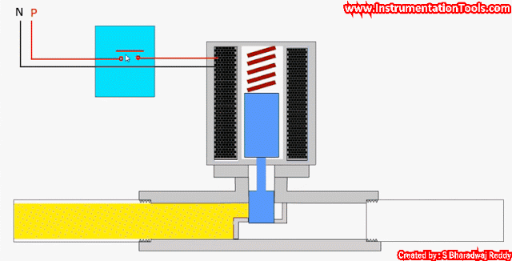
Solenoids offer fast and safe switching, high-reliability, long service life, good medium compatibility of the materials used, low control power and compact design.

Slide 17
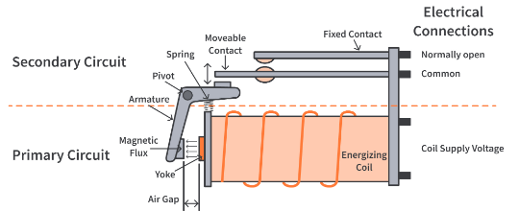
Relays
A relay is an electrically operated switch.
It consists of a set of input terminals for a single or multiple control signals, and a set of operating contact terminals.
The switch may have any number of contacts in multiple contact forms, such as make contacts, break contacts, or combinations thereof.
Components of Relay

Slide 18
Internal Structure of a Relay
There is a primary circuit (control circuit) and a secondary circuit (load circuit) in the relay. The primary circuit consists of an electromagnetic coil of wire wrapped around a soft iron core and a movable armature. The armature and the coil are separated by a small air gap when the coil is not energized. The primary side is powered through a low voltage DC signal. The armature is present at the end of the coil which is pivoted at a point and can move towards the yoke of the electromagnet if the coil is energized.

Slide 19
The other end of the armature is connected to a spring which helps the armature return to its original position.
On the secondary side, we have our load circuit, the circuit on which we have to perform the switching, connected between the normally open and common terminal of the relay. The common terminal is a movable contact and the normally open terminal is a fixed contact. The connected load could be anything that consumes electricity like a fan, motor, light bulb, etc.

Slide 20
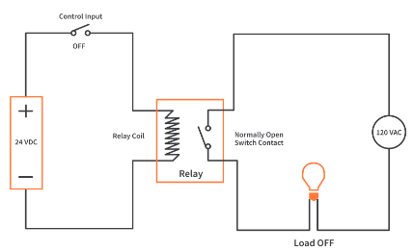
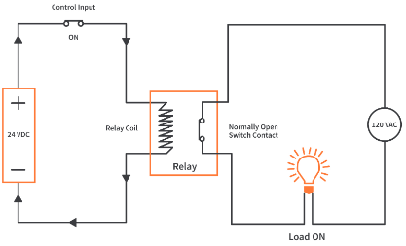
Working of a Relay in the circuit
A relay works on the principle of electromagnetism. We know that passing a current through a wire generates a magnetic field. Relays use the same principle to perform switching. The coil of the relay or the primary side is powered with a 24V DC source with the help of a control input switch. On the secondary side is our load connected between the other terminals of the relay and powered by a 120V AC source.
Initially, the control input is kept off and the coil stays in the unenergized state. As a result, our load stays in the OFF condition.

Slide 21
When the control input is turned on, the current starts flowing through the coil and it gets energized.
The energized coil generates a magnetic field around it, strong enough to attract the movable armature towards itself.
This motion of the armature pushes the common terminal (movable contact), present at the other end of the armature, towards the normally open terminal (fixed contact). They come in contact, complete the load circuit and our load is turned ON.
Important: The AC power supply of the load side is completely isolated from the DC supply in the primary circuit but still, we were able to perform the switching.

Slide 22
Solid State Relays (SSR)
Solid-state relays are the semiconductor equivalents of the electromechanical relays, and therefore can be used to control electrical loads.
The solid-state relay is a fairly complex device, but it has a simple purpose – to activate a single output load when energized.
SSR is an electronic switching device that switches ON or OFF when an external voltage (AC or DC) is applied across its control terminals voltage
ADVANTAGES:
They serve the same function as an electromechanical relay.
But as solid-state electronics contain no moving parts and have a longer operational lifetime.

Slide 23
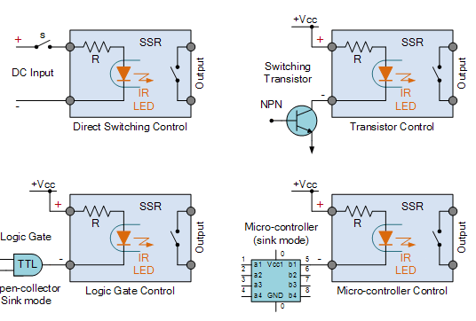
SSRs consist of
1. a sensor which responds to an appropriate input (control signal),
2. an electronic switching device which switches power to the load circuitry, and
3. a coupling mechanism to enable the control signal to activate this switch without mechanical parts.
Solid State Relay DC Input Circuit

Slide 24
Features:
They may be designed to switch either AC or DC loads.
Packaged SSRs use power semiconductor devices such as thyristors and transistors, to switch currents up to around a hundred amperes.
SSRs have fast switching speeds compared with electromechanical relays, and have no physical contacts to wear out (isolation).
SSRs are unable to withstand a large momentary overload the way an electromechanical relay can, as well as having a higher "on" resistance.

Slide 25
SSRs can be designed to switch both AC or DC currents by using an SCR, TRIAC, or switching transistor output instead of the usual mechanical normally-open (NO) contacts.
Advantages:
No moving parts to wear out, and
Therefore no contact bounce issues,
They are able to switch both “ON” and “OFF” much faster than a mechanical relays
Eliminating electrical noise and transients.
This makes them ideal for microcontroller, PIC and Arduino interfacing as the opto-isolators.
.

Slide 26
Disadvantages
Solid state relays can be bought in standard off-the-shelf packages ranging from just a few volts or amperes to many hundreds of volts and amperes of output switching capability.
However, solid state relays with very high current ratings (150A plus) are still too expensive to buy due to their power semiconductor and heat sinking requirements, and as such, cheaper electro-mechanical contactors are still used.

Slide 27
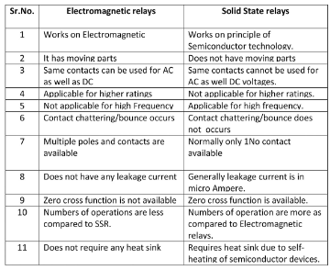
Solid State relays and Electromechanical relays

Slide 28
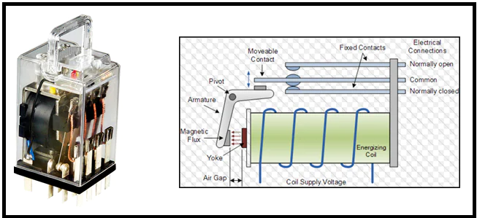
Solid State relays and Electromechanical relays

Slide 29
Selection Criterion of Control valve
To properly select a control valve, the following fluid and system properties must be known:
its state (vapor, liquid or two-phase),
vapor pressure,
Flow rate, inlet and outlet pressures, inlet temperature,
density, molecular weight, viscosity, specific heat ratio, critical temperature and critical pressure.
Type of fluid to be controlled.
Temperature range of fluid.
Viscosity range of fluid.
Specific gravity range of fluid.
Minimum and maximum flow required.
Minimum and maximum inlet pressure at the control valve.
Minimum and maximum outlet pressure at the control valve.

Slide 30
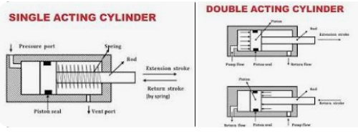
Single acting and Double acting Cylinders
A single-acting hydraulic cylinder includes just one port.
This is where the hydraulic fluid enters and forces the plunger out in one direction.
A double-acting cylinder includes two ports.
One for the hydraulic fluid to enter and extend the plunger, and the other for retracting the cylinder.

Slide 31
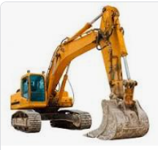
Double Acting Cylinders
A double-acting cylinder is a cylinder in which the working fluid acts alternately on both sides of the piston.
Double acting cylinders are a useful application when your machine requires more than one movement.
Double acting cylinders can extend and retract without the need of a spring.
A double-acting cylinder is bidirectional and can seal dynamic pressure from both sides.
An excavator is one example.
When digging a trench, the excavator's arm
is first pushed in one direction by extending
the rod.
Then it is pulled
down in another direction
by retracting the rod.

Slide 32
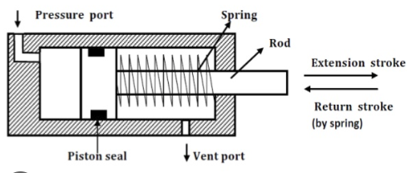
Single acting cylinder
A single-acting cylinder in a reciprocating engine is a cylinder in which the working fluid acts on one side of the piston only.
A single-acting cylinder relies on the load, springs, other cylinders, or the momentum of a flywheel, to push the piston back in the other direction.

Slide 33
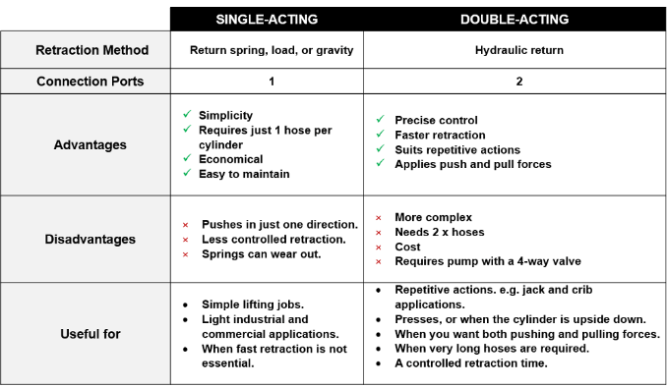

Slide 34
Electro-Pneumatic: Pneumatic Motors
Electro-pneumatic systems use electrical technologies to control the compressed air used as the working medium.
Electrical devices such as solenoids, limits switches, valves, and relays are some of the mechanisms used.
In a typical electro-pneumatic setup, electrical power is applied to a directional control valve.
Electro-pneumatic actuators are widely used to automate a number of areas of industrial applications, from production to assembly and packaging systems.
With electro-pneumatic actuators, the pneumatic components are controlled by electrical components including sensors, switches and industrial computer systems.

Slide 35
Pneumatic Motor
A pneumatic motor (air motor), or compressed air engine, is a type of motor which does mechanical work by expanding compressed air.
Pneumatic motors generally convert the compressed air energy to mechanical work through either linear or rotary motion.
A pneumatic motor (air motor), or compressed air engine, is a type of motor which does mechanical work by expanding compressed air.
Linear motion can come from either a diaphragm or piston actuator, while rotary motion is supplied by either a vane type air motor, piston air motor, air turbine or gear type motor.

Slide 36
There are several types of air motor. The most commonly used types are vane, piston and turbine motors. This technical guide deals with vane motors only. Vane motors are produced with power ratings up to approximately 5 kW.
Air motors are used to produce continuous rotary power from a compressed air system. They boast a number of advantages over electric motors: Because they do not require electrical power, air motors can be used in volatile atmospheres.

Slide 37
Valve function outlines the number of flow paths a valve has as well as the positions of a valve. The flow paths or ports are referred to as ways in the valve function. The number of positions is how many different positions that valve can be in.
A 2-way 2 position valve is known as a 2/2 valve. A basic example of a 2/2 valve is a ball valve. A basic ball valve has two ports (in and out) along with two positions (open or closed).

Slide 38
Valves: Electro Hydraulic: 3/2 Valves
A 3/2-way valve has three connection ports and two positions that can be driven pneumatically, mechanically, manually or electrically via a solenoid valve.
They are used to control a single-action cylinder, for driving pneumatic actuators, used as a blow-off valve, as pressure release valve and in vacuum applications.
https://www.youtube.com/watch?v=iFhG57-dTaM
They are used, for example, to control a single-action cylinder, driving pneumatic actuators, blow-off, pressure release and vacuum applications. A valve is used to fill the cylinder, and also to exhaust it afterwards, so that a new working stroke can be realized. Therefore, a valve with two ports would not be adequate. Venting requires a third port. There are two kinds of 3/2 valves: mono-stable and bi-stable. Mono-stable 3/2-way valves can also be normally closed or normally open, just like 2/2-way valves.

Slide 39
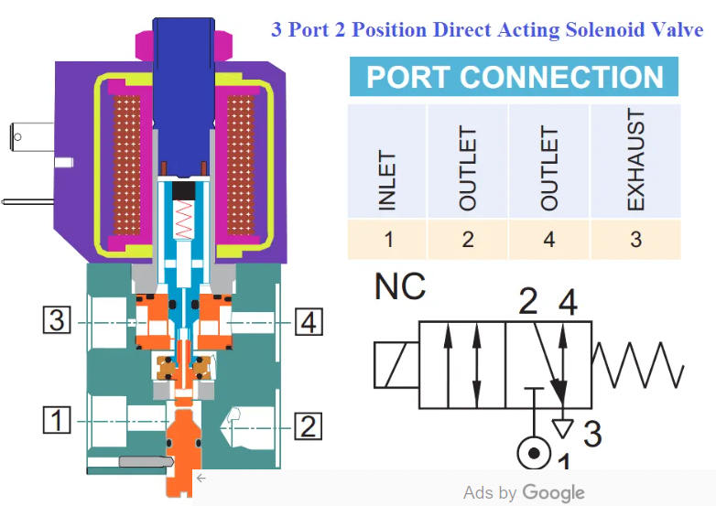

Slide 40
Selecting the appropriate valve for any application is imperative to ensure proper direction of flow, flow rate, exhaust function, and even basic valve functionality.
In pneumatics there are so many terms for valves that it can seem overwhelming.
Knowledge of valve function, porting, and actuation is key to obtaining the correct valve for the application.

Slide 41
Valves: Electro Hydraulic: 4/2 Valves
The 4/2 directional spool valves are direct operated, pressure compensated cartridge valves.
They control the start, stop and direction of a flow and basically comprise a housing (1) with a movably mounted socket (2), the control spool (5) and a return spring (4).
https://www.youtube.com/watch?v=J5DEB88dPok
4-way 2 position valve is known as a 4/2.
These valves are common in double acting cylinder applications where they are always supplying pressure to one side of the cylinder while venting the opposite side to atmosphere.

Slide 43
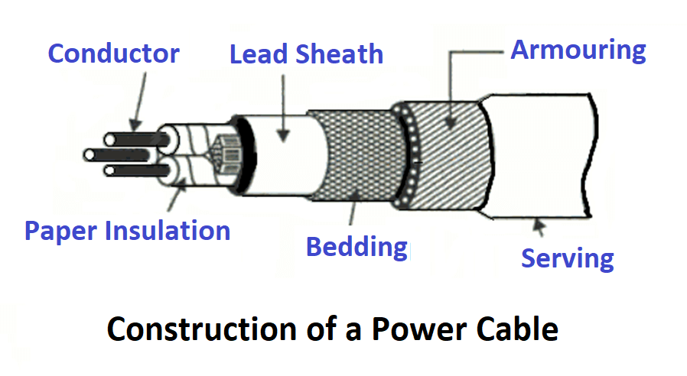
Cables: Power cable and Signal cables
The power cable is an electrical cable that comprises one or more conductors held together with an overall sheath.
Types of Cables
The type of cable is basically decided based on the voltage level for which it is manufactured and the material used for the insulation such as paper, cotton, rubber, etc.

Slide 44
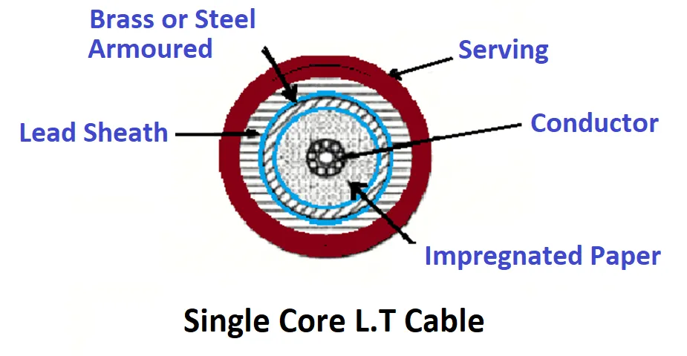
One way of classification of power cables is according to the voltage levels is
Low Tension Cables (LT cables)
High Tension Cables (HT cables)
Low Tension Cables
Low tension cables are used for voltage levels up to 1 kV.
The electrostatic stresses in LT cable are not dangerous, hence no special construction is used for this cable.
The paper is used as an insulation in these LT cables. Sometimes resin is also used which improves the viscosity and helps to prevent drainage.
Find below the cross-section of a single core LT cable. It consists of a circular core of stranded copper or aluminum conductor.

Slide 45
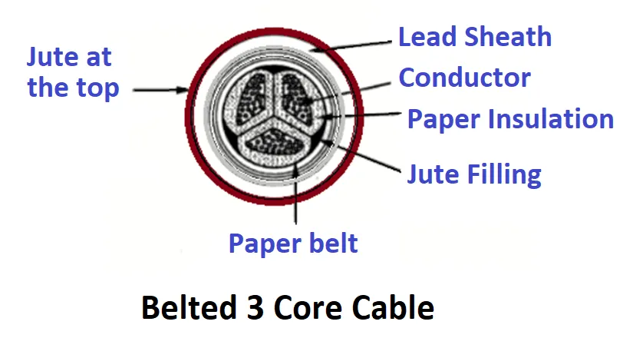
The conductor is insulated by impregnated paper. Over the paper insulation, the protective lead sheath is provided.
Then armored strength is provided and finally covered again with a layer of fibrous compounded material.
Medium and High Tension Cables
For voltages, up to 66 kV, the three core cables that are multicore cables are used.
1. HT cables up to 11 kV level which is belted type.
2. Super tension (ST) cables for 22 kV and 33 kV levels which are screened cables.
3. Extra high tension (EHT) cables for voltage levels from 33 kV to 66 kV which are pressure cables.

Slide 46
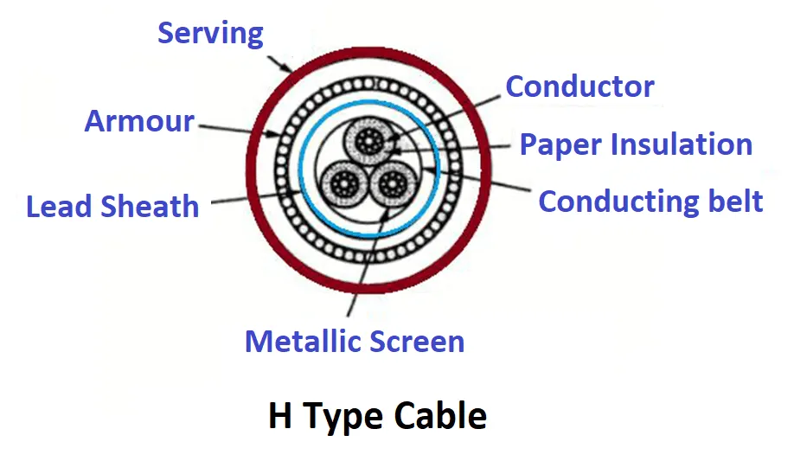
Super Tension Cables
These cables are utilized for the voltage levels of 22 kV and 33 kV. The two types of screened cables are
H type cables.
SL type cables.
H Type Cables
In this type of cable, there is no paper belt is used. Each conductor in this cable is insulated with paper, covered with a metallic screen which is generally an aluminum foil.

Slide 47
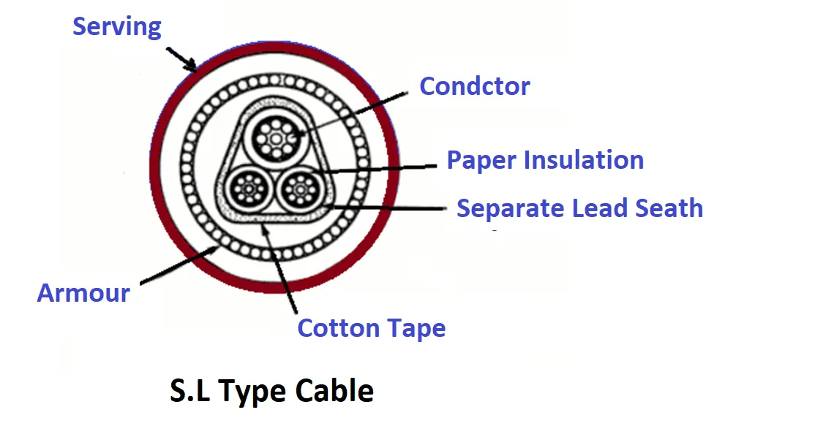
S.L Cables
Separate Lead Type Cable
The name S.L sands for separate lead screened cables.
In this cable, each core is insulated with an impregnated paper and each one is then covered by a separate protective lead sheath. Then there is a cotton tape covering all 3 cores together used a proper filler material.
The difference between H type and S.L types cable is that in S.L type a common lead sheath covering all the three cores is absent while each core is provided with a separate lead sheath. This allows bending of cables as per the requirement.

Slide 48
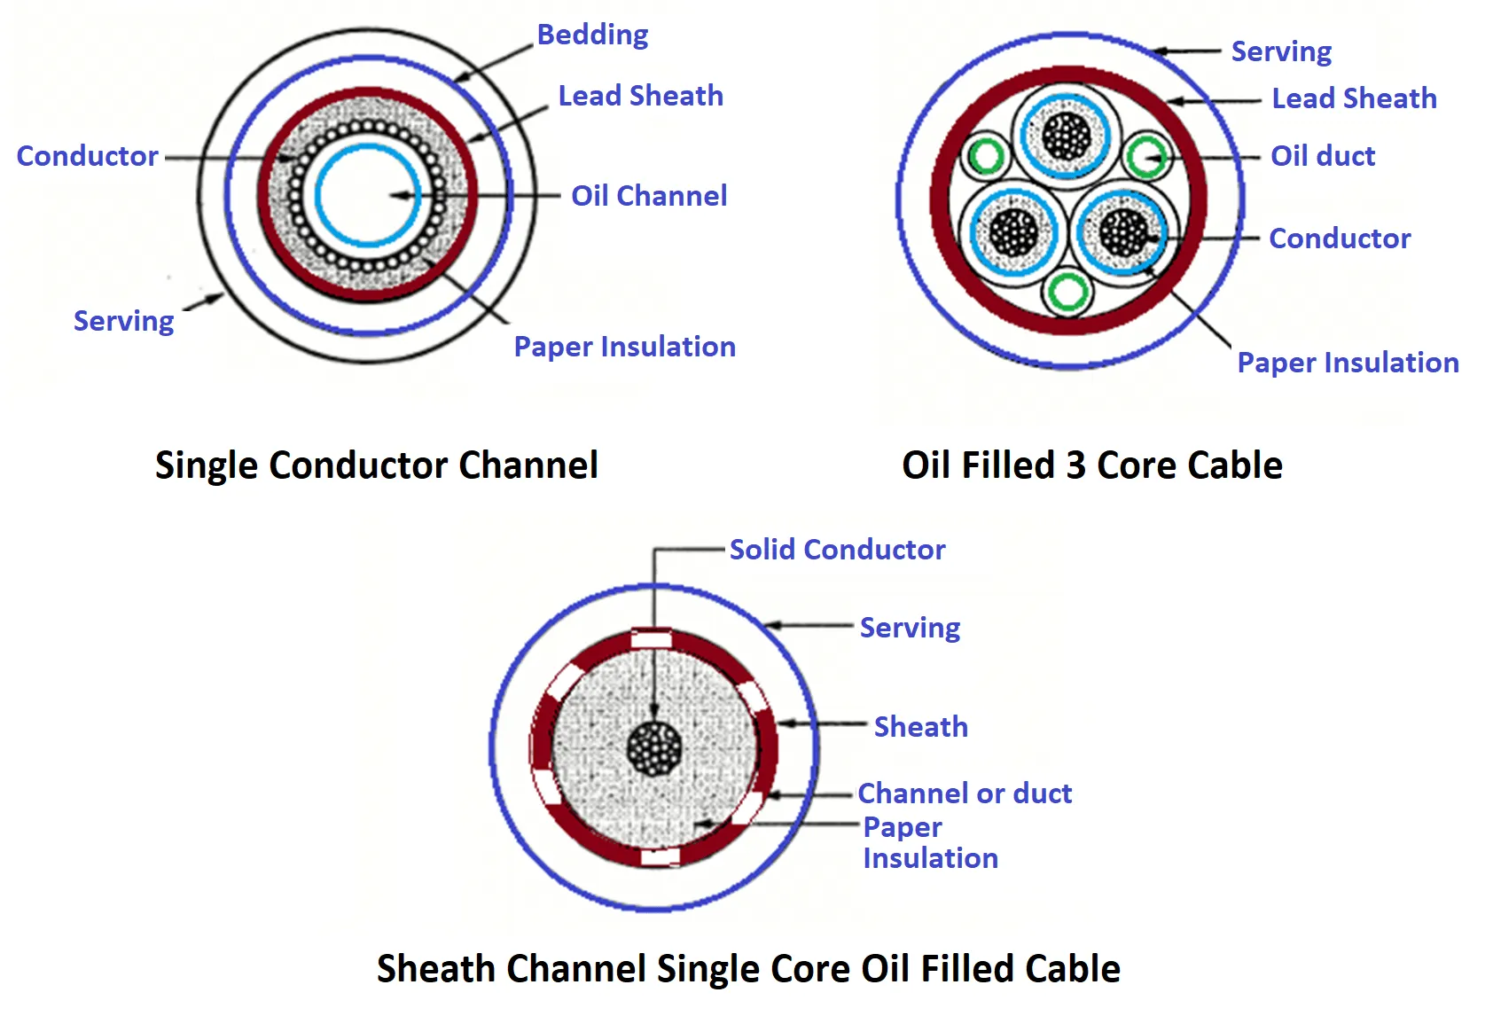
Oil-filled Cables
The cable consists of a concentrically stranded conductor but built around a hollow cylindrical steel spiral core. This hollow-core in a conductor acts as a channel for the oil.
The oil channel is filled in a factory and pressure is maintained in the oil by connecting the oil channel to the reservoirs which are placed at an appropriate distance along the path of the cable.
When the cable is heated, the oil expands but expanded oil is collected in the reservoir. When the cable is cooled, extra oil is supplied by the tank to maintain the oil pressure.
Since the oil channel is within the cable conductor hence it is called single-core conductor channel oil-filled cables. The cable is similar to that of the solid type cable.
The oil-filled cables are three types:
Single conductor channel
Single core-sheath channel
Three core filler space channels.

Slide 49
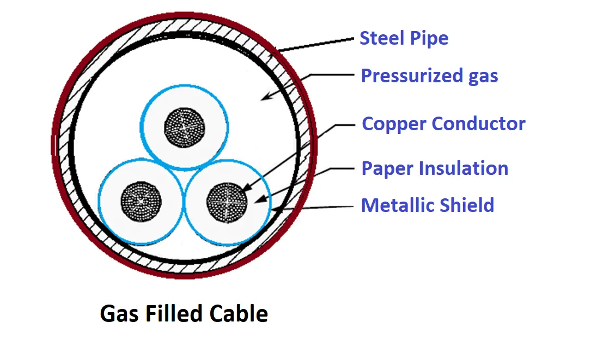
Gas-filled Cables
The cable is triangular in shape and put in the steel pipe. The pipe is filled with nitrogen at 12 to 15 atmospheres pressure.
Because of such high pressure, there is a radial compression due to which the ionization is totally eliminated.
The working power factors for such cables are also high.

Slide 50
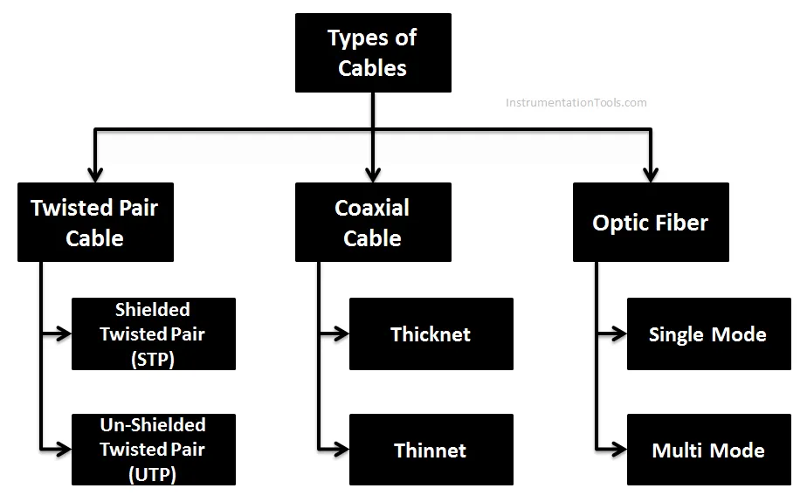
Signal cables
The cable is a physical media, through which an analog and digital data transfer take place

Slide 51
Twisted pair cable
Twisted pair cables consist of color-coded pairs of insulated copper wires, one wire carries the signal, and the other is used for ground reference. Every two wires are twisted around each other to form pairs that are encased in a plastic sheath each wire with a diameter of 0.4 mm to 0.8 mm.
The number of pairs varies depending on the cable type. More twists per foot in a pair of wires, less the cross talk.
The significance of twisting is it reduces or nullifies the interference such as noise or cross talk caused due to radiofrequency of electromagnetic interference.
By twisting the wires, the effect of noise or disturbance is the same on both wires. Since the receiver takes only the difference between the two wires the effective noise is canceled.

Slide 52
Twisted pair cables are two types.
Shielded Twisted cable (STP)
Unshielded Twisted pair cable (UTP).
Shielded Twisted Pair cable (STP)
As the name implies, Shielded twisted pair cable adds a conductive layer (typically a metal foil or a mesh) surrounding either each pair or entire cable.
Purpose
Shield on twisted pair allows a higher transmission rate.
Advantages
Easy installation.
It has a higher capacity as compared to UTP cable.
It is shielded that provides a higher data transmission rate.
Disadvantages
Cables are bigger in diameter more expensive compared to UTP or coaxial cable.
Applications
Used as instrumentation cable in industrial applications.
Used in harsh cold and hot environments.
Research applications.

Slide 53
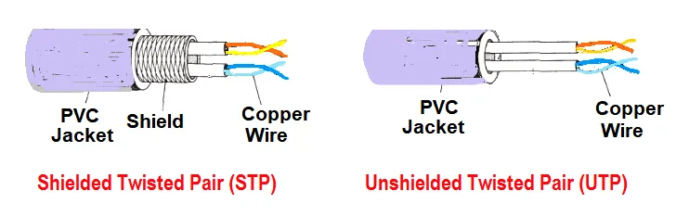

Slide 54
Un Shielded Twisted Pair cable (UTP)
Unshielded twisted pair cable uses no additional shielding like mesh or aluminum foil which adds bulk are used.
There are different types of unshielded twisted pair cable, all support different bandwidths.
Category 1: Is used for a telephone line that has a low-speed data rate.
Category 2: It can support up to 4 Mbps.
Category 3: It can support up to 16 Mbps.
Category 4: It can support up to 20 Mbps.
Category 5: It can support up to 200 Mbps.
Purpose
Untwisted pair cable is used for voice, low speed, and high-speed data and audio support systems.
Advantages
It is cheap compared to coaxial or optic fiber cable.
Used in computer networking such as Ethernet for short to medium distances.
Disadvantages
This cable can be used for shorter distances because of the signal attenuation.
Applications
Used in LAN

Slide 55
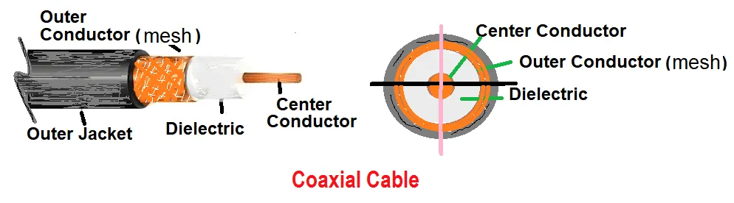
Coaxial Cable
Coaxial cables are also called coax (short form).
Coaxial cable is a type of cable with multiple layers.
Coaxial cables have an inner conductor is called the core, which carries the radio frequency signal. The core wire may be a single solid conductor or multi strands of twisted cable. It is surrounded by a dielectric insulator.
The dielectric insulator separates the inner conductor and outer copper braided mesh. The dielectric insulator is covered by copper mesh (foil or braided conductor). The dielectric insulator may be polyethylene foam or PTFE which minimizes ohmic losses arising from contact with the conductors. Outer jacket is to protect the cable from environmental and mechanical damages. A common choice is PVC.

Slide 56
Both inner conductor and braided wire mesh conductor is in the cable share a common central axial, hence the term coaxial. Coaxial cables are rated in ohms for their impedance. Common impedances are 50 ohms, 75 ohms, 95 ohms.
There are many types of coaxial cable connectors.
Four are common. BNC, SMA, N, F types. Coaxial cables are categorized based on the type of signal transmission. One is Baseband and the other is Broadband cable.
Baseband cable
It is a 50 ohms resistance cable that is capable of digital transmission. Used in short distances for optimum performance.
Broadband cable
It is a 75 ohms resistance cable used for analog data transmission. It is used up to 100 km.
Based on Radio Gauge (RG) standards, there are two types of Coaxial cables:
Thicknet and Thinnet
Thicknet: RG 8, RG 9, RG 11 coaxial cable is also known as Thick Ethernet or 10Base5 systems. 10 means, it is 10 Mbps speed and 5 refers to 500 meters distance between nodes or repeaters. Where Base indicates that the transmission type is a “Baseband transmission”
Thicknet cabling uses heavier gauge coaxial cable than Thinnet.
Thinnet: RG 58 Coaxial cable is used 10Base2 systems. 10 means 10mbps speed and 2 refers to 200 meters distance between nodes or repeaters.

Slide 57
Advantages
Coaxial cable is useful for both analog and digital data transmission.
It has a higher bandwidth, so it supports a mixed range of services.
Relatively less expensive compare to fiber optic cable.
Disadvantages
The number of node connections is limited.
Prone to damage due to lightning strikes.
Applications
Broadband internet, high-speed computer data buses, cable TV, Ethernet.

Slide 58
Optical Fiber Cable
It also is known as fiber optic cable consists of strands of one or more fibers inside the casing and its assembly is similar to electrical cable.
Optical fiber has three parts
Core
It is the inner layer is called the core, with refractive index n1. Light is guided in this part. The core will have a higher refractive index than cladding.
Cladding
which surrounds the core, with refractive index n2. Whose refractive index is less than the core? The purpose of cladding is to keep the light reflections in core instead of being reflections.
Casing
Which is an outer layer for protecting the cable from damages.
There are two types of optical fibers, glass, and plastic. Plastic fiber is used for short communication. Optical fiber transfers data at the speed of light in the glass.
Optical fiber cable uses light pulses instead of electrical pulses to transmit data. The potential hazard of Infrared red light used in telecommunications cannot be seen by the naked eye.
Optical fiber cable comes in single-mode or multimode connections.

Slide 59
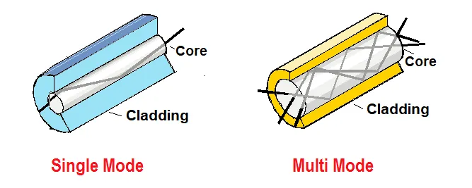
Single Mode
The single-mode allows only one mode of light to transmit at a time through the core, which makes for higher bandwidth.
Single-mode fiber optic, the number of light reflections in the core is less resulting in low attenuation and allowing data to travel further, faster. Single-mode provides the lowest losses in communication.

Slide 60
Multi-Mode
Multimode connections have a larger core diameter. It allows multiple wavelengths of light transmitted in multiple paths at once.
Multimode connections are used over shorter distances as signal attenuation will be more, the data transfer rate is slow as a number of reflections in the core are more.
Advantages
Extremely high bandwidth and speed.
Impervious to electromagnetic interference.
Several kilometers of optical fiber cable can be made cheaper than the equivalent length of copper cable.
Optical fibers usually have a longer life cycle for more than 100 years.
The loss of signal in fiber optic cable is very less than that in copper wire.
The smaller size and lightweight than a comparable copper wire cable.
Less weight can be bundled together.
Optical fiber is thinner and can be drawn to smaller diameters than copper wire.
Disadvantages
More unsafe than damage compared to copper wires.
Should not twist or bend fiber optic cables too tightly. Follow specification for cable bend radius.
Applications
Used in Telephone signals, internet communication, cable television.

