Slide 1
Unit VI
Mechatronics Systems in Automobile

Slide 2
CONTENTS
(Treatment with Block Diagram Approach) Boat Autopilot
High Speed tilting trains
Automatic car parking systems
Engine Management systems
Antilock Brake systems (ABS)
CNC Machines(Only Black Diagram and explanation)

Slide 3
Boat Autopilot
Autopilots are self-steering devices for power or sailboats.
In early days, ships carry compasses to help navigate when conditions required a reference aboard the ship to provide orientation.
At night, or otherwise out of sight of familiar landmarks, a compass provides vital information for the navigator.
They can hold your vessel on a pre-set compass course (even the most basic pilots do this) and sophisticated pilots that connect to GPS receivers or gather data from your boat's instruments can handle a lot more advanced tasks.
An autopilot is an example of a control system.

Slide 4
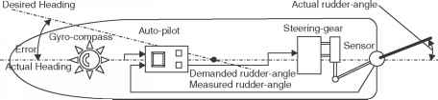
Compass
Control Unit
Error amplifier
Transmitter
Receiver
Steering Gear
Course set control
Rudder

Slide 5
A classic example of a control system is the negative feedback loop.
It's called a negative feedback loop because the result of a certain action inhibits further performance of that action.
All negative feedback loops require a receptor, a control center and an effector.
In the example above, the receptor is the thermometer that measures air temperature.
The control center is the processor inside the thermostat. And the effector is the air conditioning unit.

Slide 6
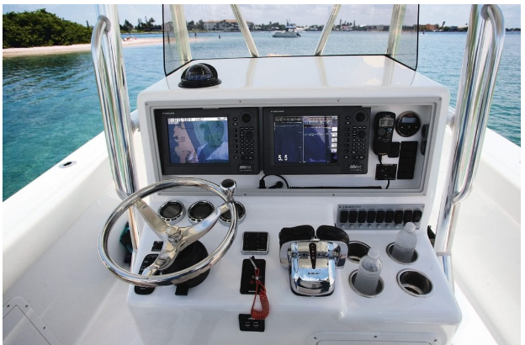
As computers become smaller and more powerful, adaptive learning (or a sort of artificial intelligence) is what drives today’s best autopilots to guide boats more efficiently.
In rough conditions, a well-tuned autopilot will sense small changes in heading before the captain does.
An autopilot comprises a computer chip, head display, drive unit, and compass.
When the captain plots a waypoint on the display, the computer, and compass signal the drive unit which powers the electric/hydraulic ram or rudder.
On most recent boats, the autopilot is networking facility.

Slide 7
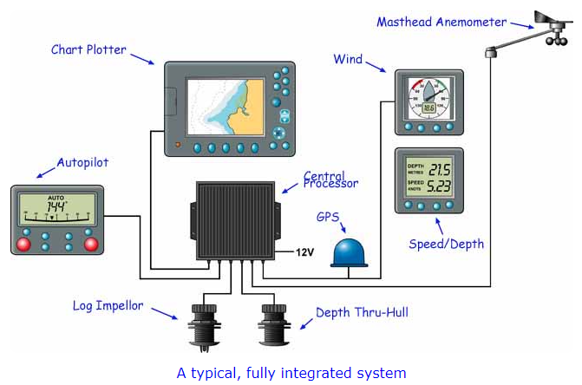
Boat Autopilot takes the existing learning algorithm and watches the performance of the boat over time and then optimizes the performance.
The cockpit autopilots that have a separate control/display unit.

Slide 8
To get the most out of such units you need to integrate them with a compatible GPS or chartplotter, and a wind instrument either mounted at the masthead or at the stern of the boat. This gives three main operating modes:~
Auto - the autopilot is locked onto a heading;
Track - the autopilot is locked onto a track between two waypoints;
Wind Vane - the autopilot maintains a course relative to the apparent wind. However, in practice if there's much of a swell running, neither a masthead instrument nor a stern-mounted one will give a particularly satisfactory result. The masthead unit will suffer from the motion of the boat, and a stern-mounted unit will be operating in a disturbed airflow. The resulting impulses have to be damped and processed to obtain a useful signal.
All sorts of data display and functionality is now available on the display unit - cross-track error, off-course alarm, waypoint proximity alarm, windshift alarm and so on.

Slide 9
High Speed tilting trains
A tilting train is a train that has a mechanism enabling increased speed on regular rail tracks.
As a train (or other vehicle) rounds a curve at speed, objects inside the train experience centrifugal force. This can cause packages to slide about or seated passengers to feel squashed by the outboard armrest, and standing passengers to lose their balance. Tilting trains are designed to counteract this by tilting the carriages towards the inside of the curve, thus compensating for the g-force. The train may be constructed such that inertial forces cause the tilting (passive tilt), or it may have a computer-controlled powered mechanism

Slide 10
A high-speed tilting train is a tilting train that operates at high speed, typically defined as by the European Union to include 200 km/h (124 mph) for upgraded track and 250 km/h (155 mph) or faster for new track.
So, the APT was designed to tilt as it went into curved track sections, rather like a motorbike on a winding road, allowing it to go up to 40% quicker than non-tilting trains.
The high-speed train is named ‘Pendolino’, meaning small pendulum in Italian, due to its mechanism to tilt at the bends.
The trains use Tiltronix technology, and feature hydraulic tilting bogies. The tilting rods installed in the bogies activate the tilting. The train’s wheel forces have been minimised by reducing suspended masses. The bodyshell sits centred with the use of active lateral air suspension system.

Slide 11
The new Pendolino trains are claimed to be 95% recyclable. The electric brake systems save up to 8% of energy consumed. Alstom says 97% of the power is recycled and fed back into the catenary system.
Sound insulation under the body and optimised aerodynamic design reduce sound penetration through the roof. A shock absorber dumping system vibration under the wheels also contributes to decrease noise pollution.

Slide 12
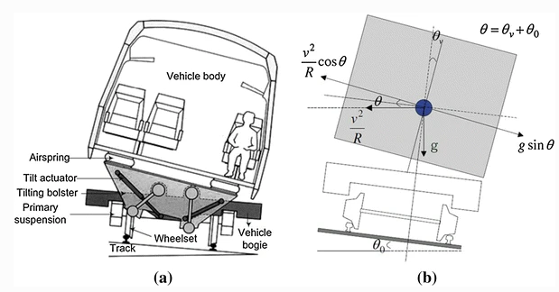
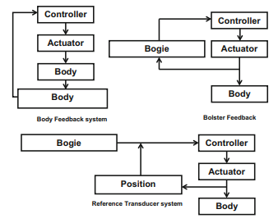
Pl REFER SPRINGER PAPER

Slide 13
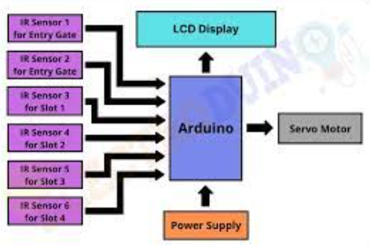
Automatic car parking systems
How it works: Drivers take their cars to the entrance of the automatic parking system where all occupants exit the vehicle. From here, the vehicle is moved by mechanical maneuvers to an available space where it is automatically parked or parked by an attendant.

Slide 14
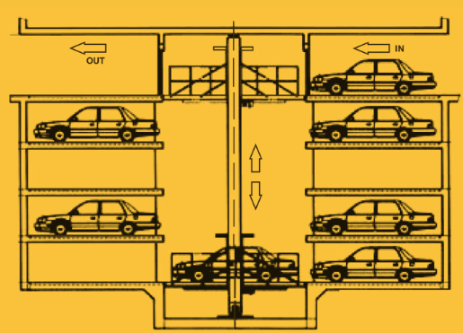
An automated (car) parking system (APS) is a mechanical system designed to minimize the area and/or volume required for parking cars. Like a multi-story parking garage, an APS provides parking for cars on multiple levels stacked vertically to maximize the number of parking spaces while minimizing land usage.

Slide 15
A typical Car parking System have the following features:
The system uses state-of-the-art servo drives and laser based guidance system.
The typical parking time is less than 1 minute.
Horizontal carts in each level optimizes the parking and retrieval time.
Based on the parking frequency, additional car lifts can be provided to speedup parking and retrieval.
The system is very modular to suit the space availability at site.
http://ajaps.co.kr/ENG?utm_source=Google&utm_medium=CPC&utm_campaign=SA_Global_%EB%B0%98%EC%9D%91%ED%98%95&utm_term=car%20parking%20solutions&gclid=Cj0KCQiAyracBhDoARIsACGFcS4BYWegKZNw7M8lpb9QHfTOOI1GAqAW8puZdfmN9ylXyMk8pBNzmR8aAqnJEALw_wcB

Slide 16
http://ajaps.co.kr/ENG?utm_source=Google&utm_medium=CPC&utm_campaign=SA_Global_%EB%B0%98%EC%9D%91%ED%98%95&utm_term=car%20parking%20solutions&gclid=Cj0KCQiAyracBhDoARIsACGFcS4BYWegKZNw7M8lpb9QHfTOOI1GAqAW8puZdfmN9ylXyMk8pBNzmR8aAqnJEALw_wcB

Slide 17
Engine Management systems (EMS)
An EMS is a self, custom-built device that regulates an engine’s operation by regulating its speed, load, and temperature, supplying the ignition spark at the appropriate time for the conditions, and metering the fuel engine in the precise amount needed.
EMS consisting of a wide range of electronic and electrical components such as sensors, relays, actuators, and an Engine Control Unit.
They work together to provide the Engine Management System with vital data parameters.
These are essential for governing various engine functions effectively.
Furthermore, modern-day engine technologies incorporate the EMS.
These include MPFi & GDi systems in Petrol engines and CRDi systems in diesel engines for improved performance.

Slide 18
Engine Management System (EMS) Main Components
Sensors, relays, actuators, and an Engine Control Unit make up the EMS which comprises various electronic and electrical parts.
These are needed for the efficient control of various engine functions.
They work collaboratively to supply valuable data parameters to the Engine Management System.
ECU stands for Engine Control Unit and ECM for Engine Control Module. Both are the same.
Engine Control Unit/Module:
The Engine Control Unit is a central part of the Engine Management System, virtually the ‘Brain’ of the engine.
It plays a vital role in collecting, analyzing, processing, and executing the data it receives from various sub-systems. Furthermore, an ECU comprises a computer that uses a microchip to process the inputs from multiple engine sensors in real-time.

Slide 19
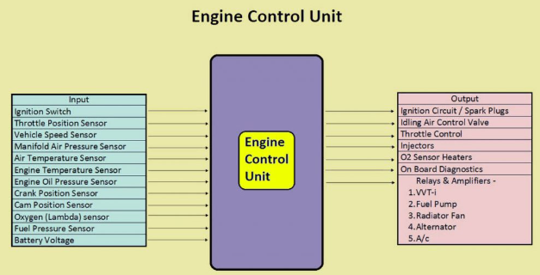

Slide 20
The Electronic Control Unit contains hardware and software.
The ECU’s printed circuit board (PCB) consists of a micro-controller chip or the CPU (Central Processing Unit).
The micro-controller or chips on the PCB store the software.
It is possible to re-program the ECU by updating the software or replacing chips.
All the engine sensors send data inputs through electrical signals to the ECU.
In turn, the ECU controls various actuators, ignition timing, variable valve timing, etc.

Slide 21
How an ECU Works?
Based on this data input, the ECU precisely calculates and delivers the ideal air-fuel mixture.
It also regulates the engine’s idle speed and limits the top speed of a vehicle.
This system is also widely referred to as an ”Electronic Engine Management System” or the EMS.
Furthermore, it is possible to customize the modern-day ECUs to suit different vehicular applications and varying customer demands.

Slide 22
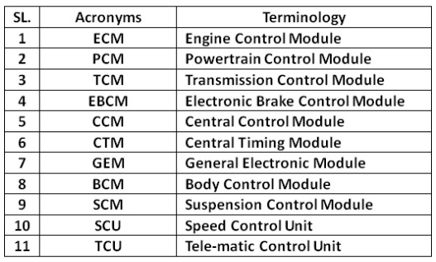
Also, some cars have an individual’ ‘Control Module” for all major systems.
For example, a modern car has the following individual Control Modules that control the respective systems.
An Engine Control Unit connects to all the individual Electronic Control Modules (ECMs). A modern-day car consists of more than one Control Modules, each exclusive for every primary system, which improves performance. However, the manufacturers seldom refer to these systems as car computers since they are multiple computers instead of one.

Slide 23
Modern Engine Management Systems
Modern engine management systems are excellent at ensuring that engines operate cleanly and effectively under a wide range of environments.
They are generally reliable and need little to no maintenance.
The EMS system is made up of many sensors (which send data to the ECU) and actuators (which receive their inputs from the ECU).
The fuel or injection system and the ignition system are two separate sub-systems that operate within the EMS.
Ignition Mapping
Inside the EMS, there will usually be a map for injector timings (fuel map) and a separate map for ignition timing settings (ignition map).
The engine’s fuel and ignition timing specifications can differ when running, depending on the engine’s operating conditions.
Engine speed and engine load are the two most important factors.

Slide 24
A map is nothing more than a lookup table organized by engine speed and load that displays the acceptable fuel or timing set for each speed and load state.
What are the ECU and ECM?
An engine control unit (ECU), also known as an engine control module (ECM), is an electronic control unit that ensures optimum engine output by controlling a series of actuators on an internal combustion engine.
The Engine Control Unit is a critical component of the Engine Management System, which functions as the engine’s ‘brain.’ It collects, analyses, processes, and executes data received from various sub-systems. An ECU also includes a computer that processes data from various engine sensors in real-time using a microchip.

Slide 25
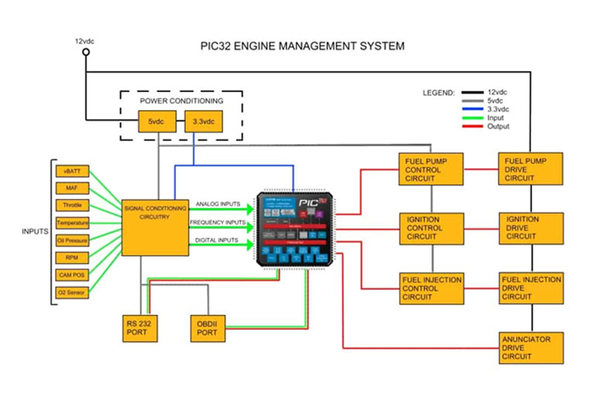

Slide 26
Antilock Brake systems (ABS)
An anti-lock braking system is a system which is used to avoid skidding of the wheel by rapid braking action.
Generally, in vehicles without ABS, when a driver presses the brake pedal,‌ due to braking, the wheel immediately gets locked.
Hence wheel skids on the road.
So in such case, if suddenly a big rock comes in front of the vehicle, the driver presses the brake pedal & then due to skidding of a wheel, the driver losts control over the vehicle.

Slide 27
Therefore by Antilock Brake systems ABS, if suddenly a big rock comes in front of the vehicle, then with ABS, the driver can easily reduce the vehicle speed and also change the direction of the vehicle.
In easy language, ABS helps to stop the constant locking of a vehicle wheel, hence resulting in vehicle stops without the skidding of a wheel.

Slide 28
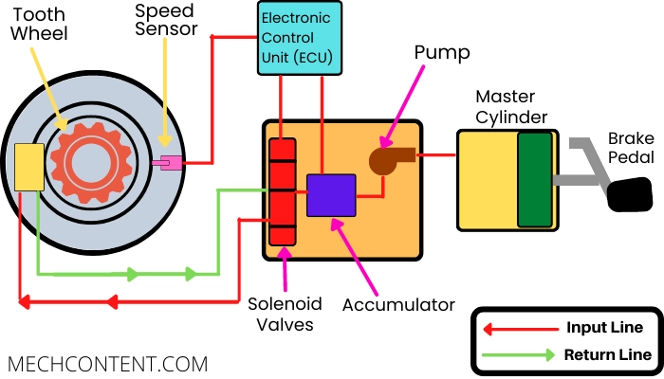
ABS system consists of the following key components:-
Master cylinder
Hydraulic control unit (Shown as an orange color box in the above diagram)
Electronic control unit (ECU)
Tooth wheel & speed sensor

Slide 29
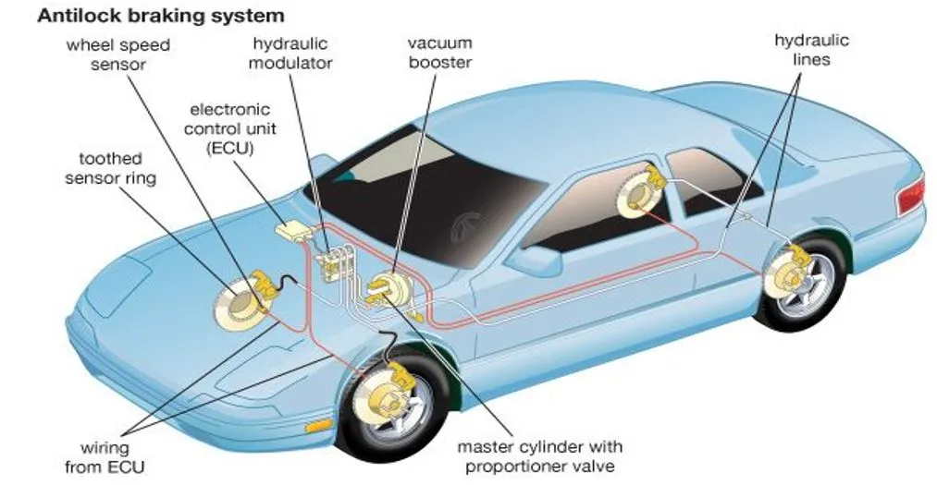
1) Master cylinder:-
It is a device that is used to pump the brake fluid and it consists of a piston, brake fluid, and return spring.
The piston rod is connected to the brake pedal hence when the driver presses the brake pedal, the piston presses the brake fluid inside the master cylinder.
The oil reservoir is connected to the master cylinder, which maintains the oil quantity inside the system. The outlet of the master cylinder is connected to the hydraulic control unit.

Slide 30
2) Hydraulic control unit (HCU):-
It is a control unit that works as per signals received from an electronic control unit (ECU). So, as per ECU signals, the Hydraulic control unit (HCU) sends the brake fluid through the input line or stops the flow or take returns the brake fluid from the return lines to apply and release the brake to prevent the wheel from constant locking during braking.
HCU consists of the following components:-
i) Pump
ii) Accumulator
iii) Solenoid Valves
i) Pump:- The Inlet of the pump is connected to the master cylinder & outlet is connected to the accumulator. The pump pressurizes the brake fluid received from the master cylinder & sends it to the accumulator.
ii) Accumulator:- It is a storage device, which is used to store the pressurized brake fluid. The outlet of the accumulator is connected to the solenoid valves.
iii) Solenoid valves:- Solenoid valves work as per signal received from the ECU to – Supply pressurizes brake fluid to apply the brake, To stop the supply of brake fluid, To take return flow of brake fluid to release brake force on the wheel.

Slide 31
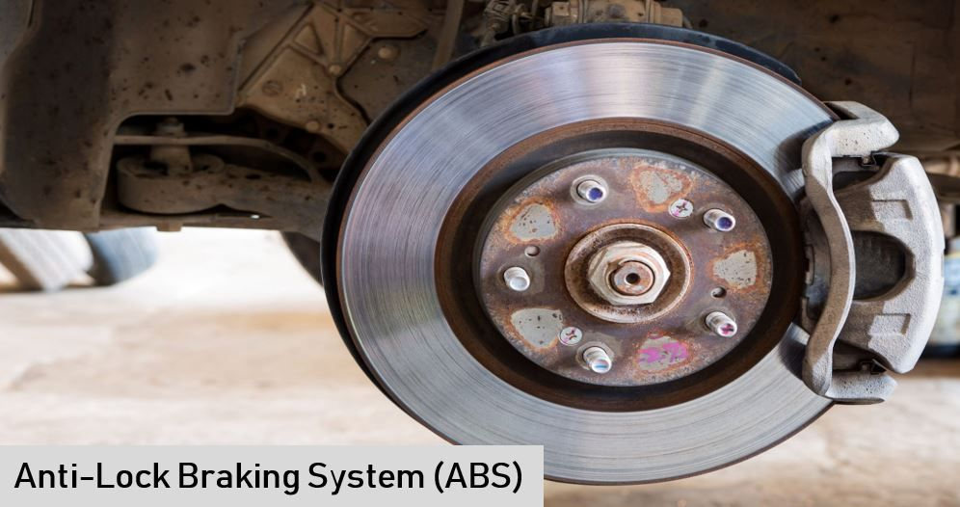
3) Electronic control unit (ECU):-
It is a control unit, which receives a signal from the speed sensor & sends signals to components (Accumulator, Solenoid valves, Pump, Master cylinder) to perform required operations when a brake is applied.
4) Tooth wheel & speed sensor:-
These devices help ECU to know about the wheel speed. The tooth wheel is connected to the wheel & rotates with the wheel.
The speed sensor is also located behind the tooth wheel. It senses the rotation of the tooth wheel & sends the signal to the ECU. So ECU gets data about the vehicle speed through the speed sensor

Slide 32
The ABS works as per the following steps:-
STEP-1:-
When the driver presses the brake pedal, the piston presses the brake fluid & then ECU sends a signal to the solenoid valve & pump to start the flow of brake fluid towards the brake drum.
Hence Brake fluid flows from – Master cylinder -> Pump -> Accumulator -> Solenoid valves -> Brake drum and wheel stops.
STEP-2:-
When the wheel stops due to a brake, the speed sensor sends a signal to ECU. ECU sends a signal to the pump & solenoid valve to stop brake fluid flow & release pressure on the wheel (by returning the brake fluid through the return line).
Therefore brake fluid flows from the Brake drum -> Solenoid valves -> Accumulator and the resulting wheel again starts to rotate.
STEP-3:-
Again speed sensor sends a signal to the ECU about wheel speed. Again ECU sends a signal to the solenoid valve & pump to start the flow, Hence Again brake fluid flows from – Pump -> Accumulator -> Solenoid valves -> Wheel Drum
This step occurs rapidly till vehicle speed reduces or the vehicle stops without skidding.

Slide 33
Advantages:
The advantages of using the Anti-lock braking system are as follows:-
Less braking distance
Good steering control, so the vehicle can turn in the desired direction
Avoids accidents.
Anti-lock braking system applications:
The ABS has the following applications:-
Bike
Car

Slide 34
CNC Machines (Only Black Diagram and explanation)
CNC stands for Computer Numerical Control.
When computers are used to control a Numerical Control (NC) machine tool than the machine is called CNC machine.
In other words, the use of computers to control machine tools like lathe, mills, slotter, shaper etc is called CNC machine.
The cutting operations performed by the CNC is called CNC machining.
The Various machining services in which CNC machine is used are known as CNC machining services.
In CNC machine shops, programs are designed or prepared first, and then it is fed to the CNC machine.
According to the program, the CNC controls the motion and speed of the machine tools.

Slide 35
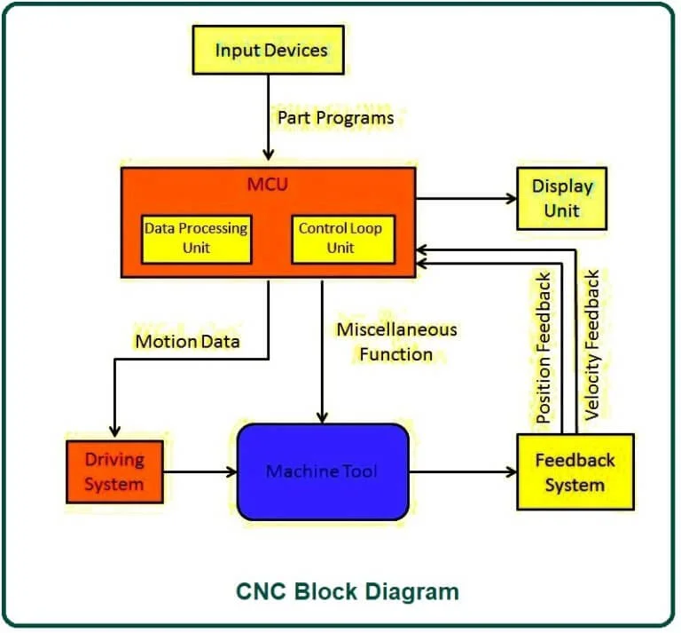

Slide 36
Main Parts of CNC Machine
The main parts of the CNC machine are
Input Devices: These are the devices which are used to input the part program in the CNC machine.
There are three commonly used input devices and these are punch tape reader,
magnetic tape reader and computer via RS-232-C communication.
(ii) Machine Control Unit (MCU): It is the heart of the CNC machine. It performs all the controlling action of the CNC machine, the various functions performed by the MCU are:
It reads the coded instructions fed into it.
It decodes the coded instruction.
It implements interpolation ( linear, circular and helical ) to generate axis motion commands.
It feeds the axis motion commands to the amplifier circuits for driving the axis mechanisms.
It receives the feedback signals of position and speed for each drive axis.
It implements the auxiliary control functions such as coolant or spindle on/off and tool change.

Slide 37
(iii) Machine Tool: A CNC machine tool always has a slide table and a spindle to control of the position and speed. The machine table is controlled in X and Y axis direction and the spindle is controlled in the Z axis direction.
(iv) Driving System: The driving system of a CNC machine consists of amplifier circuits, drive motors and ball lead screw. The MCU feeds the signals (i.e. of position and speed) of each axis to the amplifier circuits. The control signals are than augmented (increased) to actuate the drive motors. And the actuated drive motors rotate the ball lead screw to position the machine table.
(v) Feedback System: This system consists of transducers that act as sensors. It is also called a measuring system. It contains position and speed transducers that continuously monitor the position and speed of the cutting tool located at any instant. The MCU receives the signals from these transducers and it uses the difference between the reference signals and feedback signals to generate the control signals for correcting the position and speed errors.
(vi) Display Unit: A monitor is used to display the programs, commands and other useful data of CNC machine.

Slide 38
How CNC Machine Works?
First, the part program is inserted into the MCU of the CNC.
In MCU all the data process takes place and according to the program prepared, it prepares all the motion commands and sends it to the driving system.
The drive system works as the motion commands are sent by MCU. The drive system controls the motion and velocity of the machine tool.
The feedback system records the position and velocity measurement of the machine tool and sends a feedback signal to the MCU.
In MCU, the feedback signals are compared with the reference signals and if there are errors, it corrects it and sends new signals to the machine tool for the right operation to happen.
A display unit is used to see all the commands, programs and other important data. It acts as the eye of the machine.

Slide 39
Advantages
It can produce jobs with the highest accuracy and precision than any other manual machine.
It can be run for 24 hours a day.
The parts produced by it have the same accuracy. There is no variation in the parts manufactured.
A highly skilled operator is not required to operate it. A semi-skilled operator can also operate accurately and more precisely.
Operators can easily make changes and improvements and reduce the delay time.
It has the capability to produce complex designs with high accuracy in minimum possible time.
The modern design software, allows the designer to simulate the manufacturer of his/her idea. And this removes the need for making a prototype or model and saves time and money.
Fewer workers are required to operate a CNC and save labor costs.

Slide 40
Disadvantages
Despite of having so many advantages, It has some disadvantages too. And these are:
The cost of the CNC machine is very high as compared with a manually operated machine.
The parts of the CNC machines are expensive.
The maintenance cost in the case of CNC is quite high.
It does not eliminate the need for costly tools.
Application
Almost every manufacturing industry uses CNC machines.
With an increase in the competitive environment and demands, the demand for CNC usage has increased to a greater extent.
The machine tools that come with the CNC are lathe, mills, shaper, welding, etc. The industries that are using CNC machines are the automotive industry, metal removing industries, industries of fabricating metals, electrical discharge machining industries, wood industries, etc.

