Slide 1
UNIT-II ARM7 processor 07 Hours
ARM Architecture (LPC 2148) and Organization,
Registers,
Program Status Register,
Instruction
Pipeline,
Interrupts
Vector Table
ARM/ Thumb Instruction set
LPC2148 Microcontroller:
Features,
Block diagram,
GPIO, Interrupts,
Timers,
PLL,
ADC/DAC,
PWM,
RTC interfacing and programming,
Protocols such as UART, CAN, I2C & SPI Implementation.

Slide 2
ARM Architecture (LPC 2148) and Organization Features:-
16/32-bit ARM7TDMI-S microcontroller in a tiny LQFP64 (plastic, low profile quad flat package).
• 8 to 40 kB of on-chip static RAM and 32 to 512 kB of on-chip flash program memory.
128 bit wide interface/accelerator enables high speed 60 MHz operation.
Single flash sector or full chip erase in 400 ms and programming of 256 bytes in 1 ms.
• The real-time debugging.
.
• USB 2.0 Full Speed Device Controller.
In addition, the LPC2146/8 provide 8 kB of on-chip RAM accessible to USB by DMA.

Slide 3
• One or two (LPC2141/2 vs. LPC2144/6/8) 10-bit A/D converters provide a total of 6/14 analog inputs, with very less conversion times.
• Single 10-bit D/A converter provides variable analog output.
• Two 32-bit timers/external event counters, PWM unit and watchdog.
• Multiple serial interfaces: 1. two UARTs (16C550),
2.two I2C-bus communication between a master and a single or multiple slave devices,
3. SPI (Serial Peripheral Interface) and
4.SSP with buffering and variable data length capabilities.
• Vectored interrupt controller with configurable priorities and vector addresses.
• General purpose I/O pins in a tiny LQFP64 package.
• Up to nine edge or level sensitive external interrupt pins available.

Slide 4
60 MHz maximum CPU clock available from programmable on-chip PLL (Phase locked loop).
• On-chip integrated oscillator operates with an external crystal in range from 1 MHz to 30 MHz and with an external oscillator up to 50 MHz.
• Power saving modes include Idle and Power-down.
• Individual enable/disable of peripheral functions as well as peripheral clock scaling for additional power optimization.
• Processor wake-up from Power-down mode via external interrupt, USB, Brown-Out
Real-Time Clock (RTC).

Slide 5
Applications
• Industrial control
• Medical systems
• Access control
• Point-of-sale
• Communication gateway
• Embedded soft modem
• General purpose applications
ARM7TDMI-S processor
The ARM7TDMI-S is a general purpose 32-bit microprocessor, which offers high performance and very low power consumption.
The ARM architecture is based on Reduced Instruction Set Computer (RISC) principles.
The instruction set and related decode mechanism are much simpler than CISC
This simplicity results in a high instruction throughput and impressive real-time interrupt response from a small and cost-effective processor core.

Slide 6
Pipeline techniques are employed
The ARM7TDMI-S processor has THUMB mode for high-volume applications (memory restrictions, code density).
THUMB is a super-reduced instruction set.
Essentially, the ARM7TDMI-S processor has two instruction sets:
1. The standard 32-bit ARM instruction set.
A 16-bit THUMB instruction set.
ADV. OF THUMB MODE
The THUMB set’s 16-bit instruction length allows it to approach twice the density of standard ARM code while retaining most of the ARM’s performance advantage over a traditional 16-bit processor using 16-bit registers.
This is possible because THUMB code operates on the same 32-bit register set as ARM code.

Slide 7
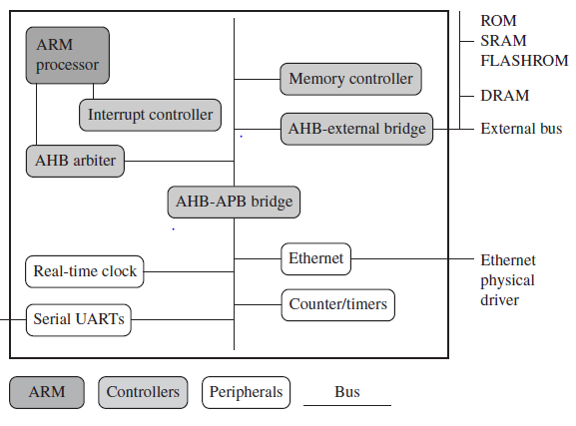
Embedded systems can control many different devices, from small sensors found.
All these devices use a combination of software and hardware components.
Figure 1.2 An example of an ARM-based embedded device, a microcontroller.

Slide 8
Figure 1.2 shows a typical embedded device based on an ARM core.
We can separate the device into four main hardware components:
■ The ARM processor controls the embedded device.
An ARM processor comprises a core (the execution engine that processes
instructions and manipulates data) plus the surrounding components that
interface it with a bus.
These components can include memory management and caches.
■ Controllers coordinate important functional blocks of the system.
Two commonly found controllers are interrupt and memory controllers.
■ The peripherals provide all the input-output capability external to the chip and are responsible for the uniqueness of the embedded device.
■ A bus is used to communicate between different parts of the device.

Slide 9
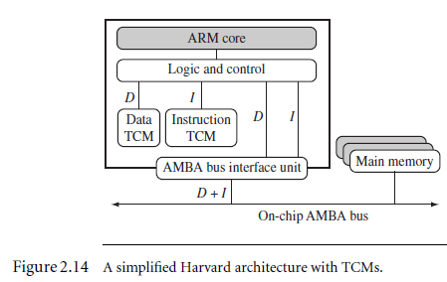
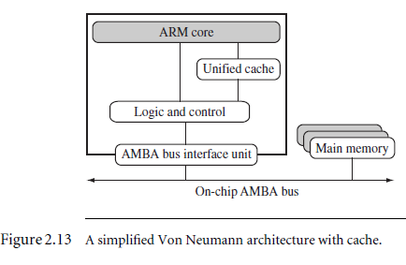
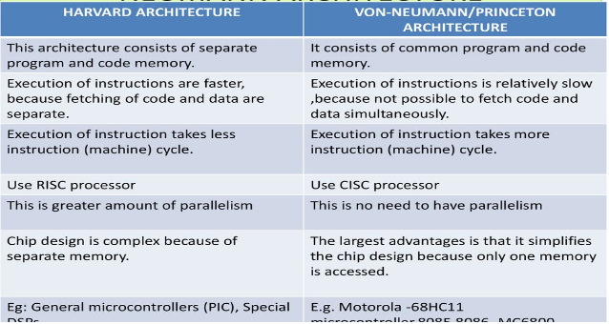
AMBA -
ARM Advanced
Microcontroller
Bus Architecture
TCM- Tightly
coupled memory

Slide 10
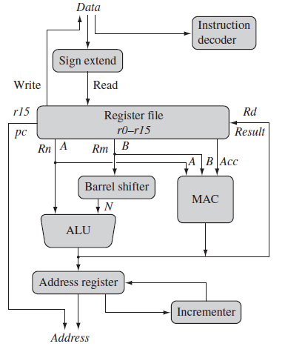
Figure 2.1 ARM core dataflow model.
An overview of the processor core and describe how data moves..
Data processing is carried out solely in
Registers (and not in the memory (a RISC
feature)).
Registers are holding signed or unsigned
32-bit values.
Two source registers, Rn and Rm and
a single result or destination register, Rd.
Multiply Accumulate unit
Load and store instructions use the ALU
to generate an address and store in the
address register and loaded on the
address bus to access the memory.

Slide 11
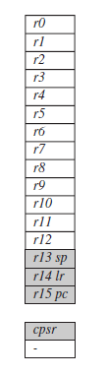
REGISTERS
General-purpose registers hold either data or an address.
Figure - Registers available in user mode.
The processor can operate in seven different modes.
All the registers shown are 32 bits in size.
There are up to 18 active registers: 16 data registers and 2 processor
status registers.
The data registers are visible to the programmer as r0 to r15.
They are identified with the letter r prefixed to the register number.
For example, register 4 is given the label r4.

Slide 12
The ARM processor has three registers assigned to a particular task or
Special function:
r13, r14, and r15. Different from the other GP registers.
In Figure, the shaded registers identify the assigned special-purpose
registers:
■ Register r13 is traditionally used as the stack pointer (sp) and stores
the head of the stack in the current processor mode.
■ Register r14 is called the link register (lr) and is where the core puts
the return address whenever it calls a subroutine.
■ Register r15 is the program counter (pc) and contains the address of
the next instruction to be fetched by the processor.
Depending upon the context, registers r13 and r14 can also be used as
GPRs, which can be particularly useful since these registers are banked during a processor mode change.

Slide 13
However, it is dangerous to use r13 as a general register when the processor is running any form of operating system because operating systems often assume that r13 always points to a valid stack frame.
In ARM state the registers r0 to r13 are orthogonal—any instruction that you can apply to r0 you can equally well apply to any of the other registers.
However, there are instructions that treat r14 and r15 in a special way.
In addition to the 16 data registers, there are two program status registers: cpsr and spsr (the current and saved program status registers, respectively).
The register file contains all the registers available to a programmer.
The registers which are visible to the programmer depend upon the current mode of the processor.

Slide 14
Processor Modes
The processor mode determines which registers are active and the access rights to the cpsr register itself.
Each processor mode is either privileged or non-privileged.
A privileged mode allows full read-write access to the cpsr.
Conversely…
2. A non-privileged mode (user mode) only allows read access to the control field in the cpsr but still allows read-write access to the condition flags.
There are seven processor modes in total:
six privileged modes (abort, fast interrupt request, interrupt request, supervisor, system, and undefined) and
one non-privileged mode (user).

Slide 15
The processor enters …
1. Abort mode when there is a failed attempt to access memory.
2.Fast interrupt request (FIR) and Interrupt request (IR) modes correspond to the two interrupt levels available on the ARM processor.
3. Supervisor mode is the mode that the processor is in after reset and
is generally the mode that an operating system kernel operates in.
4. System mode is a special version of user mode that allows full read-write access to the cpsr
5.Undefined mode is used when the processor encounters an instruction that is undefined or not supported by the implementation.
6.User mode is used for programs and applications.

Slide 16
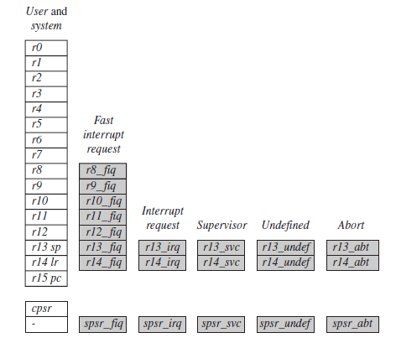
Figure shows all 37 registers in the register file.
Of those, 20 registers are hidden from a program at different times.
These registers are called banked registers and are identified by the shading in the diagram.
They are available only when
the processor is in a
particular mode;
e.g.
Abort mode has banked
registers r13_abt, r14_abt
and spsr_abt.
Banked registers of a particular
mode are denoted by an
underline character post-fixed
to the mode mnemonic
_mode.
A Saved Program Status Register (SPSR) stores the current value of the CPSR when an exception is taken.
Figure 2.4 Complete ARM
register set.

Slide 17
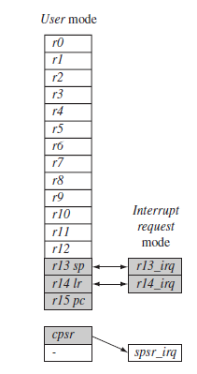
Every processor mode except user mode can change mode by writing directly to the mode bits of the cpsr.
All processor modes except system mode have a set of associated
banked registers that are a subset of the main 16 registers.
A banked register maps one-to one onto a user mode register.
If you change processor mode, a banked register from
the new mode will replace an existing register.
e.g. when the processor is in the interrupt request
mode, the instructions you execute still access registers
named r13 and r14. However, these registers are the
banked registers r13_irq and r14_irq.
Figure Changing mode on an exception.

Slide 18
The user mode registers r13_usr and r14_usr are not affected by the
instruction referencing these registers.
A program still has normal access to the other registers r0 to r12.
The processor mode can be changed by a program that writes directly to the cpsr (the processor core has to be in privileged mode) or by hardware when the core responds to an exception or interrupt.
The following exceptions and interrupts cause a mode change:
reset, interrupt request, fast interrupt request, software interrupt, data abort, pre-fetch abort, and undefined instruction.
Exceptions and interrupts suspend the normal execution of sequential instructions and jump to a specific location.

Slide 19
Figure 2.5 illustrates what happens when an interrupt forces a mode change.
The figure shows the core changing from user mode to interrupt request mode,
which happens when an interrupt request occurs due to an external device raising
an interrupt to the processor core.
This change causes user registers r13 and r14 to be banked.
The user registers are replaced with registers r13_irq and r14_irq, respectively.
Note r14_irq contains the return address and r13_irq contains the stack pointer
for interrupt request mode.
Figure 2.5 also shows a new register appearing in interrupt request mode: the saved
program status register (spsr), which stores the previous mode’s cpsr. You can see
in the diagram the cpsr being copied into spsr_irq.
To return back to user mode, a special return instruction is used that instructs
the core to restore the original cpsr from the spsr_irq and bank in the user
registers r13 and r14.
Note that the spsr can only be modified and read in a privileged mode.
There is no spsr available in user mode.

Slide 20
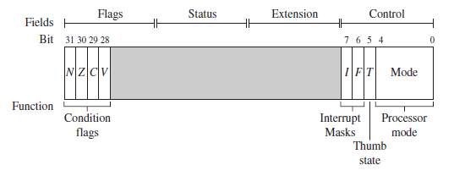
The ARM core uses the cpsr (current and saved program status registers)
to monitor and control internal operations.
The cpsr is a dedicated 32-bit register and resides in the register file.
Figure 2.3 shows the basic layout of a generic program status register.
Note that the shaded parts are reserved for future expansion.
Program Status Register
The cpsr is divided into four fields, each 8 bits wide: flags, status, extension, and
Control.

Slide 21
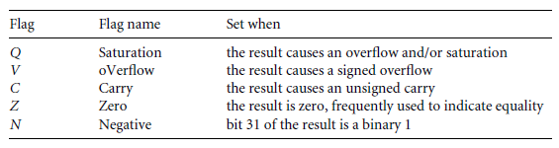
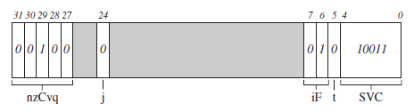
In current designs the extension and status fields are reserved for future use.
The control field contains the processor mode, state, and interrupt mask bits.
The flags field contains the condition flags.
Some ARM processor cores have extra bits allocated.
For example, the J bit, which can be found in the flags field, is only available on Jazelle-enabled processors, which execute 8-bit instructions.
Table Condition flags.
Figure 2.6 Example:
cpsr = nzCvqjiFt_SVC

Slide 22
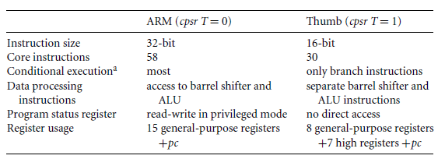
INSTRUCTION
Table 2.2 ARM and Thumb instruction set features
The state of the core determines which instruction set is being executed. There are three instruction sets: ARM, Thumb, and Jazelle.
The ARM instruction set is only active when the processor is in ARM state. Similarly the Thumb instruction set is only active when the processor is in Thumb state.
Once in Thumb state the processor is executing purely
Thumb 16-bit instructions. You cannot intermingle sequential ARM, Thumb, and Jazelle instructions.

Slide 23
The Jazelle J and Thumb T bits in the cpsr reflect the state of the processor.
When both J and T bits are 0, the processor is in ARM state and executes ARM instructions.
This is the case when power is applied to the processor.
When the T bit is 1, then the processor is in Thumb state.
To change states the core executes a specialized branch instruction.
Table 2.2 compares the ARM and Thumb instruction set features.
The ARM designers introduced a third instruction set called Jazelle.
Jazelle executes 8-bit instructions and is a hybrid mix of software and hardware designed to speed up the execution of Java bytecodes.

Slide 24
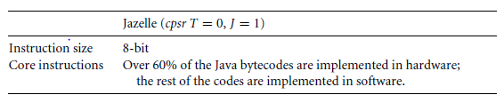
Table 2.3 Jazelle instruction set features.

Slide 25

PIPELINE,
A pipeline is the mechanism a RISC processor uses to execute instructions.
Using a pipeline speeds up execution by fetching the next instruction while other instructions are being decoded and executed.
One way to view the pipeline is to think of it as an automobile assembly line, with each stage carrying out a particular task to manufacture the vehicle.
Figure 2.7 ARM7 Three-stage pipeline.
Figure 2.7 shows a three-stage pipeline:
■ Fetch loads an instruction from memory.
■ Decode identifies the instruction to be executed.
■ Execute processes the instruction and writes the result back to a register.
Figure 2.8 illustrates the pipeline using a simple example. It shows a sequence of
three instructions being fetched, decoded, and executed by the processor.
Each instruction takes a single cycle to complete after the pipeline is filled.

Slide 26
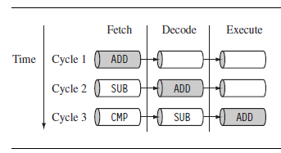
Figure 2.8 Pipelined instruction sequence.
The three instructions are placed into the pipeline sequentially. In the first cycle the core fetches the ADD instruction from memory. In the second cycle the core fetches the SUB instruction and decodes the ADD instruction.
In the third cycle, both the SUB and ADD instructions are moved along the pipeline.
The ADD instruction is executed, the SUB instruction is decoded, and the CMP instruction is fetched.
This procedure is called filling the pipeline.
The pipeline allows the core to execute an instruction every cycle.
As the pipeline length increases, the amount of work done at each stage is reduced, which allows the processor to attain a higher operating frequency. This in turn increases the performance.

Slide 27
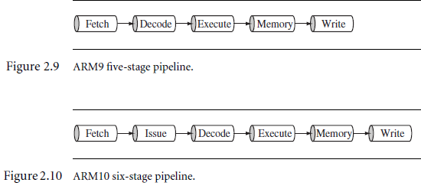
The system latency also increases because it takes more cycles to fill the
pipeline before the core can execute an instruction.
The increased pipeline length also means there can be data dependency between
certain stages.
You can write code to reduce this dependency by using instruction scheduling
(for more information on instruction scheduling take a look at
Chapter 6).

Slide 28
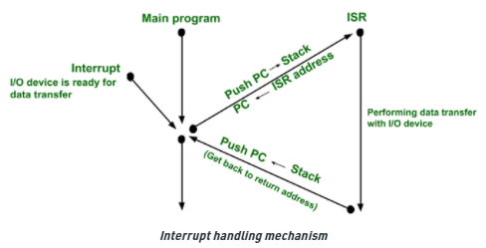
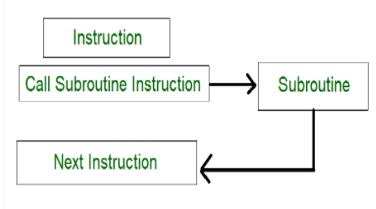
Interrupts
When an exception or interrupt occurs (IR, FIR, SWI, Pre-fetch abort), the processor sets the pc to a specific memory address.
When an exception or interrupt occurs, the processor suspends normal execution and starts loading instructions from the exception vector table
The address is within a special address range called the vector table.
The entries in the vector table are instructions that branch to specific routines designed to handle a particular exception or interrupt.

Slide 29
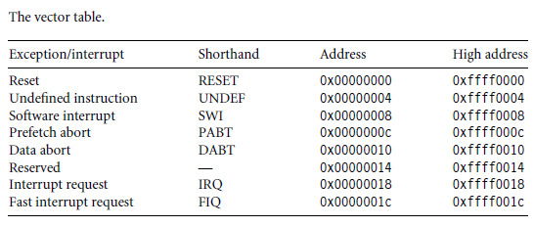
The memory map address 0x00000000 is reserved for the vector table, a set of 32-bit words.
On some processors the vector table can be optionally located at a higher address in memory (starting at the offset 0xffff0000).
Each vector table entry contains a form of branch instruction pointing to the start of a specific routine:
Reset vector is the location of the first instruction executed by the processor when
power is applied.
This instruction branches to the initialization code.

Slide 30
IVT for different modes of operation of ARM
Undefined instruction vector is used when the processor cannot decode an instruction.
■ Software interrupt vector is called when you execute a SWI instruction. The SWI instruction is frequently used as the mechanism to invoke an operating system routine.
■ Prefetch abort vector occurs when the processor attempts to fetch an instruction from an address without the correct access permissions. The actual abort occurs in the decode stage.
■ Data abort vector is similar to a prefetch abort but is raised when an instruction attempts to access data memory without the correct access permissions.
■ Interrupt request vector is used by external hardware to interrupt the normal execution flow of the processor. It can only be raised if IRQs are not masked in the cpsr.
■ Fast interrupt request vector is similar to the interrupt request but is reserved for hardware requiring faster response times.
It can only be raised if FIQs are not masked in the cpsr.

Slide 31
Interrupt Masks
Interrupt masks are used to stop specific interrupt requests from interrupting the processor.
There are two interrupt request levels available on the ARM processor core—interrupt request (IRQ) and fast interrupt request (FIQ).
The cpsr has two interrupt mask bits, (7 and 6) i.e. ( I and F)
of IRQ and FIQ, respectively.
The I bit masks IRQ when set to binary 1, and similarly the F bit masks FIQ when set to binary 1.

Slide 32
ARM/ Thumb Instruction set
The state of the core determines which instruction set is being executed.
There are three instruction sets: ARM, Thumb, and Jazelle.

Slide 33
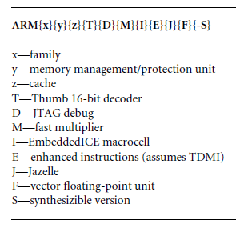
ARM nomenclature.
ARM uses the nomenclature shown in Figure 2.16 to describe the processor
implementations.
The letters and numbers after the word “ARM” indicate the features a processor may have.
In the future the number and letter combinations may change as more features are added. Note the nomenclature does not include the architecture revision information.

Slide 34
There are a few additional points to make about the ARM nomenclature:
■ All ARM cores after the ARM7TDMI include the TDMI features even though they may not include those letters after the “ARM” label.
■ The processor family is a group of processor implementations that share the same hardware characteristics.
For example, the ARM7TDMI, ARM740T, and ARM720T all share the same family characteristics and belong to the ARM7 family.
■ JTAG is described by IEEE 1149.1 Standard Test Access Port and boundary scan architecture.
It is a serial protocol used by ARM to send and receive debug information
between the processor core and test equipment.
■ Embedded ICE macrocell is the debug hardware built into the processor that allows breakpoints and watch points to be set.
■ Synthesizable means that the processor core is supplied as source code that can be compiled into a form easily used by EDA tools.

Slide 35
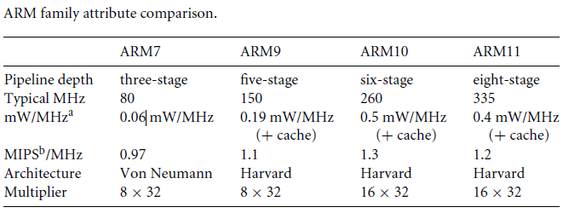
ARM Processor Families
ARM has designed a number of processors that are grouped into different families according to the core they use.
The families are based on the ARM7, ARM9, ARM10, and ARM11 cores.
The postfix numbers 7, 9, 10, and 11 indicate different core designs.
The ascending number equates to an increase in performance and sophistication. ARM8 was developed but was soon superseded.

Slide 36
LPC2148 Microcontroller: Features
(Source Data sheets)
The LPC2141/2/4/6/8 microcontrollers -32/16 bit ARM7TDMI-S CPU
High speed flash memory ranging from 32 kB to 512 kB.
A 128-bit wide memory interface.
For critical code size applications, 16-bit Thumb mode.
Due to their tiny size and low power consumption.
A blend of serial communications interfaces ranging from a USB 2.0. Full Speed device, multiple UARTs, SPI, SSP to I2Cs.
On-chip SRAM of 8 kB up to 40 kB.
The 32-bit timers, single or dual 10-bit ADC(s),
The 10-bit DAC, PWM channels and 45 fast GPIO lines with up Edge or level sensitive external interrupt pins.
Make these microcontrollers particularly suitable for industrial control and medical systems.

Slide 37
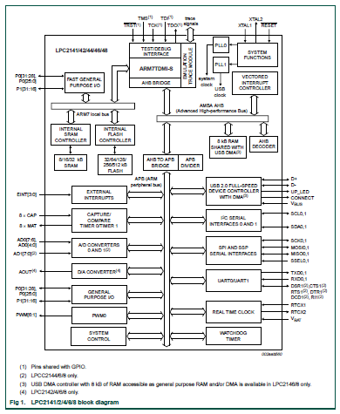
Block
diagram

Slide 38
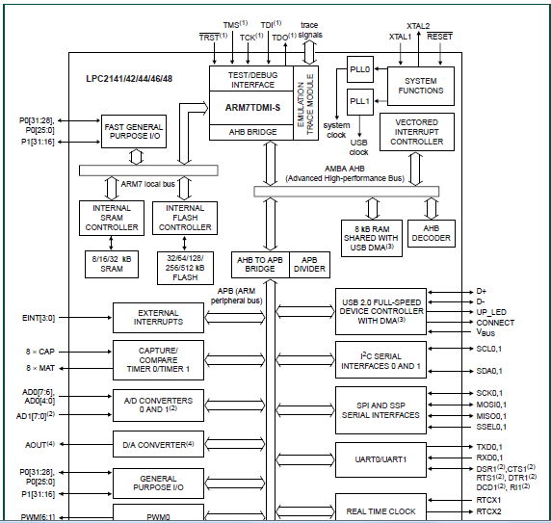

Slide 39
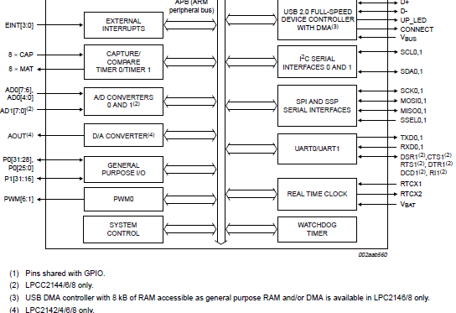

Slide 40
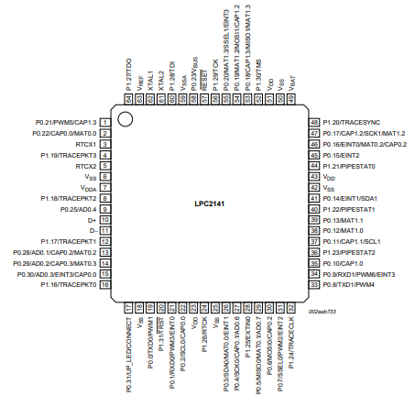
Pin
Configuration

Slide 41
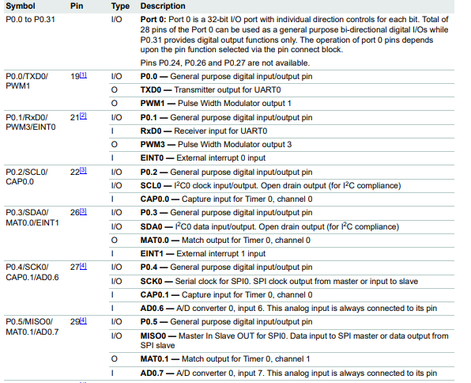

Slide 42
GPIO
GPIO pins can be used for driving loads, reading digital and analog signal, controlling external components, generating triggers for external devices etc.
LPC2148 has two IO ports namely PORT0 (P0) and PORT1 (P1).
These two IO ports are of 32-bit wide and are provided by the 64 pins of the microcontroller.
The ARM7 based LPC2148 Processor has 64 pins, it comes in Quad Flat Package.
PORT0 pins are designated as P0. 0 to P0. 31
PORT1 (P1. 0 to P1. 31)pins are designated as P1.

Slide 43
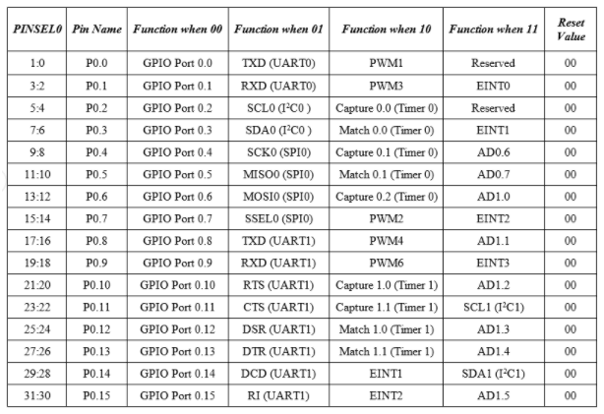

Slide 44
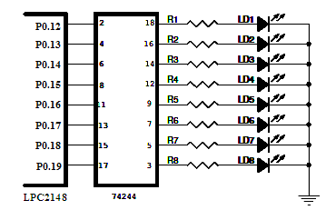
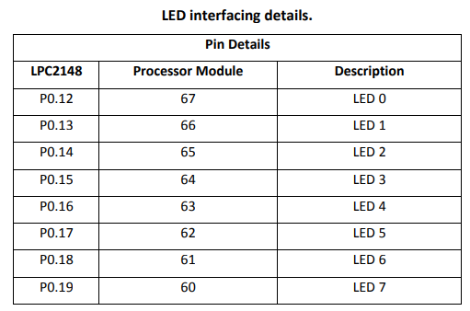
LED Interfacing with ARM processor
(LPC 2148 )
(Ref: Micro Embedded Technologies Manual)
8 general purpose LED’s are provided on the Micro-A748 Board in common anode configuration.LD1 thru LD8 are interface to Port Pins P0.12 thru P0.19. In order to make the LED ON we have to give Logic “1” (HIGH).

Slide 45
1. PORT0 pins are configured as GPIO using PINSEL register.
2. and then their direction is set as Output using the IODIR register.
3. LEDs are turned ON by sending a high pulse using IOSET register.
IOxDIR : This is the GPIO direction control register. (Input OR Output lines)
IOxSET : This register can be used to drive an 'output' configured pin to Logic 1 i.e HIGH. ...
IOxCLR : This register can be used to drive an 'output' configured pin to Logic 0 i.e LOW.

Slide 46
/* This Program is to demonstrate the LED Functionality */
Board : SBC_ARM7
Processor : LPC2148
LED Mapping : LED0 thru LED7 : P0.4 thru P0.11 /
#include<lpc214x.h>
//LED Mapping for the board
#define LED_SET IOSET0 //LEDs are turned ON by sending a high// //pulse using IOSET register.//
#define LED_CLR IOCLR0
#define LED_DIR IODIR0 // Direction set as output//
#define LED_IO IOPIN0
#define LED_MASK 0x000FF000 //0000 0000 0000 1111 1111 0000 0000 0000//
#define LED0 12 D12-D19
void delay(unsigned int time)
{
unsigned int i,j;
for (i = 0; i < time; i++ ) Delay Subroutine
{
for (j = 0; j < 5000 ; j++);
}
}

Slide 47
int main(void)
{
int i,j;
i = PINSEL0; // set the pin function for the pins as GPIO : 00
PINSEL0 = (i & ~LED_MASK); //read , modify and write
PINSEL0 = 0;
LED_DIR = LED_MASK; // set the direction of the pins as output : 1
------------------------------------------------------------------------------------------------
while(1)
{
// LED Blinking
for(i = 0; i < 4 ; i++)
{
LED_SET = LED_MASK; // set the port pins to 1
delay(150);
LED_CLR = LED_MASK; //clear the port pins to 0
delay(150);
}

Slide 48
// LED Rolling
for (i = 0 ; i < 4 ; i++)
{
for (j = 0 ; j < 8; j++)
{
LED_SET = 1 << (LED0 + j); // set the port pins to 1
delay(50);
}
for (j = 7 ; j >= 0; j--)
{
LED_CLR = 1 << (LED0 + j); //clear the port pins to 0
delay(50);
}
}

Slide 49
// LED SINGLE Rolling
for (i = 0 ; i < 5 ; i++)
{
for (j = 0 ; j < 8; j++)
{
LED_CLR = 1 << (LED0 + j); //clear the port pins to 0
delay(50);
LED_SET = 0xFF << (LED0 + j); // set the port pins to 1
delay(50);
}
for (j = 7 ; j >= 0; j--)
{
LED_CLR = 1 << (LED0 + j); //clear the port pins to 0
delay (50);
LED_SET = 0xFF << (LED0 + j); // set the port pins to 1
delay (50);
}
}
}
return 0;
}

Slide 50
Character LCD Interfacing with ARM processor
LCDs (Liquid Crystal Displays) are used for displaying status or parameters in embedded systems.
LCD 16x2 is 16 pin device which has 8 data pins (D0-D7) and 3 control pins (RS, RW, EN). The remaining 5 pins are for supply and backlight for the LCD.
The control pins help us configure the LCD in command mode or data mode. They also help configure read mode or write mode and also when to read or write.
LCD 16x2 can be used in 4-bit mode or 8-bit mode depending on the requirement of the application.
In order to use it we need to send certain commands to the LCD in command mode and once the LCD is configured according to our need, we can send the required data in data mode.

Slide 51
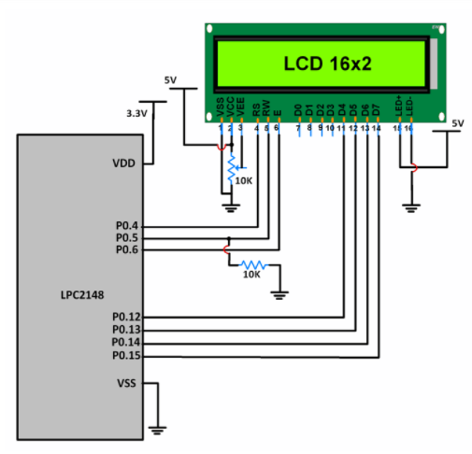
LCD in 4-bit mode
Only 4 Data pins.
LCD Data pins D4-D7 are connected to pins P0.12-P0.15 of Port 0.
LCD control pins RS, RW and EN are connected to P0.4, P0.5 P0.6 respectively.

Slide 52
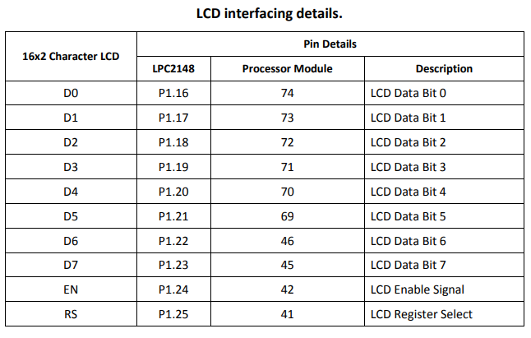
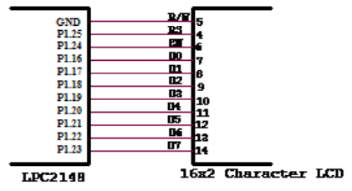
Character LCD Interfacing with ARM processor: LCD in 8-bit mode
A 16x2 Character LCD module can be connected to over connector CN8 on the LPC 2148 board.
The LCD is write only i.e. we cannot read from the LCD.

Slide 53
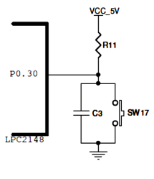
Interrupts
The ARM processor has two levels of external interrupt:
                FIQ and IRQ.
Both are level-sensitive, active LOW signals into the processor.
For an interrupt to be taken (No Masking),
the appropriate disable bit in the CPSR
must be clear.
The External Interrupt is generated
using a switch SW17 connected to
Pin P0.30 (INT3) of LPC 2148.
(Ref-User Manual)

Slide 54
Timers
Difference between a Timer and a Counter:
Timer:
A timer uses the frequency of the internal clock, and generates delay.
Counter:
A counter uses an external signal to count pulses.
It is used to enable / disable or reset the Timer Counter.
Only the first two bits of the TCR must be used for these operations.
LPC2148 has two 32-bit timers/counters: Timer0/Counter0 & Timer1/Counter1.
LPC2148 Timer has input of peripheral clock (PCLK) or an external clock.
It counts the clock from either of these clock sources for its operation.

Slide 55
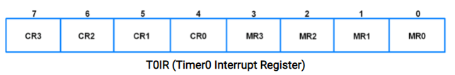
LPC2148 has two 32-bit timers/counters:Timer0/Counter0 & Timer1/Counter1.
Timer0 Registers
T0IR (Timer0 Interrupt Register)
It is an 8-bit read-write register.
Consists of 4 bits for match register interrupts and 4 bits for compare register interrupts.
If interrupt is generated, then the corresponding bit in this register will be high, otherwise it will be low.
Writing a 1 to any bit of this register will reset that interrupt.
Writing a 0 has no effect.

Slide 56
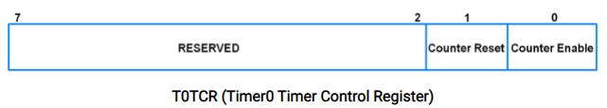
2. T0TCR (Timer0 Timer Control Register)
It is an 8-bit read-write register.
It is used to control the operation of the timer counter.
Bit 0 – Counter Enable
0 = Counters are disabled
1 = Timer counter and Pre-scale counter are enabled for counting
Bit 1 – Counter Reset
0 = Counter not reset
1 = Timer counter and Pre-scale counter are synchronously reset on next positive edge of PCLK
(The purpose of the pre-scaler is to allow the timer to be clocked at the rate a user desires.)

Slide 57
4. T0PR (Timer0 Pre-scale Register)
It is a 32-bit register.
It holds the maximum value of the Pre-scale Counter.
5. T0PC (Timer0 Pre-scale Counter Register)
It is a 32-bit register.
It controls the division of PCLK by some constant value before it is applied to the Timer Counter.
It is incremented on every PCLK.
When it reaches the value in Pre-scale Register, the Timer Counter is incremented and Pre-scale Counter is reset on next PCLK.
6. T0MR0-T0MR3 (Timer0 Match Registers)
These are 32-bit registers.
The values stored in these registers are continuously compared with the Timer Counter value.
When the two values are equal, the timer can be reset or stop or an interrupt may be generated. The T0MCR controls what action should be taken on a match.

Slide 58

T0CTCR (Timer0 Counter Control Register)
It is an 8-bit read-write register.
T0CTCR (Timer0 Counter Control Register)
Used to select between timer counter mode.
When in counter mode, it is used to select the pin and edges for counting.
Bits 1:0 – Counter/Timer Mode
This field selects which rising edges of PCLK can increment Timer’s Prescale Counter (PC), or clear PC and increment Timer Counter (TC).
00 = Timer Mode: Every rising edge of PCLK
01 = Counter Mode: TC is incremented on rising edge on the capture input selected by Bits 3:2.
10 = Counter Mode: TC is incremented on falling edge on the capture input selected by Bits 3:2
01 = Counter Mode: TC is incremented on both edges on the capture input selected by Bits 3:2

Slide 59
Bits 3:2 – Count Input Select
When bits 1:0 in this register are not 00, these bits select which capture pin is sampled for clocking.
00 = CAP0.0
01 = CAP0.1
10 = CAP0.2
11 = CAP0.3
Note : If counter mode is selected for a certain capture (CAP) input, then the corresponding 3 bits in the T0CCR register must be programmed as 000. Capture and/or interrupt can be selected for other CAP inputs.

Slide 60

T0MCR (Timer0 Match Control Register)
It is a 16-bit register.
It controls what action is to be taken on a match between the Match Registers and Timer Counter.
Bit 0 – MR0I (Match register 0 interrupt)
0 = This interrupt is disabled
1 = Interrupt on MR0. An interrupt is generated when MR0 matches the value in TC (Timer Counter)
Bit 1 – MR0R (Match register 0 reset)
0 = This feature is disabled
1 = Reset on MR0. The TC (Timer Counter) will be reset if MR0 matches it
Bit 2 – MR0S (Match register 0 stop)
0 = This feature is disabled
1 = Stop on MR0. The TC (Timer Counter) and PC (Prescale Counter) is stopped and Counter Enable bit in T0TCR is set to 0 if MR0 matches TC
MR1, MR2 and MR3 bits function in the same manner as MR0 bits.

Slide 61
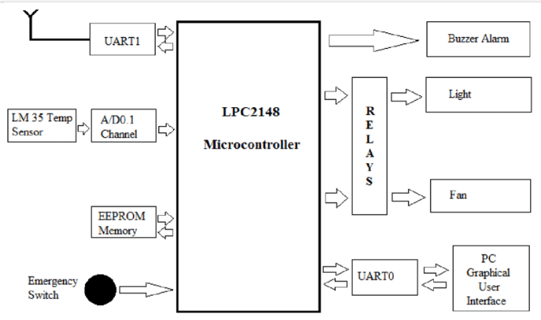
ADC
Analog to Digital Converter(ADC) is used to convert analog signal into digital form.
LPC2148 has two inbuilt 10-bit ADC i.e. ADC0 & ADC1.
ADC0 has 6 channels & ADC1 has 8 channels. Hence, we can connect 6 distinct types of input analog signals to ADC0 and 8 distinct types of input analog signals to ADC1.

Slide 62
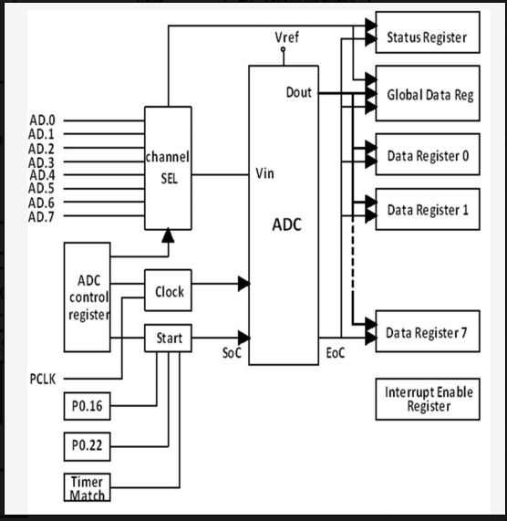
These converters are single 10-bit successive approximation ADCs.
While ADC0 has six channels, ADC1 has eight channels.
Therefore, total number of available ADC inputs for LPC2148 is 14.

Slide 63
Digital to Analog Converter (DAC)
Digital to Analog Converter (DAC) are mostly used to generate analog signals (e.g. sine wave, triangular wave etc.) from digital values.
LPC2148 has 10-bit DAC with resistor string architecture. It also works in Power down mode.
LPC2148 has Analog output pin (AOUT) on chip, where we can get digital value in the form of Analog output voltage.
The Analog voltage on AOUT pin is calculated as ((VALUE/1024) * VREF).
Hence, we can change voltage by changing VALUE (10-bit digital value) field in DACR (DAC Register).
e.g. if we set VALUE = 512,
then, we can get analog voltage on AOUT pin as ((512/1024) * VREF) = VREF/2.

Slide 64
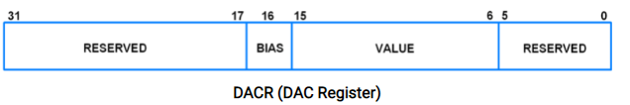
1. AOUT (Analog Output)
This is Analog Output pin of LPC2148 DAC peripheral where we can get Analog output voltage from digital value.
2. VREF (Voltage Reference)
Provides Voltage Reference for DAC.
3. VDDA& VSSA (Analog Power and Ground)
These are the power and ground pins for DAC. These should be same as VDD& VSS.
Register used for DAC
DACR (DAC Register)
DACR is a 32-bit register.
It is a read-write register.

Slide 65
Bit 5:0 – RESERVED
Bits 15:6 – VALUE
This field contains the 10-bit digital value that is to be converted in to Analog voltage. We can get Analog output voltage on AOUT pin and it is calculated with the formula (VALUE/1024) * VREF.
Bit 16 – BIAS
0 = Maximum settling time of 1µsec and maximum current is 700µA
1 = Settling time of 2.5µsec and maximum current is 350µA
Note that, the settling times are valid for a capacitance load on the AOUT pin not exceeding 100 pF. A load impedance value greater than that value will cause settling time longer than the specified time.
Bit 31:17 – RESERVED

Slide 66
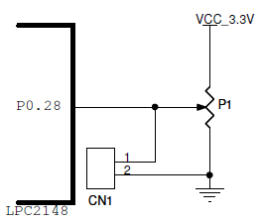
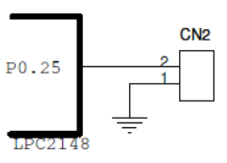
Interfacing of Analog to Digital Converter (ADC) and Digital to Analog Convertor (DAC) with ARM LPC 2148.
(a) (b)
a) ADC Interfacing:
The processor contains a 10 bit ADC.
Analog voltage is provided using potentiometers P1 .
ADC0 peripheral is connected to this input.
The Analog voltage can be measured at connector CN1.
DAC Interfacing:
The Processor contains a 10 bit Digital to Analog Convertor.
The Output of this DAC is brought out on pin P0.25 on the board at connector CN2

Slide 67
Phase Locked Loop (PLL)
There are two PLL modules in the LPC2141/2/4/6/8 microcontroller.
The PLL0 is used to generate the CCLK clock (system clock).
While the PLL1 has to supply the clock for the USB at the fixed rate of 48 MHz.
Structurally these two PLLs are identical with exception of the PLL interrupt capabilities reserved only for the PLL0.
The PLL0 and PLL1 accept an input clock frequency in the range of 10 MHz to 25 MHz only.
The input frequency is multiplied up the range of 10 MHz to 60 MHz for the CCLK and 48 MHz for the USB clock using a Current Controlled Oscillators (CCO).
60 MHz maximum CPU clock available from programmable on-chip PLL with settling time of 100 μs.

Slide 68
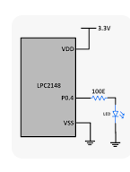
RTC interfacing and programming
RTC stands for real time clock which provides years, months, weeks, days, hours, minutes and seconds based on crystal frequency.
RTC consists of inbuilt RAM memory for data storage.
A battery backup will be provided in case
of failure of main power supply by
connecting a battery to RTC device.
The LPC 2148 board uses the internal RTC
on the processor LPC2148.
A crystal of 32.768 KHz is populated on the
LPC 2148 board.
Backup power is provided by the lithium
ion battery cell.

Slide 69
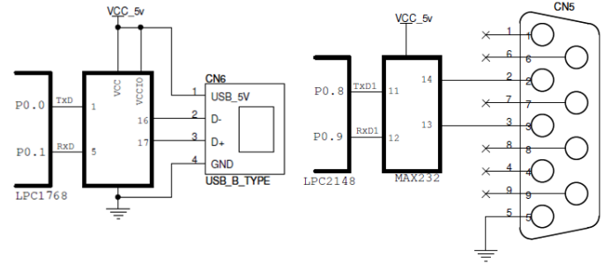
1. Protocols such as UART
Serial Communication using Universal Asynch Rx Tx:
Two UART interfaces from the processor are available for the user on the LPC 2148 board.
UART0 is connected to USB to Serial
and
UART1 is connected to COM1 which is for RS232 interfacing.

Slide 70
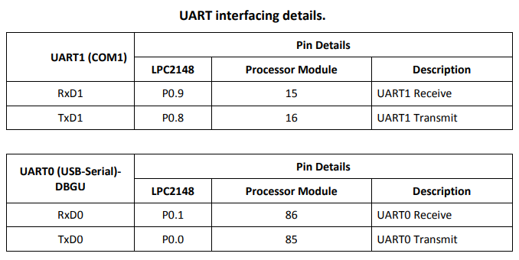

Slide 71
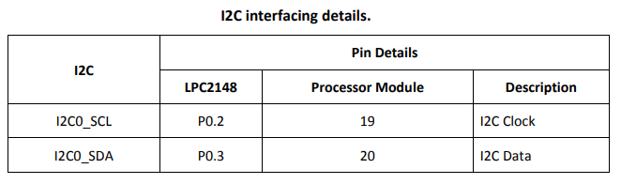
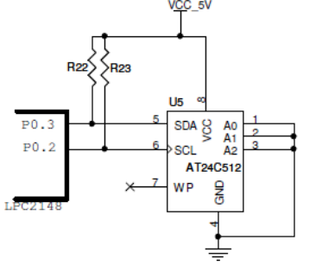
2. I2C (Inter-Integrated Circuit)Interface (EEPROM)
I²C is appropriate for peripherals where simplicity and low manufa-cturing cost are more important than speed.
The EEPROM (AT24Cxx) with I2C interface has been integrated on the board. The Port pins have to be configured to work as I2C clock and Data lines.

Slide 72
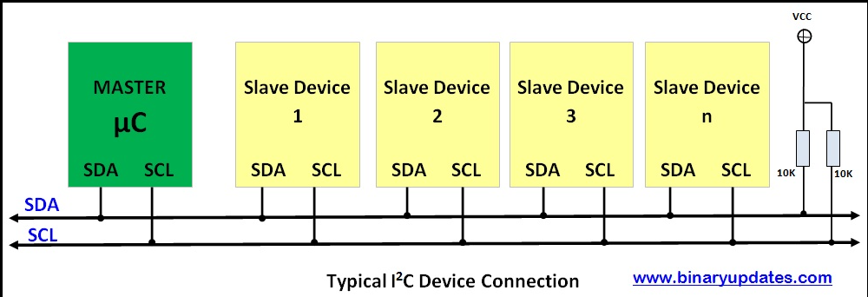
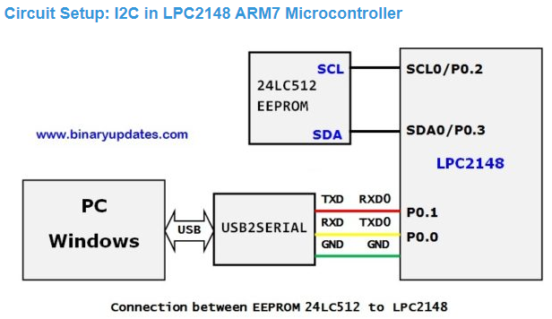

Slide 73
3. SPI Interfacing
The Serial Peripheral Interface (SPI) is a synchronous serial communication interface specification used for short-distance communication, primarily in embedded systems.
SPI works in a slightly different manner.
It's a "synchronous" data bus, which means that it uses separate lines for data and a "clock" that keeps both sides in perfect sync.
The clock is an oscillating signal that tells the receiver exactly when to sample the bits on the data line.

Slide 74
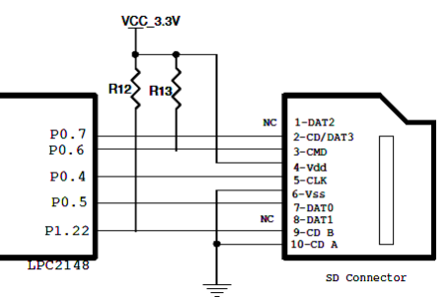
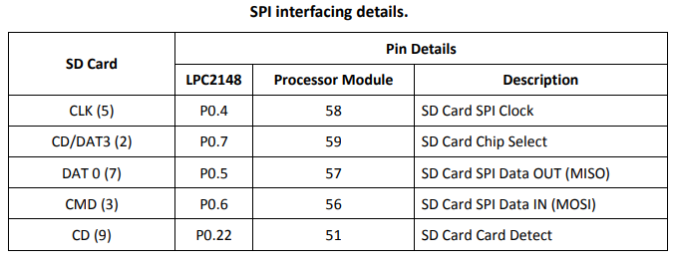
SPI Implementation
The SPI interface from the processor is available on the Micro-A748 board.
Devices such as SPI based SD(Secure digital card)/MMC (Multimedia) Card can be interfaced on the board using the SPI.

Slide 75
Controller Area Network (CAN)
A CAN bus is a robust vehicle bus standard designed to allow microcontrollers and devices to communicate with each other's applications without a host computer.
The CANs is another type of serial communications protocol that was developed within the automotive industry to allow a number of electronic units on a single vehicle to share essential control data.
A vehicle nowadays uses many microcontrollers for autonomous control systems.
It is a message based protocol, designed originally for multiplex electrical wiring within automobiles.
For each device, the data in a frame is transmitted sequentially but in such a way that if more than one device transmits at the same time, the highest priority device can continue while the others back off.
Frames are received by all devices, including by the transmitting device.

Slide 76
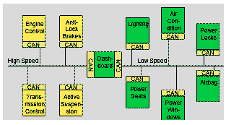
The advantages of a CAN-bus are evident:
Simplicity of operation: the limitation of the number of cables simplifies not only mounting but also maintenance.
No need to search in a forest of cables to repair a dysfunction.
The CAN-bus system allows memorization of the equipment operating history: errors are memorized and indexed, so can be easily detected and repaired during maintenance operations.

Slide 77
Reduction of production costs:
the installation of CAN-bus systems reduces the cable quantity and all related costs (materials and labor).
Innovation: the CAN-bus format has allowed to improve the functionalities of numerous applications (automotive, aviation…): lower consumption, security, comfort, error detection, etc.
Listening to its clients, APEM has integrated CAN-bus systems in the HMI solutions offered to its customers. Our expertise in these systems allow our teams to propose complete interface solutions combining components (switches, switch panels, indicators, joysticks), standard PC board and programming.
A real added-value for APEM, who offers turnkey solutions reducing development costs by using standard internally-developed technological bricks. Customer advantages are numerous: simplicity, reactivity, flexibility and cost reduction.
Communication tools are our future and APEM is constantly working on developing new interface solutions based on the very latest wireless communication systems.

Slide 78
PWM
PWM or Pulse Width Modulation is a technique that modulates the width of a rectangular pulse wave in order to get a variation in the average value of the resulting wave.
This method is used to encode the data corresponding to the width of the pulse with in the fixed frequency.
But the main application of PWM is to control the power delivered to the loads.
The power is controlled by switching the voltage between the supply and load at an extremely high rate (or depending on the load).

Slide 79
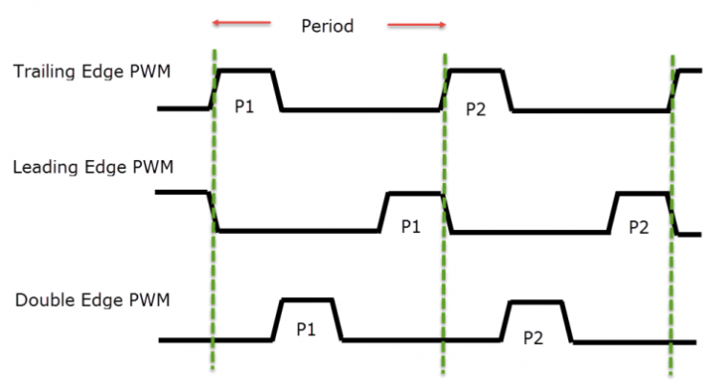
PWM or Pulse Width Modulation is a technique that modulates the width of a rectangular pulse wave in order to get a variation in the average value of the resulting wave. ...
PWM in LPC2148 are classified in to 2 types: Single Edged PWM signal and Double Edged PWM signal

Slide 80
Although the PWM pin on the LPC214x series of MCUs are mentioned separately, it is based on the standard Timer block.
PWM in LPC2148 are classified in to 2 types: Single Edged PWM signal and Double Edged PWM signal.
In case of Single Edged PWM, the pulse will be always at the beginning or the ending of the period. Based on the position of the edge, the single edged PWM is again divided in to Trailing Edge PWM and Leading Edge PWM.
In case of Trailing Edge PWM, the pulse is fixed at the beginning of the period while the position of the trailing edge is varied.
In case of Leading Edge PWM, the pulse is fixed at the end of the period and the position of the leading edge is varied.
Coming to the Double Edge PWM signal, the pulse can be placed anywhere in the period and either the leading edge or the trailing edge can be modulated.

Slide 81




INSTRUCTION SET LPC 2148 ARM PROCESSOR
Load-Store Instructions

Slide 82


Slide 83


Slide 84


Slide 85
Thank you

