Slide 1
UNIT-VI
Embedded software development tools and Applications
08 Hours

Slide 2
Host and target machines
• Host: – A computer system on which all the programming tools run – Where the embedded software is developed, compiled, tested, debugged, optimized, and prior to its translation into target device.
• Target: – After writing the program, compiled, assembled and linked, it is moved to target – After development, the code is cross-compiled, translated – cross-assembled, linked into target processor instruction set and located into the target.

Slide 3
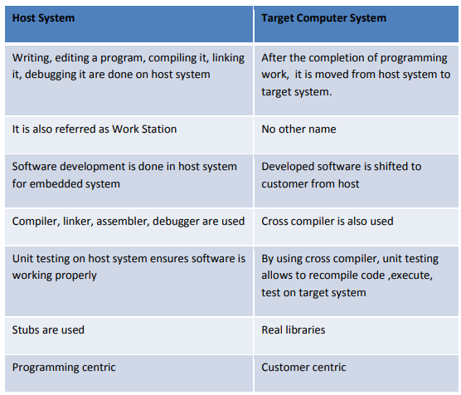

Slide 4
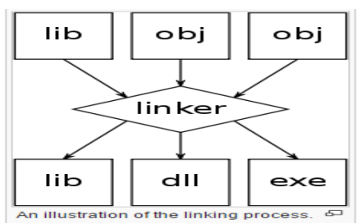
Linker/locators for embedded software
• Linker: – a linker or link editor is a computer program that takes one or more object files generated by a compiler and combines them into a single executable file, library file, or another object file.
• Locator: • locate embedded binary code into target processors • produces target machine code (which the locator glues into the RTOS) and the combined code (called map) gets copied into the target ROM

Slide 5
• The native linker creates a file on the disk drive of the host system that is read by a part of operating system called the loader whenever the user requests to run the programs. • The loader finds memory into which to load the program, copies the program from the disk into the memory

Slide 6
Getting embedded software into the target system
The locator will build a file as an image for the target software.
There are few ways to getting the embedded software file into target system.
– PROM programmers
– ROM emulators
– In circuit emulators
– Flash
– Monitors
PROM Programmers:
The classic way to get the software from the locator output file into target system by creating file in ROM or PROM. •
Creating ROM is appropriate when software development has been completed, since cost to build ROMs is quite high. Putting the program into PROM requires a device called PROM programmer device. •
PROM is appropriate if software is small enough, if you plan to make changes to the software and debug.

Slide 7
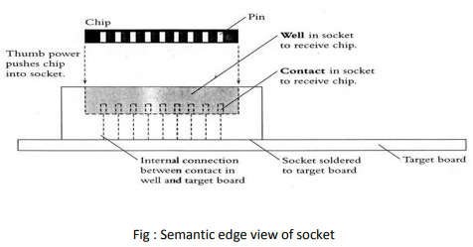
To do this, place PROM in socket on the Target than being soldered directly in the circuit (the following figure shows).
When we find bug, you can remove the PROM containing the software with the bug from target and put it into the eraser (if it is an erasable PROM) or into the waste basket.
Otherwise program a new PROM with software which is bug fixed and free, and put that PROM in the socket.
We need small tool called chip puller (inexpensive) to remove PROM from the socket.
We can insert the PROM into socket without any tool than thumb (see figure8). If PROM programmer and the locator are from different vendors, its up to us to make them compatible.

Slide 8
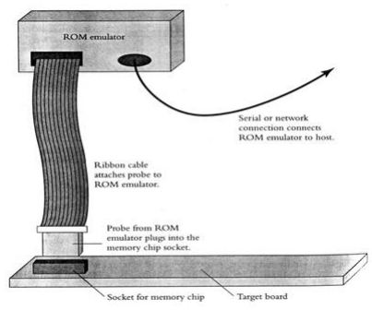
2. ROM Emulators:
Other mechanism is ROM emulator which is used to get software into target.
ROM emulator is a device that replaces the ROM into target system.
It just looks like ROM, as shown figure9; ROM emulator consists of large box of electronics and a serial port or a network connection through which it can be connected to your host.
Software running on your host can send files created by the locator to the ROM emulator.
Ensure the ROM emulator understands the file format which the locator creates.

Slide 9
3. In circuit emulators:
If we want to debug the software, then we can use overlay memory which is a common feature of in-circuit emulators.
In-circuit emulator is a mechanism to get software into target for debugging purposes.
4. Flash:
If your target stores its program in flash memory, then one option you always have is to place flash memory in socket and treat it like an EPROM.
However, If target has a serial port, a network connection, or some other mechanism for communicating with the outside world, link then target can communicate with outside world, flash memories open up another possibility: you can write a piece of software to receive new programs from your host across the communication link and write them into the flash memory.
Although this may seem like difficult

Slide 10
Monitors: It is a program that resides in target ROM and knows how to load new programs onto the system.
A typical monitor allows you to send the data across a serial port, stores the software in the target RAM, and then runs it.
Sometimes monitors will act as locator also, offers few debugging services like setting break points, display memory and register values.
You can write your own monitor program.

Slide 11
Debugging techniques: Testing on host machine
Testing on host machine
Using laboratory tools
An example system Introduction:
While developing the embedded system software, the developer will develop the code with the lots of bugs in it.
The testing and quality assurance process may reduce the number of bugs by some factor.
But only the way to ship the product with fewer bugs is to write software with few fewer bugs.
The world extremely intolerant of buggy embedded systems.
The testing and debugging will play a very important role in embedded system software development process

Slide 12
Using laboratory tools, an example system
Using laboratory Tools:
• Volt meters and Ohm Meters
• Oscilloscopes
• Logic Analyzers
• Logic Analyzers in Timing mode • Logic Analyzers in State Mode
• In-circuit Emulators
• Getting “ Visibility” into the Hardware
• Software only Monitors
• Other Monitors

Slide 13
Case study of ES: Automatic Chocolate Vending M/C
(ES By Rajkamal)
ACVM system consists of a slot into which a child inserts the coins for buying the chocolate.
Whenever a coin is inserted, a mechanical system directs each coin of value Rs 1 or 2 or 5 to port -1, port -2, port -5 respectively. When a port is receiving a coin, the port generates an interrupt.
Purpose:-
1. To sell chocolate through an ACVM from which children can automatically purchase the chocolates.
2. The payment is by inserting the coins of appropriate amount into a coin-slot.
RTOS:-
An RTOS has to schedule the buying tasks from start to finish.
Let MuC/OS-II be the RTOS used in ACVM

Slide 14
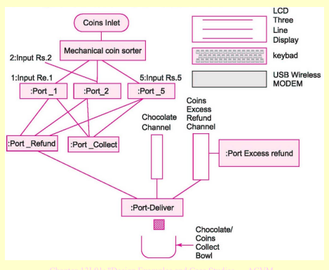
SCHEMATIC
DIAGRAM
OF ACVM

Slide 15
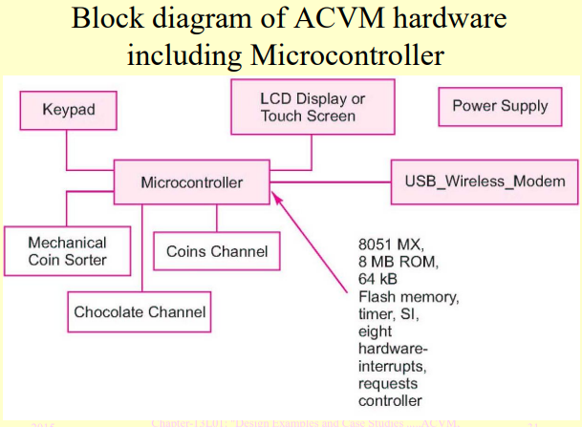

Slide 16
Functions of the system
A child sends commands to the system using a GUI (graphic user interface).
GUI consists of the LCD display and keypad units.
The child inserts the coins for cost of chocolate and the machine delivers the chocolate.
If the coins are not inserted as per the cost of chocolate in reasonable times then all coins are refunded.
If the coins are inserted of amount more than the cost of chocolate, the excess amount is refunded along with chocolate.
The coins for the chocolates purchased collect inside the machine in a collector channel, so that owner can get the money, again through appropriate commands using the GUI.
USB wireless modem enables communication through Internet to the ACVM owner

Slide 17
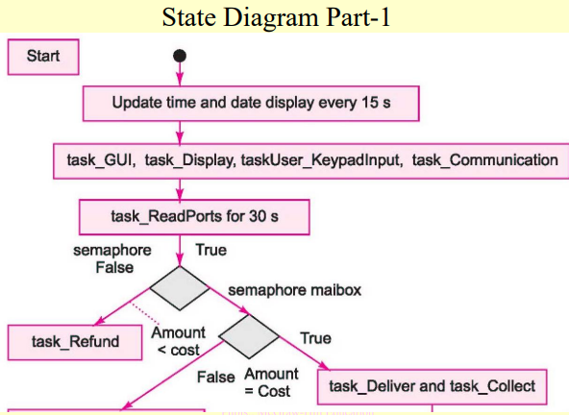
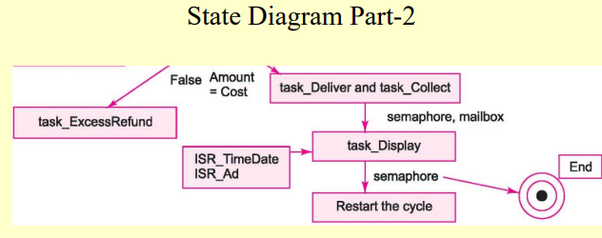

Slide 18
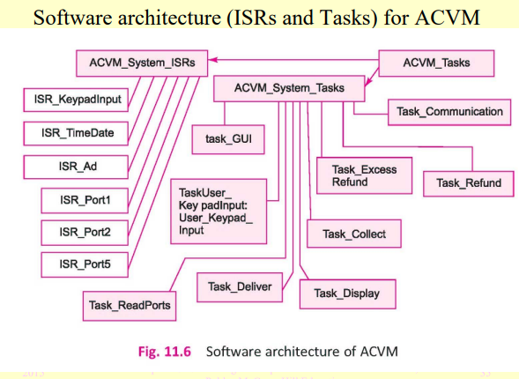

Slide 19
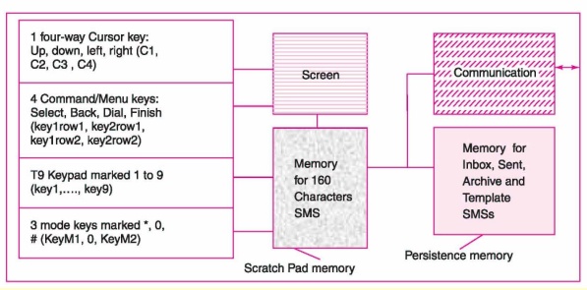
Mobile Phone
SMS Create and Send Application Requirements:
Purpose:
To create an SMS message and communicate using a T9 format keypad and using the tasks for adding number, editing message and then sending the message
Keypad, screen, memory and communication units:

Slide 20
Hardware architecture:
● Same as mobile phone system with SMS features
● T9 keypad
● Processors, ASIPs, keys, memory, ports and devices
● Interfacing and mapping of these components.
Functions of the system:
When set of options consisting of 4 notifications, one for a command Messages, next for command-option Text Messages, next for application Create Message and last for Text, generates, an event E_SMS
E_SMS signals creation of text messages entered and edited with T9 keypad of nine keys
When any key clicked by user, its state computed based upon key’s earlier state, cursor present position and timer status and count  Notification E_NewState is posted in a message box to send signal to an ISR, task or application for the required action.
Continue..

Slide 21
Continue..
For choosing SMS creating text application, the cursor and command-cum-options select (Key1Row1) key are used as follows:
(a) When command key (key1Row1) is used to select ‘command Messages’, a command-option is then selected using a GUI.
(b) User selects Text Messages option by clicking for the displayed option ‘Text messages’.
(c) A menu then shows up for selecting one of the followings using the cursor down and up keys: Create message, Inbox, Sent items, Archive, Templates, My folders, Distribution lists, Delete messages and Message settings.  User selects ‘Create message’ for selecting SMS creation application.

Slide 22
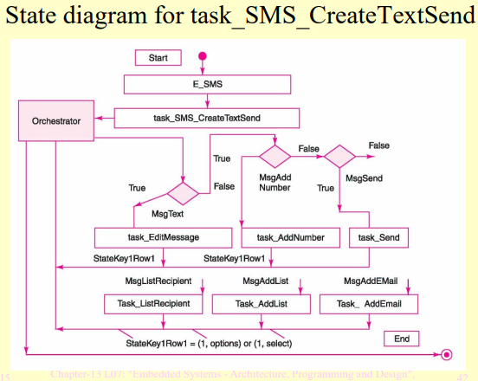
● (d) A menu then shows up for selecting type of message to be created.  Cursor can select one of the following menu items on display: Text and Numeric page.  User selects ‘Text’ for creating SMS text.

Slide 23
ATM
An ATM is an embedded system which utilizes a computer to set up a network between a bank computer and an ATM itself.
It also has a microcontroller to bear both input and output operations.
An automated teller machine (ATM) is an electronic banking outlet that allows customers to complete basic transactions without the aid of a branch representative or teller. Anyone with a credit card or debit card can access cash at most ATMs.
An ATM typically is made up of the following devices: CPU (to control the user interface and transaction devices) Magnetic and/or Chip card reader (to identify the customer) PIN Pad (similar in layout to a Touch tone or Calculator keypad), often manufactured as part of a secure enclosure.

Slide 24
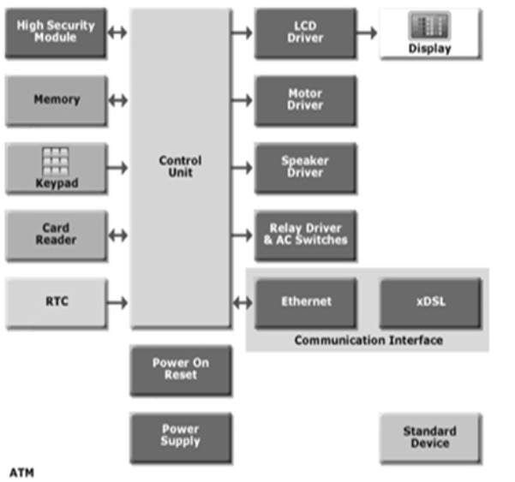

Slide 25
1. Card Reader
The card reader is an input device that reads data from a card. The card reader is part of the identification of your particular account number and the magnetic strip on the backside of the ATM card is used for connection with the card reader. The card is swiped or pressed on the card reader which captures your account information i.e. the data from the card is passed on to the host processor (server). The host processor thus uses this data to get the information from the cardholders.
2. Keypad
The card is recognized after the machine asks for further details like your identification number, withdrawal, and your balance inquiry Each card has a unique PIN so that there is little chance for some else to withdraw money from your account. There are separate laws to protect the PIN code while sending it to the host processor. The PIN is mostly sent in encrypted form. The keyboard contains 48 keys and is interfaced to the processor.

Slide 26
3. Output Devices
The output devices are speaker, display screen, receipt printer, and cash depositor.
4. Speaker
The speaker provides audio feedback when a particular key is pressed.
5. Display Screen
The display screen displays the transaction information. Each step of withdrawal is shown by the display screen. A CRT screen or LCD screen is used by most of the ATMs.
6.Receipt Printer
The receipt printer prints all the details recording your withdrawal, date and time, and the amount of withdrawal and also shows the balance of your account in the receipt.

Slide 27
7. Cash Dispenser
The cash dispenser is the heart of the ATM. This is a central system of the ATM from where the required money is obtained. From this portion, the user can collect the money. The cash dispenser must count each bill and give the required amount. If in some cases the money is folded, it will be moved to another section and becomes the reject bit. All these actions are carried out by high precision sensors. A complete record of each transaction is kept by the ATM with the help of an RTC device.
8. ATM Networking
The internet service provider (ISP) also plays an important role in the ATMs. This provides communication between ATM and host processors. When the transaction is made, the details are input by the cardholder. This information is passed on to the host processor by the ATM. The host processor checks these details with an authorized bank. If the details are matched, the host processor sends the approval code to the machine so that the cash can be transferred.

Slide 28
Digital camera (Rajkamal, Frank Vahid)
A digital camera is an example of sophisticated ES.
Simple Description of Digital camera:
It consists of a lot of components including the DSP processors.
Systems-on-a-chip: Multiple processors & memories on an IC
Digital camera includes various types of memories like DRAM, memory card, flash memory with controller etc.
Number depends on amount of memory and bits used per image
High-capacity flash memory
Downloads images to Computer System (PC) Only Recently Possible

Slide 29
• Captures images
• Stores images in digital format
▪ No film
▪ Multiple images stored in camera
Variable size images, image deletion, digital stretching, zooming in/out, etc.
Real Digital Camera has more features

Slide 30
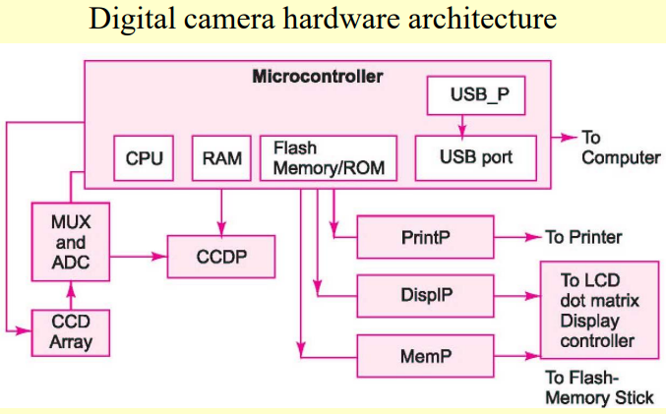

Slide 31
Purpose of digital camera
Digital recording and display of pictures.
Processing to get the pictures of required brightness, contrast and color.
Permanent saving of picture in file in a standard format at a flash-memory stick or card.
Transfer files to a computer and printer through a USB port
Functions of the system
Enables manual adjustment of view of the picture to be taken.
For shooting a shutter button pressed─ a charge-coupled device (CCD) array placed at the focus generates a byte stream in output after operations by ADC on analog output of each CCD cell.
A file creates after encoding (compression) and pixel co-processing.
The byte stream is preprocessed and then encoded in a standard format using a CODEC. CONT.

Slide 32
The encoded picture file saved for permanent record. A memory stick saves the file.
The file is used for display of recorded picture using a display processor and can be copied or transferred to a memory stick and to computer or printer connected through USB port.
The LCD displays picture file after it is decoded (decompressed) using the CODEC.
Text such as picture-title, shooting date and time and serial number are also displayed.
USB port is used for transferring and storing pictures on a computer. Alternatively, Bluetooth or IR port can be used for interfacing the computer

Slide 33
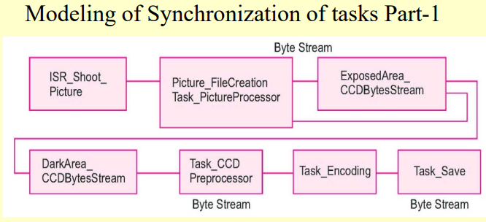
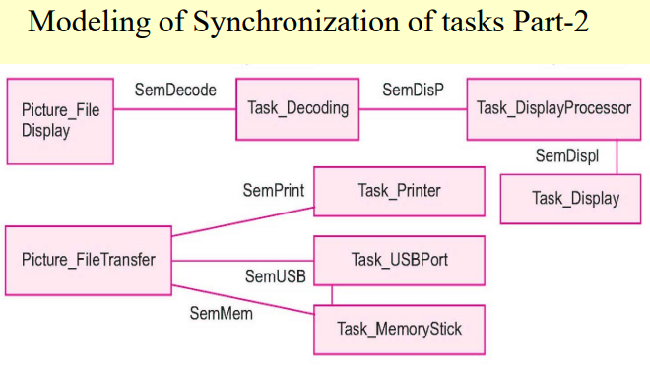

Slide 34
Point of sales terminal (POS)
A point of sale system is a solution to centralize all the business operations in a retail store.
The POS is responsible for the management of all the purchases and sales being carried out in any business, keeping track of inventories, employees, marketing campaigns, and various other features.
Purpose: To keep the business data organized, well-managed, and maximize profit.
The POS knowledge will help your staff to work efficiently and enhanced productivity.
In addition, a feature-rich and highly efficient POS system will help you easily handle costs.

Slide 35
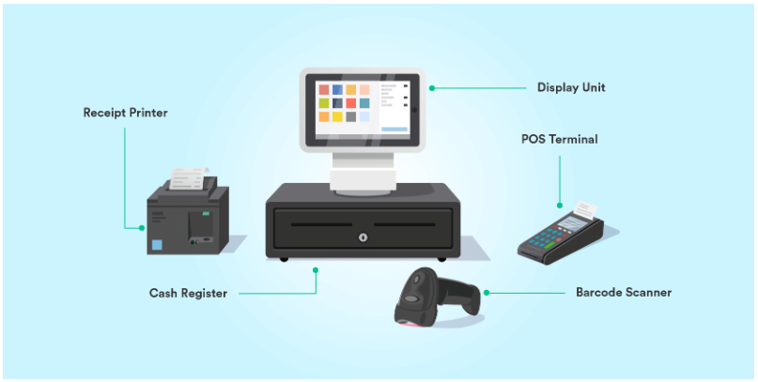

Slide 36
The most common and prominent features of any POS system include the following:
Sales management
Inventory management
Employee management
Analytics
Reporting
Loyalty programs and offers
Marketing integrations
The key features of this highly reliable Point of Sale brand include:
Detailed customer profiles
Detailed reports and analytics
The staff permissions are unlimited
High performance

Slide 37
Point of sales terminal:
The performance of Point of Sale remains fast and stable even during offline hours and the data is synced properly once the mode changes to online.
The loyalty program makes sure that no offer or discount is wasted.
Inventory keeps track of your stock flow across all sales channels and locations.
Ensure the right stock in the right place anytime.
Users can check out both as a registered user or guest as well.
Avoids any kind of delays in transactions during rush hours due to the high speed and good performance.
Get a clear picture of your current business performance with extensive inventory reports & key sales metrics.

Slide 38
The key features include:
Speed up your revenue generation with our robust and seamless POS system.
Intuitive and easy to understand user interface
Convert your sales easily with the help of our amazing sales modules
Manage your inventories and keep track of all the minute details related to sales and purchases.
The processing of sales and purchases involving any number and category of products is accurate and error-free.
Multiple payment methods enhancing user convenience. These include:
  Online payment
  Offline payment
  Split payment
  Partial payment
  Later payment
  Custom payment

Slide 39
ECG machines
A low cost embedded system for monitoring an ECG has been developed using operational amplifiers and a Microchip's microcontroller.
Digitized ECG has been transmitted serially to computer for real time analysis of HRV. Nonlinear energy associated with QRS complex is highest amongst the ECG beat.
The focus of this study is on embedded Heart disease diagnosis system for individual centered on the Electrocardiographic (ECG) biometrics.
This proposed real time system design is a diagnostic algorithm that extracts information from the ECG wave signal on architecture based Single Board Computer (SBC) represented by the Raspberry PI Platform.

Slide 40
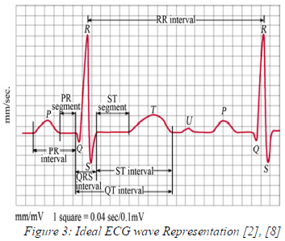
The proposed system is targeted to be free standing, and in situ heart abnormality identifying beside warning system.
In addition the system is easy to use in different environments. Preliminary results show the successful implementation in an embedded platform, enabling its usage on a countless of operations.
The ECG is applied to interpret some different kinds of cases caused by abnormal heart like conduction disturbance, arrhythmias and heart morphology (e.g., evolving infarction or myocardial ischemia, and hypertrophy). The clinical practices show that some cardiac disease can be diagnosed accurately.

Slide 41
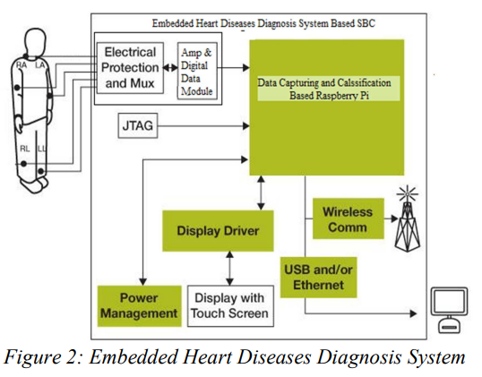

Slide 42
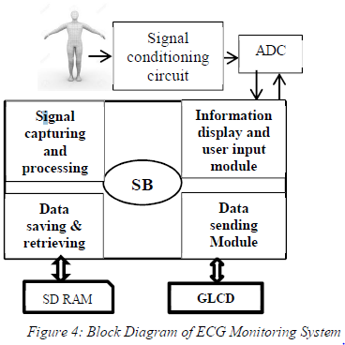

Slide 43
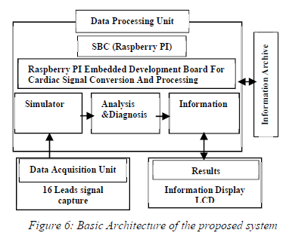

Slide 44
Engine control units
An electronic control unit (ECU), also known as an electronic control module (ECM), is an embedded system in automotive electronics that controls one or more of the electrical systems or subsystems in a car or other motor vehicle.
An electronic control unit that controls a series of actuators on an internal combustion engine to ensure optimal engine performance.

Slide 45
The ECM regulates four main parts of your vehicle's operating systems:
air-fuel ratio,
idle speed,
variable valve timing, and
ignition timing.
In terms of the air-fuel ratio, the ECM uses sensors to regulate the oxygen to f
uel ratio detected in your car's exhaust to detect an engine rich/lean reading.

Slide 46
