Slide 1
_{UNIT-IV}
_{μCOS II OS 07 Hours}
_{By}
Jean J. Labrosse –
MicroC OS II_ The Real Time Kernel-CRC Press (2002)

Slide 2
CONTENTS
Features of μCOS II.
Kernel structure.
μCOS II RTOS services: Task management
Memory management
Time management
Task Scheduling
Intertask Communication
Synchronization.

Slide 3
μCOS II
μCOS II is a small, yet powerful real-time operating system developed by Jean J. Labrosse.
The operating system is highly CPU independent and has been ported to numerous microprocessor platforms.
RTOS-MicroC/OS-II It is a priority-based real-time multitasking OS kernel for microprocessors, written mainly in the C programming language.
Many RTOS products are available in the market.
But µC/OS-II is a freeware with minimum facility and more popular among the hobbyist, researchers and small embedded system developers.
The µC/OS-II supports preemptive scheduling.

Slide 4
The μC/OS-II is an RTOS used for microcontrollers and microprocessors.
  A very small real-time kernel.
    Memory footprint is about 20KB for a fully functional
    kernel.
    Source code is about 5,500 lines, mostly in ANSI C
    (The American National Standards Institute).
    It’s source is open but not free for commercial usages.
      Supports of various 8-bit to 64-bit platforms: x86, 68x,
      MIPS, 8051, etc
    Easy for development: Borland C++ compiler and DOS
    (optional).

Slide 5
    However, uC/OS-II still lacks of the
    following features:
    Resource synchronization protocols.
    Sporadic (something that happens
    occasionally or at irregular intervals)
    task support.
    Soft-real-time support.

Slide 6
Features of µC/OS-II
Source Code:
The µC/OS-II is as neat, consistent, well commented and organized than other RTOSes.
Portable:
Most of μC/OS-II software is written in highly portable ANSI C , with target microprocessor specific code written in assembly language.
Assembly language is kept to a minimum to make µC/OS-II easy to port to other processors.
The µC/OS-II can be ported to a large number of microprocessors.
µC/OS-II can run on most 8-bit, 16-bit, 32-bit or even 64-bit microprocessors or micro-controllers and, DSP processors.
ROMable:
µC/OS-II was designed for embedded applications.
This means that if you have the proper tool chain (i.e. C compiler, assembler and linker/locator), you can embed µC/OS-II as part of a product.

Slide 7
4. Scalable:
The amount of memory (both RAM and ROM) needed by µC/OS-II is less.
Scalability is accomplished with the use of conditional compilation.
You simply specify (through #define constants) which features you need for your application/product.
Both the code and data space required by µC/OS-II are reduced.
5. Preemptive: µC/OS-II is a fully-preemptive real-time kernel. This means that µC/OS-II always runs the highest priority task that is ready. Most commercial kernels are preemptive and µC/OS-II is comparable in performance with many of them.
6. Multi-tasking: µC/OS-II can manage up to 64 tasks, however, the current version of the software reserves eight (8) of these tasks for system use. This leaves your application with up to 56 tasks. Each task has a unique priority assigned to it which means that µC/OS-II cannot do round robin scheduling. There are thus 64 priority levels.

Slide 8
7. Deterministic:
Execution time of all µC/OS-II functions and services are deterministic. This means that you can always know how much time µC/OS-II will take to execute a function or a service. Furthermore, except for one service, execution time of all µC/OS-II services do not depend on the number of tasks running in your application.
8. Task stacks: Each task requires its own stack, however, µC/OS-II allows each task to have a different stack size. This allows you to reduce the amount of RAM needed in your application. With µC/OS-II’s stack checking feature, you can determine exactly how much stack space each task actually requires.
9. Services: μC/OS-II provides a number of system services such as mailboxes, queues, semaphores, fixed-sized memory partitions, time related functions, etc.
10. Interrupt Management: Interrupts can suspend the execution of a task and, if a higher priority task is allowed as a result of the interrupt, the highest priority task will run as soon as all nested interrupts complete. Interrupts can be nested up to 255 levels deep.
11. Robust and reliable: µC/OS-II is used in hundreds of commercial applications. µC/OS-II uses the same core and most of the same functions as µC/OS…
yet offers more features.

Slide 9
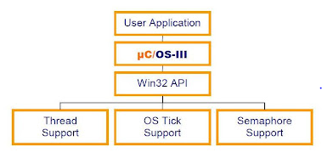
Figure shows the relationship between the user application, uCOS-II the underlying Windows system.
Figure 1: Application / uCOS-III/ Windows Vista Relationship
Note:- DIAGRAM is same for uCOS-II

Slide 10
Features of μCOS II.
The system user of μC/OS-II is able to control the tasks by using the following features
Task feature.
Task creation.
Task stack & stack checking.
Task deletion.
Change a task's priority.
Suspend and resume a task.
Get information about a task.
Semaphores
Mutual exclusion semaphores (to reduce priority inversions)
Event flags.
Message mailboxes.
Message queues.
Timer management.
Task management (create, delete, change priority, suspend/resume, etc.)
Fixed-sized memory block management.

Slide 11
Kernel structure features
Preemptible priority-driven real-time scheduling.
64 priority levels (max 64 tasks)
8 reserved for uC/OS-II
Each task is an infinite loop.
Deterministic execution times for most
uC/OS-II functions and services.
Nested interrupts could go up to 256 levels.
.

Slide 12
Kernel structure
1. Critical Sections
Def: Critical Sections: When more than one processes access a same code segment that segment is known as critical section.
A critical section contains shared variables or resources which are needed to be synchronized to maintain consistency of data variable.
The µC/OS-II real-time kernel disable interrupts in order to access critical sections of code, and re-enable interrupts when done.
This allows µC/OS-II to protect critical code from being entered simultaneously from either multiple tasks or ISRs.
The interrupt disable time is one of the most important specifications because it affects the responsiveness of your system to real-time events.
µC/OS-II tries to keep the interrupt disable time to a minimum.

Slide 13
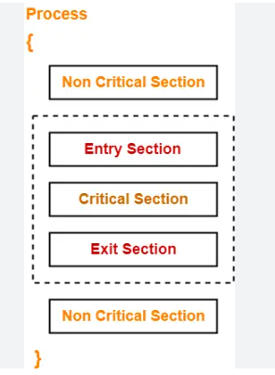
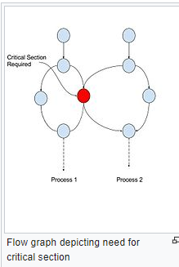

Slide 14
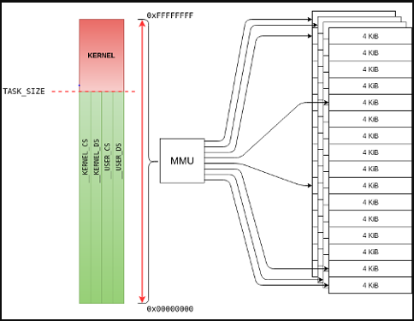

Slide 15
Every processor generally provides instructions to disable /enable interrupts and your C compiler must have a mechanism to perform these operations directly from C.
It is quite easy to insert processor instructions to enable and disable interrupts.
Other compilers will actually contain language extensions to enable and disable interrupts directly from C.
The µC/OS-II defines two macros to disable and enable interrupts:
OS_ENTER_CRITICAL() and OS_EXIT_CRITICAL(), respectively.
Because these macros are processor specific, they are found in a file called OS_CPU.H.
Each processor port will thus have its own OS_CPU.H file.

Slide 16
    µC/OS-II is a multitasking operating system.
    Each task is an infinite loop and can be in any one of the following five states:
    1. Dormant: The task has been created and a memory is allotted to its structure but the kernel has not scheduled this task.
    The dormant state corresponds to a task which resides in program space (ROM or RAM) but has not been made available to µC/OS-II.
2. Running: The task which is executing currently is said to be in running state. It owns the CPU.

Slide 17
3. Ready: The task which is neither suspended nor blocked but still not executing will be ready state.
Its not in running state because either a high priority or equal priority task is executing.
4. Blocked: A task will go in blocked state whenever its waiting for a event to happen. The event can be completing a delay period or availability of a resource.
5. Suspended: When TaskSuspend() is called, the task goes in suspended state. To resume it, TaskResume() is called.
The suspended tasks are also not available for scheduling.

Slide 18
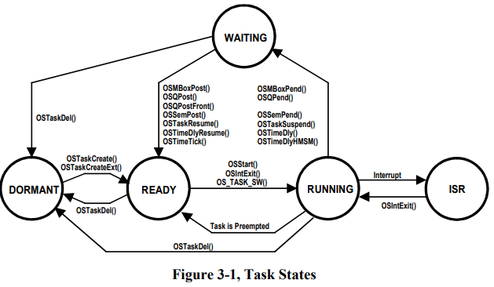
μCOS II RTOS services : Task management
The state transition diagram for tasks under µC/OS-II.

Slide 19
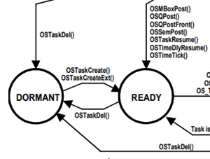
A task is made available to µC/OS-II by calling either OSTaskCreate()
or OSTaskCreateExt().
When a task is created, it is made READY to run.
Tasks may be created before multitasking starts or dynamically by a running task.
When created by a task, if the created task has a higher priority than its creator, the created task is immediately given control of the CPU.
A task can return itself or another task to the dormant state by calling OSTaskDel().

Slide 20
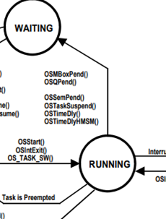
Multitasking is started by calling OSStart().
OSStart() runs the highest priority task that is READY to run.
Only one task can be running at any given time.
A ready task will not run until all higher priority
tasks are either placed in the wait state or are
deleted.
The running task may delay itself for a certain
amount of time by either calling OSTimeDly()
or OSTimeDlyHMSM().
This task is thus WAITING for some time to
expire and the next highest priority task that
is ready-to-run is immediately given control of
the CPU.
.

Slide 21
The running task may also need to wait until
an event occurs, by calling either OSSemPend(),
OSMboxPend() or OSQPend().
The task is thus WAITING for the occurrence of the event.
When a task pends on an event, the next highest priority task is immediately given control of the CPU.
The task is made ready when the event occurs.
The occurrence of an event may be signaled by either another task or an ISR.

Slide 22
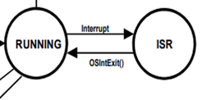
A running task can always be interrupted, unless the
task or µC/OS-II disables interrupts. (preemptive)
The task thus enters the ISR state.
When an interrupt occurs, execution of the task
is suspended and the ISR takes control of the CPU.
The ISR may make one or more tasks ready to run by signaling one or more events.
In this case, before returning from the ISR, µC/OS-II determines if the interrupted task is still the highest priority task ready to run.
If a higher priority task is made ready to run by the ISR then the new highest priority task is resumed.
Otherwise, the interrupted task is resumed.
When all tasks are either waiting for events or for time to expire then µC/OS-II executes the idle task, OSTaskIdle().

Slide 23
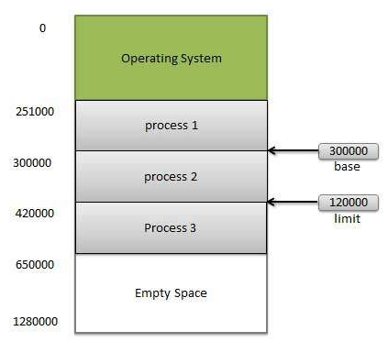

Slide 24
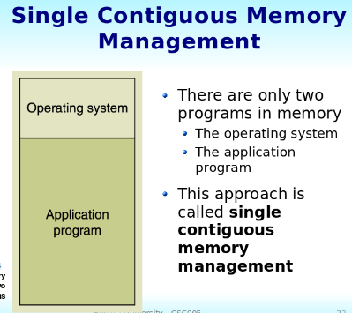
Memory management
Following are the important memory management techniques:
1. Single Contiguous Allocation
This is the easiest memory management technique where all types of computer memories except the one reserved for the OS are available for one application.

Slide 25
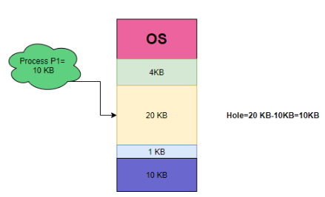
2. Partition Allocation
In this allocation, the primary memory is divided into various memory partitions .
Each partition stores the information for a specific job.
A job is given a partition when it starts executing and the partition is taken away after the job finishes execution.

Slide 26
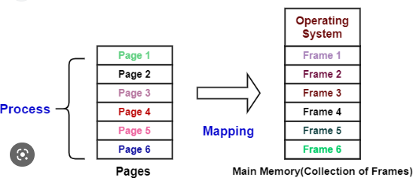
3. Paged Memory Management
In this method, page frames are created which are fixed-size units formed after dividing the system memory.

Slide 27
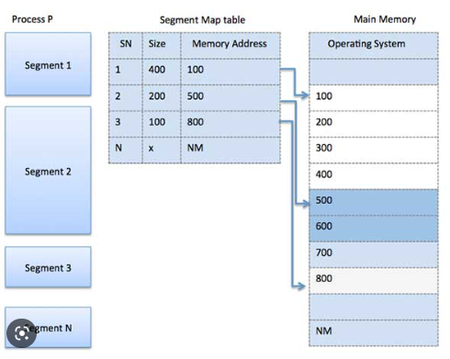
4. Segmented Memory Management
This method is similar to the one above. It does not provide a linear and contiguous address space for a user program. Instead, there is a segment table that contains the physical address, size, and other data about the memory.

Slide 28
This is a set of logical addresses that a process mentions in its code. The OS maps the logical address to the physical address during memory allocation. Three types of addresses are used during allocation:
Symbolic address: This address is used in a source code. The basic elements of this address space are variable names, constants, and instruction labels.
2. Relative address: During compilation, the compiler converts symbolic address to relative address.
3. Physical address: The loader generates a physical address when a program is being loaded into main memory.
Virtual addresses and physical addresses are similar.
A set of logical addresses generated by a program is known as logical address space. Physical address space comprises of the set of physical addresses corresponding to logical addresses. Memory management unit (MMU) does the runtime mapping from virtual to physical address.

Slide 29
Memory management
Your application can allocate and free dynamic memory using any ANSI C compiler’s malloc() and free() functions, respectively.
However, using malloc() and free() in an embedded real-time system is dangerous because eventually, you may not be able to obtain a single contiguous memory area because of fragmentation.
Fragmentation is the development of a large number of separate free areas (i.e. the total free memory is fragmented into small pieces).

Slide 30
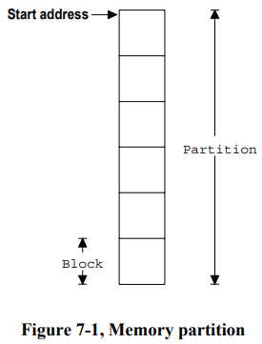
µC/OS-II provides fixed-sized memory blocks from a partition made of a contiguous memory area as illustrated in Figure 7-1.
All memory blocks are the same size and the partition contains an integral number of blocks. Allocation and de-allocation of these memory blocks is done in constant time and is deterministic.

Slide 31
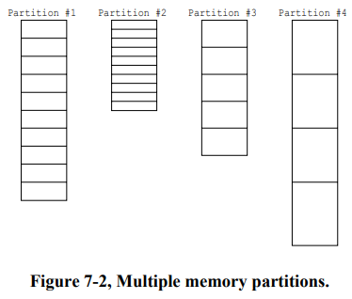
As shown in Figure 7-2, more than one memory partition can exist and thus, you application can obtain memory blocks of different sizes.
A specific memory block must, however, always be returned to the partition from which it came from.
This type of memory
management is not
subject to fragmen-
tation.

Slide 32
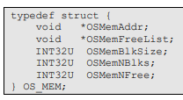
Memory Control Blocks µC/OS-II keeps track of memory partitions through the use of a data structure called a memory control block as shown in listing 7.1. Each memory partition requires its own memory control block.
OSMemAddr is a pointer to the beginning (i.e. base) of the memory partition from which memory blocks will be allocated from.
This field is initialized when you create a partition and is not used thereafter.
2. OSMemFreeList is a pointer used by µC/OS-II to point to either the next free memory control block or to the next free memory block. The use depends on whether the memory partition has been created or not.

Slide 33
3. OSMemBlkSize determines the size of each memory block in the partition and is a parameter you specify when the memory partition is created (see section 7.01).
4. OSMemNBlks establishes the total number of memory blocks available from the partition. This parameter is specified when the partition is created (see section 7.01).
5. OSMemNFree is used to determine how many memory blocks are available from the partition.

Slide 34
Time management
µC/OS-II requires a periodic interrupt to keep track of time delays and timeouts.
This periodic time source is called a Clock Tick.
Clock Tick should occur between 10 and 100 times per second or Hertz.
The actual frequency of the clock tick depends on the desired tick resolution of your application.
However, the higher the frequency of the ticker, the higher the overhead.
The function needed to call to notify µC/OS-II about the tick interrupt is OSTimeTick().

Slide 35
The five services that deal with time issues:
1) OSTimeDly(),
2) OSTimeDlyHMSM(),
3) OSTimeDlyResume(),
4) OSTimeGet() and,
5) OSTimeSet().
1 . Delaying a task, OSTimeDly():
µC/OS-II provides a service that allows the calling task to delay itself for a user specified number of clock ticks. This function is called OSTimeDly().
Calling this function causes a context switch and forces µC/OS-II to execute the next highest priority task that is ready-to-run.
The task calling OSTimeDly() will be made ready-to run as soon as the time specified expires or, if another task cancels the delay by calling OSTimeDlyResume().
## You should note that this task will run only when it’s the highest priority task.

Slide 36
2. Delaying a task, OSTimeDlyHMSM()
OSTimeDly() is a very useful function but, your application needs to know time in term of ticks.
The function OSTimeDlyHMSM() has been added so that you can specify time in hours (H), minutes (M), seconds (S) and milliseconds (M) which is more ‘natural’.
This function causes a context switch and forces µC/OS-II to execute the next highest priority task that is ready-to-run.
The task calling OSTimeDlyHMSM() will be made ready-to-run as soon as the time specified expires or if another task cancels the delay by calling OSTimeDlyResume().
Again, this task will run only when it’s the highest priority task.

Slide 37
Resuming a delayed task, OSTimeDlyResume()
µC/OS-II allows you to resume a task that delayed itself.
In other words, instead of waiting for the time to expire, a delayed task can be made ready-to-run by another task which ‘cancels’ the delay.
This is done by calling OSTimeDlyResume() and specifying the priority of the task to resume.
In fact, OSTimeDlyResume() can also resume a task that is waiting for an event.
In this case, the task pending on the event will think it timed out waiting for the event.

Slide 38
4.And 5. System time, OSTimeGet() and OSTimeSet()
Whenever a clock tick occurs, µC/OS-II increments a 32-bit counter.
This counter starts at zero when you initiate multitasking by calling OSStart() and rolls over after 4,294,967,295 ((1024*1024*1024*4)-1) ticks.
At a tick rate of 100 Hz, this 32-bit counter rolls over every 497 days.
You can obtain the current value of this counter by calling OSTimeGet().
You can also change the value of the counter by calling OSTimeSet().
(Note that interrupts are disabled when accessing OSTime.
This is because incrementing and copying a 32-bit value on most 8-bit processors requires multiple instructions that must be treated indivisibly.)

Slide 39
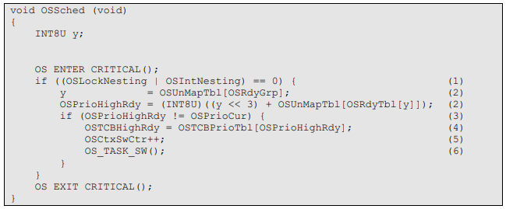
Task Scheduling
µC/OS-II always executes the highest priority task ready to run.
The determination of which task has the highest priority and thus, which task will be next to run is determined by the scheduler.
Task level scheduling is performed by OSSched().
ISR level scheduling is handled by another function (OSIntExit()).
The code for OSSched() is shown in Listing 3.8.

Slide 40
µC/OS-II's task scheduling time is constant irrespective of the number of tasks created in an application.
OSSched() exits if called from an ISR (i.e. OSIntNesting > 0) or if scheduling has been disabled because your application called OSSchedLock() at least once (i.e. OSLockNesting > 0) .
If OSSched() is not called from an ISR and the scheduler is enabled then OSSched() determines the priority of the highest priority task that is ready to run L3.8(2).
task that is ready to run has its corresponding bit set in OSRdyTbl[].
Once the highest priority task has been found, OSSched() verifies that the highest priority task is not the current task. This is done to avoid an unnecessary context switch L3.8(3). Note that µC/OS used to obtain OSTCBHighRdy and compared it with OSTCBCur.

Slide 41
On 8 and some 16-bit processors, this operation was relatively slow because comparison was made on pointers instead of 8-bit integers as it is now done in µC/OS-II.
Also, there is no point of looking up OSTCBHighRdy in OSTCBPrioTbl[] unless we actually need to do a context switch.
The combination of comparing 8-bit values instead of pointers and looking up OSTCBHighRdy only when needed should make µC/OS-II faster than µC/OS on 8 and some 16-bit processors.
To perform a context switch, we need to have OSTCBHighRdy point to the OS_TCB of the highest priority task which is done by indexing into OSTCBPrioTbl[] using OSPrioHighRdy L3.8(4).
Next, the statistic counter OSCtxSwCtr is incremented to keep track of the number of context switches L3.8(5).
Finally, the macro OS_TASK_SW() is invoked to do the actual context switch L3.8(6).

Slide 42
Intertask Communication
µC/OS-II provides many mechanisms to protect shared data and provide intertask communication.
We have already seen two such mechanisms: 1) Disabling and enabling interrupts through the two macros
OS_ENTER_CRITICAL() and
OS_EXIT_CRITICAL(), respectively.
2) Locking and unlocking µC/OS-II’s scheduler with
OSSchedLock() and
OSSchedUnlock(), respectively.
Again, you use these services to access shared data.

Slide 43
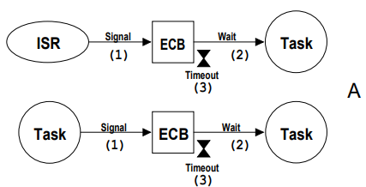
Figure 6-1 shows how tasks and Interrupt Service Routines (ISRs) can interact with each other.
A task or an ISR give signal to a task through a kernel object called an Event Control Block (ECB). This signal is considered to be an event.
Case 1) Use of the event control block - Task and ISR
Fig. F6- 1A 2 shows that a task can wait for another task or an ISR to signal the object.
Only tasks are allowed to wait for events to occur – an ISR is not allowed to wait on an ECB.
Figure 6-1, Use of Event Control Blocks.

Slide 44
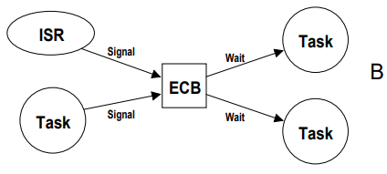
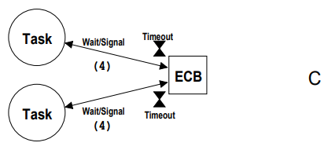
Case 2) Use of the event control block (ECB) - Multiple tasks
Multiple tasks can wait for a task
or an ISR to signal an ECB
When the ECB is signaled, only the
highest priority task waiting on the
ECB will be ‘signaled’ and thus will
be made ready-to-run.
---------------------------------------------------------------------------------------
Note: An ECB can either be a semaphore,
a message mailbox or a message
queue.
When an ECB is used as a
semaphore, tasks will both
wait and signal the ECB
Refer F6- 1C(4).

Slide 45
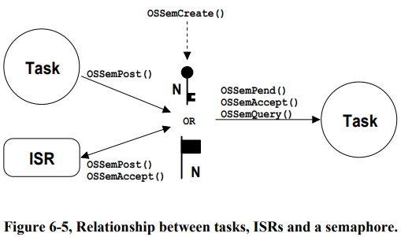
Synchronization: Intertask Communication A. Semaphore
μC/OS-II's semaphores consist of two elements:
1. a 16-bit unsigned integer used to hold the semaphore count (0 to 65535), and
2. a list of tasks waiting for the semaphore count to be greater than 0.
To enable µC/OS-II’s semaphore services, you must set the configuration constant OS_SEM_EN to 1.

Slide 46
µC/OS-II provides five services to access semaphores:
OSSemCreate() - Creating a Semaphore
OSSemPend() - Waiting on a Semaphore
OSSemPost(), - Signaling a Semaphore,
OSSemAccept() - Getting a Semaphore without waiting
OSSemQuery() - Obtaining the status of a semaphore
Figure 6-5 shows a flow diagram to illustrate the relationship between tasks, ISRs and a semaphore.

Slide 47
A semaphore needs to be created before it can be used OSSemCreate() .
Specifying the initial count of the semaphore between 0 and 65535.
If you use the semaphore to signal the occurrence of one or more events then you would typically initialize the semaphore to 0.
If you use the semaphore to access a shared resource then you would initialize the semaphore to 1 (i.e. use it as a binary semaphore).
Finally, if the semaphore allows your application to obtain any one of ‘n’ identical resources then, you would initialize the semaphore to ‘n’.
The semaphore would then be used as a counting semaphore.

Slide 48
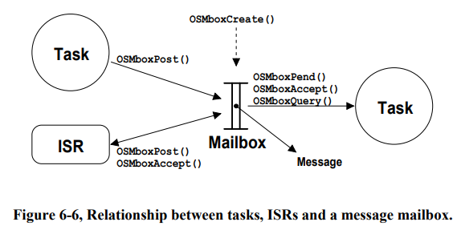
B. Message Mailboxes (i.e. Mailboxes)
A message mailbox allows a task or an ISR to send a pointer size variable to another task.
The pointer would typically be initialized to point to some application specific data structure containing a ‘message’.
To enable µC/OS-II’s message mailbox services, you must set the configuration constant OS_MBOX_EN to 1.
Figure 6-6 shows a flow diagram to illustrate the relationship between tasks, ISRs and a message mailbox.

Slide 49
µC/OS-II provides five services to access mailboxes:
OSMboxCreate() - Creating a Mailbox
OSMboxPend() - Waiting for a message at a Mailbox
OSMboxPost() - Sending a message to a mailbox
OSMboxAccept() - Getting a message without waiting
OSMboxQuery() - Obtaining the status of a mailbox

Slide 50
C. Message Queues (or Queues )
A message queue is a μC/OS-II object that allows a task or an ISR to send pointer size variables to another task.
Each pointer would typically be initialized to point to some application specific data structure containing a ‘message’.
To enable µC/OS-II’s message queue services set the configuration constant OS_Q_EN to 1
The number of µC/OS-II message queues are determined.
A queue needs to be created before it can be used.
Creating a queue is accomplished by calling OSQCreate() and specifying the number of entries (i.e. pointers) that a queue can hold.

Slide 51
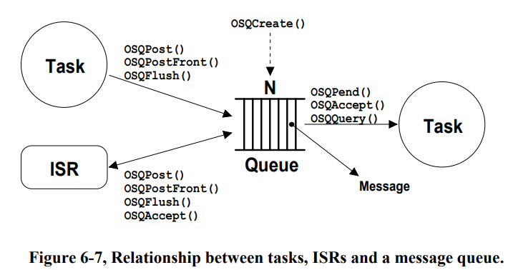

Slide 52
Creating a Queue, OSQCreate()
OSQCreate() requires that you allocate an array of pointers that will hold the message. The array MUST be declared as an array of pointers to void.
2. Waiting for a message at a Queue, OSQPend()
OSQPend() verifies that the ECB being pointed to by pevent has been created by OSQCreate()
Sending a message to a queue (FIFO), OSQPost()
After making sure that the queue, OSQPost() checks to see if any task is waiting for a message to arrive at the queue.
4. Sending a message to a queue (LIFO), OSQPostFront()
OSQPostFront() is basically identical to OSQPost() except that OSQPostFront() uses .OSQOu of .OSQIn as the pointer to the next entry to insert.
5. Getting a message without waiting, OSQAccept()
It is possible to obtain a message from a queue without putting a task to sleep if the queue is empty.
This is accomplished by calling OSQAccept()

Slide 53
UNIT 4 ENDS

