Slide 1
Overview of IOT
Mrs. D.K. Magdum

Slide 2
Basic definition of IOT
Internet technology connecting devices, machines and tools to the internet by means of wireless technologies
Unification of technologies such as low power embedded systems, cloud computing, big data, machine learning and networking
IOT is a network of physical objects that contain embedded technology to communicate and sense or interact with their internal states or the external environment
Internet of things (IOT) is a network of physical objects.
A dynamic global network infrastructure with self- configuring capabilities based on standard and interoperable communication protocols where physical and virtual things have identities, physical attributes and use intelligent interfaces and communicate data associated with users and their environments

Slide 3
Need of IOT
In a nutshell IoT wants to connect all potential objects to interact each other on the internet to provide secure, comfort life for human .
More data means better decisions
Ability to track and monitor things
Lighten the workload with automation
Increases efficiency by saving money and resources
Better quality of life
Environmental Monitoring:
Infrastructure management
Industrial applications
Building and home automation
Transport system

Slide 4
Characteristics of IOT
Dynamic and Adapting: IOT devices and systems may have the capability to dynamically adapt with the changing contexts and take actions based on their operating conditions or sensed environment.
  Eg: Surveillance cameras can adapt their modes based on day and night. Cameras can switch from lower resolution to higher resolution modes when any motion is detected and alert nearby cameras to do the same
Self-configuring: IOT devices may have self-configuring capability, allowing a large number of devices to work together to provide certain functionality(weather monitoring).
  These devices have the ability configure themselves, setup the networking and fetch fastest software upgrades with minimal manual or user intervention.
Interoperable communication protocol: IOT devices may support a number of interoperable communication protocols and can communicate with other devices and also with the interface.

Slide 5
Continued`
Unique identity: Each IOT device has a unique identity and a unique identifier(IP address or a URI). IOT systems may have intelligent interfaces which adapt based on the context, allow communicating with users and the environmental contexts.
  IOT device interfaces allow users to query the devices, monitor their status and control them remotely.
Integrated into information network: IOT devices are usually integrated into the information network that allows them to communicate and exchange data with other devices and systems.
Communication: Devices get connected so they can communicate data and this data can be analyzed. Communication can occur over short distances or over a long range to very long range.
Connectivity: Connectivity empowers Internet of Things by bringing together everyday objects. It enables network accessibility and compatibility in the things.

Slide 6
Continued
Heterogeneity: Devices in IoT are based on different hardware platforms and networks and can interact with other devices or service platforms through different networks. IoT architecture should support direct network connectivity between heterogeneous networks.
Security: IoT devices are naturally vulnerable to security threats. There is a high level of transparency and privacy issues with IoT. It is important to secure the endpoints, the networks, and the data that is transferred across.
Enormous scale: The number of devices that need to be managed and that communicate with each other will be at least an order of magnitude larger than the devices connected to the current Internet.
There should be service-based interaction between objects which means if there are two or more objects in vicinity or in contact – they should be able to communicate directly with each other and exchange information and data if necessary.

Slide 7
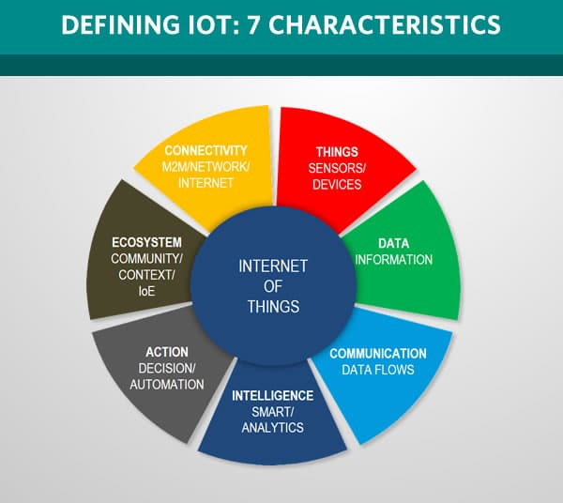
Characteristics of IOT

Slide 8
Client-server architecture
Client-server architecture is a network architecture in which each node (computer or device) on the network is either a client or a server. Clients are the nodes on the network that consume services provided by the servers. The client nodes need not be as powerful as servers
https://www.hindawi.com/journals/jece/2017/9324035/

Slide 9
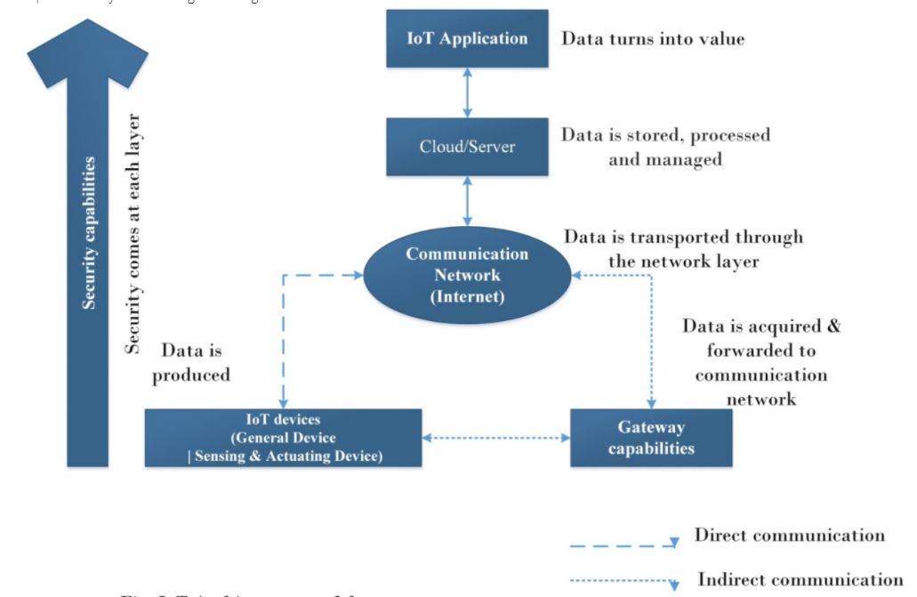
Technical building blocks of IOT

Slide 10
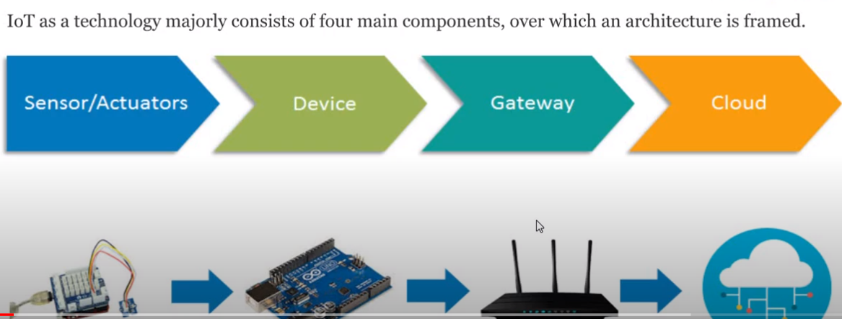
IOT Architecture

Slide 11
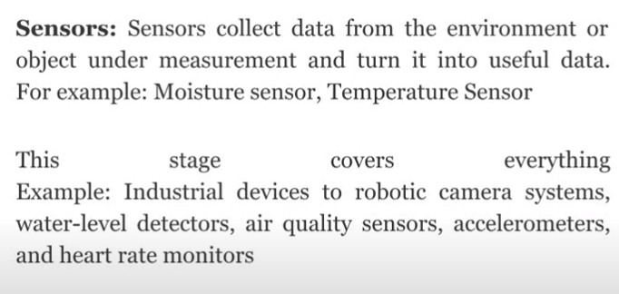
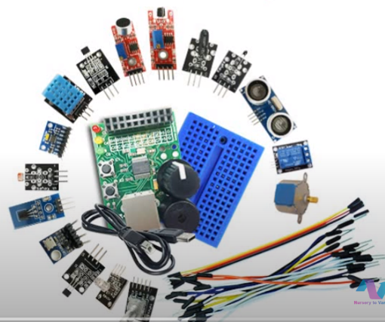
Stage 1 - Sensors

Slide 12
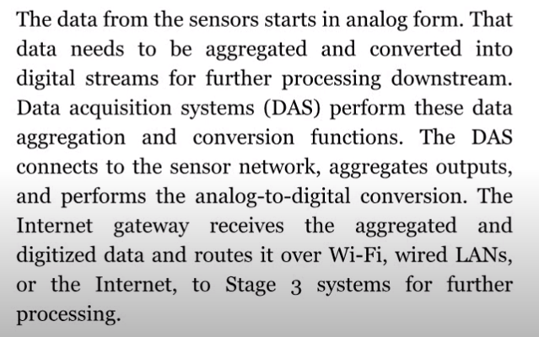
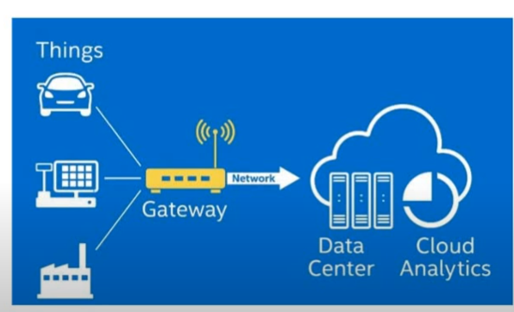
Stage 2 – Internet Gateways

Slide 13
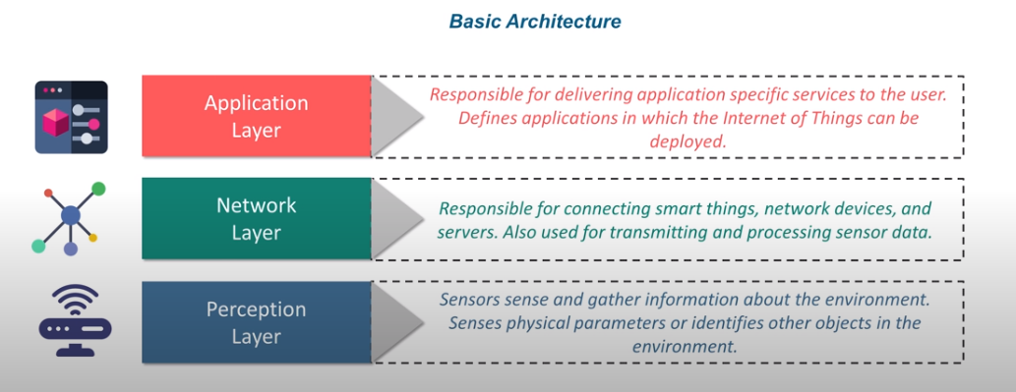
Basic Architecture

Slide 14
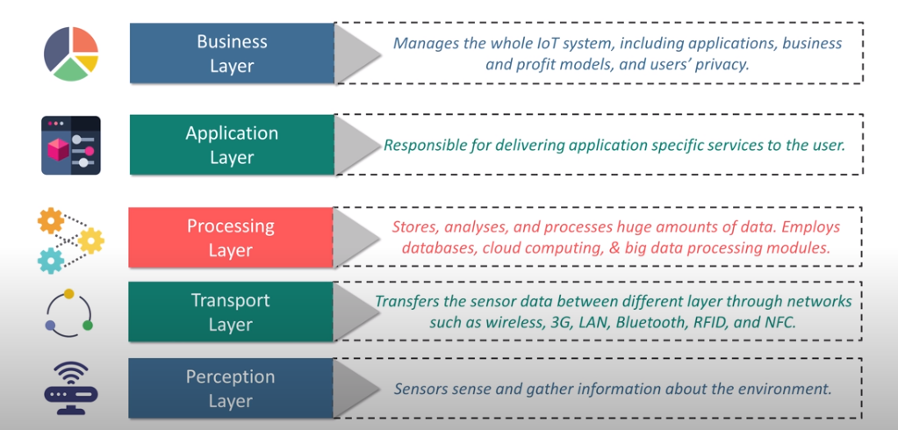
5 Layer Architecture

Slide 15
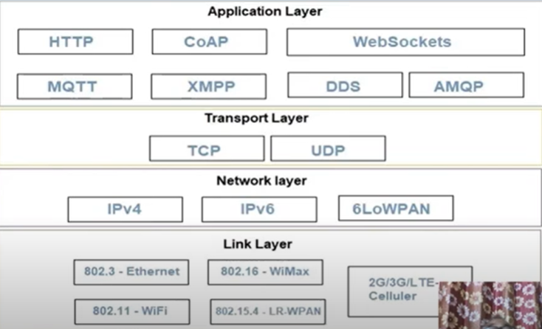
Physical design of IOT

Slide 16
Physical Design of IOT
Link Layer
802.11 - Wifi
802.16 – WiMax
Network/ Internet Layer
IPv4 – Internet Protocol version 4
IPv6 - Internet Protocol version 6
2G/ 3G/ 4G – Mobile Communication
6LoWPAN – IPv6 over Low power Wireless Personal Area Network

Slide 17
continued
Transport Layer
TCP – Transmission Control Protocol
Application Layer
HTTP – Hypertext Transfer Protocol
UDP – User Datagram Protocol
CoAP – Constrained Application Protocol
MQTT – Message Queue Telemetry Transport

Slide 18
Layers of IOT
Link Layer:
Determines how the data is physically sent over the networks physical layer or medium(copper wire, coaxial cable or radio waves)
Determines how the packet are coded and signalled by the hardware device over the medium
802.11 – Wifi – collection of wireless local area network communication standards
802.16 – WiMax - collection of wireless broadband standards
2G/ 3G/ 4G – Mobile Communication

Slide 19
continued
Network Layer:
Are responsible for sending of IP datagrams from the source network to the destination network
This layer performs the host addressing and packet routing
The datagram contains the source and destination addresses which are used to route them from the source to destination across multiple networks
IPv4
IPv6
6LoWPAN

Slide 20
continued
Transport Layer
Provides end to end message transfer capability independent of underlying network
The message transfer capability can be set up on connections, either using handshaking or without handshaking
TCP - Transmission Control Protocol – used by web browser, email programs, file transfer
UDP - User Datagram Protocol

Slide 21
continued
Application Layer:
Defines how the applications interface with the lower layer protocols to send the data over the network.
Enables process to process connections using ports
HTPP – Hypertext Transfer Protocol that forms the foundation of the
world wide web
CoAP – constrained Application Protocol for M2M applications
MQTT – Message Queue Telemetry Transport which is messaging
protocol

Slide 22
Logical design of IOT
IOT Functional Blocks:
1. Device – sensing, actuation, monitoring and control functions
2. Communication – Handles the communication for the IOT
Request Response / publish Subscribe
3. Services – Services for device monitoring, device control services,
data publishing services and services for device discovery
4. Management - Functions to govern the IOT system

Slide 23
continued
5. Security – Secures the IOT systems and providing functions such as
authentication, authorization, message and content integrity and data security
6. Application – An interface that the users can use to control and monitor various aspects of the IOT systems
Also allows users to view the system status and view or analyze the processed data

Slide 24
Functional Blocks of IOT
Application
Management
Services
Security
Communication
Device

Slide 25
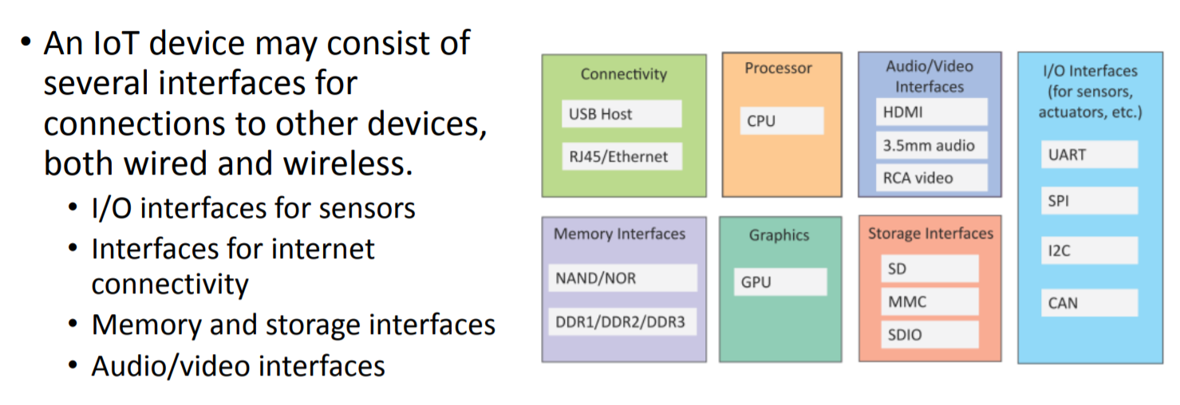
Generic Block diagram of IOT

Slide 26
P2P (peer to peer)
A P2P (peer to peer) connection is a direct communication infrastructure between two peers:
  a client device (such as a smartphone or a laptop) and an IoT device (such as a surveillance camera, smart door lock, alarm system, heat controller, or anything else that can connect to the internet).
The peer-to-peer computing architecture contains nodes that are equal participants in data sharing. All the tasks are equally divided between all the nodes. The nodes interact with each other as required to share resources.
Here each computer acts as a node for file sharing within the formed network. Here each node acts as a server and thus there is no central server to the network.
This allows the sharing of a huge amount of data. The tasks are equally divided amongst the nodes. Each node connected in the network shares an equal workload.
For the network to stop working, all the nodes need to individually stop working. This is because each node works independently.

Slide 27
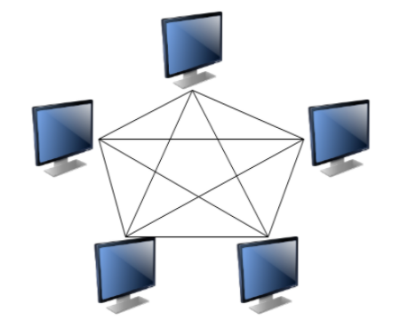
Peer to Peer Computing

Slide 28
Characteristics of Peer to Peer Computing
The different characteristics of peer to peer networks are as follows −
Peer to peer networks are usually formed by groups of a dozen or fewer computers. These computers all store their data using individual security but also share data with all the other nodes.
The nodes in peer-to-peer networks both use resources and provide resources. So, if the nodes increase, then the resource sharing capacity of the peer-to-peer network increases. This is different than client-server networks where the server gets overwhelmed if the nodes increase.
Since nodes in peer-to-peer networks act as both clients and servers, it is difficult to provide adequate security for the nodes. This can lead to denial of service attacks.
Most modern operating systems such as Windows and Mac OS contain software to implement peer-to-peer networks.

Slide 29
Advantages and disadvantages of Peer to Peer Computing
Some advantages of peer to peer computing are as follows −
Each computer in the peer-to-peer network manages itself. So, the network is quite easy to set up and maintain.
In the client-server network, the server handles all the requests of the clients. This provision is not required in peer-to-peer computing and the cost of the server is saved.
It is easy to scale the peer-to-peer network and add more nodes. This only increases the data-sharing capacity of the system.
None of the nodes in the peer to peer network are dependent on the others for their functioning
Some disadvantages of peer to peer computing are as follows −
It is difficult to back up the data as it is stored in different computer systems and there is no central server.
It is difficult to provide overall security in the peer-to-peer network as each system is independent and contains its own data.

Slide 30
Machine-to-Machine(M2M)
M2M- Networking of machines(or devices) for the purpose of remote monitoring and control and data exchange.
Features:
Large number of nodes or devices.
Low cost.
Energy efficient.
Small traffic per machine/device.
Large quantity of collective data.
M2M communication free from human intervention.
Architecture of M2M consists of
M2M area networks
Communication network
Application domains

Slide 31
M2M area networks
Comprises of machines which are embedded hardware module for sensing, actuation and communication.
Communication protocols provide connectivity between M2M nodes within an M2M area network.
Various communication protocols used for M2M local area network are
Zigbee
Bluetooth
M- bus
Wireless M- bus
Power line communication(PLC)
Modbus

Slide 32
Communication network
Communication network can use either wired or wireless networks(IP based) while M2M area network use either proprietary or non-IP based Communication protocols.
Since non-IP based protocols are used in M2M area network , the M2M nodes within one network cannot communicate with nodes in an external network.
To enable the communication between remote M2M area network , M2M gateways are used.

Slide 33
M2M Gateway
The communication between the M2M nodes and the M2M gateway is based on communication protocol which are native to the M2M area network.
M2M gateway performs protocol translations to enable IP-connectivity for M2M area networks.
M2M gateway acts as a proxy performing translations from/ to native protocols to/from IP.
With M2M gateway , each node in an M2M area network appears as a virtualized node for external M2M area networks.

Slide 34
M2M Applications
The M2M data is gathered into point solutions such as enterprise applications, service management applications, or remote monitoring applications.
M2M has various application domains such as
Smart Metering
Home Automation
Industrial Automation
Smart grids, etc.

Slide 35
Difference between M2M and IOT
M2M
IOT
It is about direct machine to machine communication
It supports point to point communication
Device not necessary relay on internet
It is mostly based on hardware
Machine normally communicates with single machine at a time
It uses either proprietary or non IP based protocols
Limited number of devices can be connected at a time
It is less scalable
It is about sensor automation and internet platform
It supports cloud based communication
Device necessary relay on internet
It is based on both hardware and software
Many users can access at a time over internet
It uses IP based protocols
More number of devices can be connected at a time
It is more scalable

Slide 36
IOT Framework
A high level M2Msystem architecture (HLSA) comprises of the device and gateway domain, the network domain, and the applications domain.
The device and gateway domain is composed of the following elements:
M2Mdevice: A device that runs M2M application(s) using M2M service capabilities.
M2M devices connect to network domain in the following manners:
Case 1 “Direct Connectivity”: M2Mdevices connect to the network domain via the access network. The M2M device performs the procedures such as registration, authentication, authorization, management, and provisioning with the network domain. The M2M device may provide service to other devices (e.g., legacy devices) connected to it that are hidden from the network domain.
Case 2 “Gateway as a Network Proxy”: The M2M device connects to the network domain via an M2M gateway. M2M devices connect to the M2M gateway using the M2M area network. The M2M gateway acts as a proxy for the network domain toward the M2M devices that are connected to it.

Slide 37
continued
The network domain is composed of the following elements:
1. Access network: A network that allows the M2M device and gateway domain to communicate with the core network. Access networks include (but are not limited to) digital subscriber line (xDSL), hybrid fiber coax (HFC), satellite, GSM/EDGE radio access network (GERAN), UMTS terrestrial radio access network (UTRAN), W-LAN, and worldwide interoperability for microwave access (WiMAX).
2. Core network: A network that provides the following capabilities (different core networks offer different features sets):
– IP connectivity at a minimum, and possibly other connectivity means
– Service and network control functions
– Interconnection (with other networks)
– Roaming

Slide 38
continued
The applications domain is composed of the following elements:
1. M2M applications: Applications that run the service logic and use M2M service capabilities accessible via an open interface.
There are also management functions within an overall M2M service provider domain, as follows:
Network management functions: Consists of all the functions required to manage the access and core networks; these functions include provisioning, supervision, fault management.
2. M2M management functions: Consists of all the functions required to manage M2Mservice capabilities in the network domain.

Slide 39
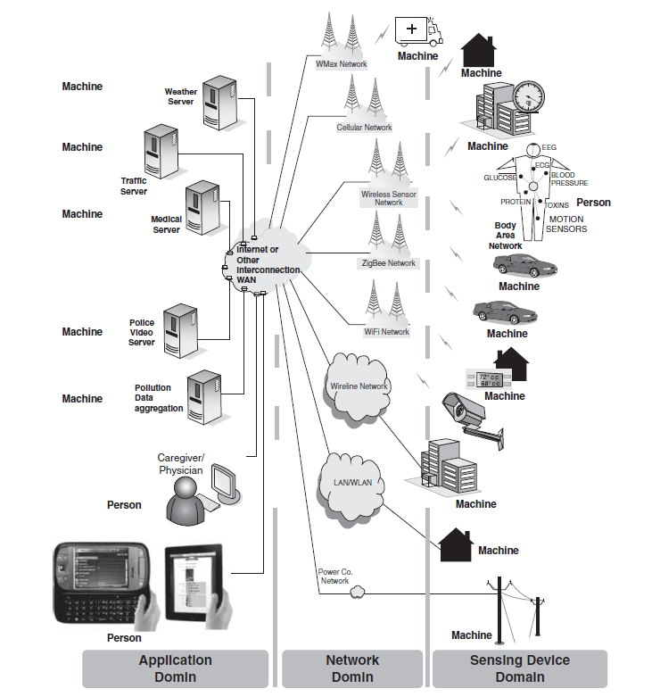

Slide 40
Hardware and Software platforms for development
https://www.intuz.com/blog/top-iot-development-platforms-and-tools

Slide 41
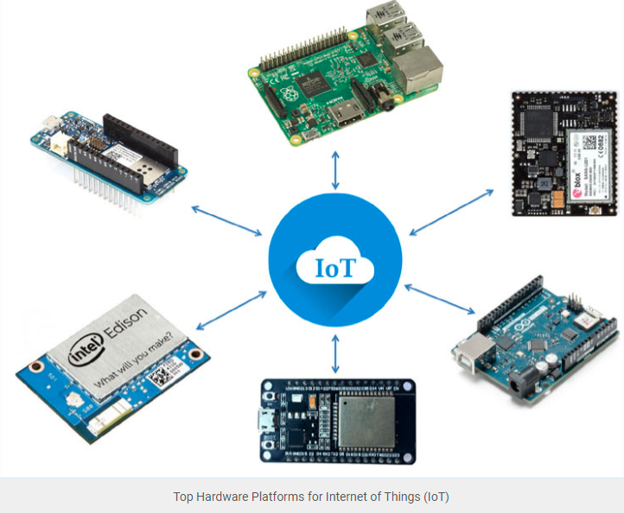

Slide 42
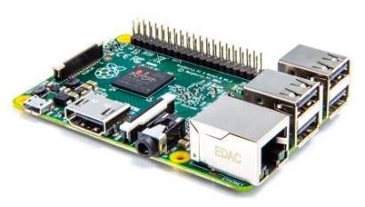
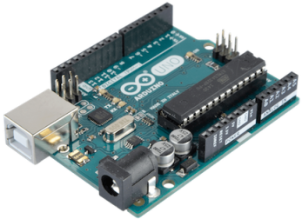
Raspberry Pi and Arduino:
The Raspberry Pi is a Single Board Computer developed by Raspberry Pi Foundation. It is widely popular as a small, inexpensive computing board among experimenters, hobbyists, educators, and technology enthusiasts.
Arduino is an open-source prototyping platform based on easy-to-use hardware and software. Arduino boards are able to read inputs – light on a sensor, a finger on a button, or a Twitter message – and turn it into an output – activating a motor, turning on an LED, publishing something online.

Slide 43
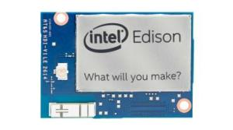
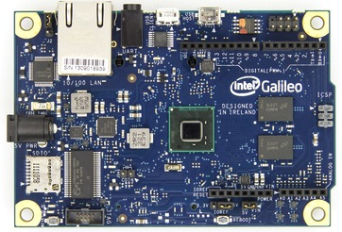
Intel Edison and Intel Galileo
Intel Edison is a tiny development platform featuring an Intel Atom CPU and 32 bit Intel Quark microcontroller. This tiny board carries all Wi-Fi and Bluetooth modules for connectivity and thus requires no external modules to do so. Also, it carries other features such as UART, SPI, I2C, I2S, GPIO, and SD card support.
Galileo is a microcontroller board based on the Intel® Quark SoC X1000 Application Processor, a 32-bit Intel Pentium-class system on a chip
It’s the first board based on Intel® architecture designed to be hardware and software pin-compatible with Arduino shields designed for the Uno R3.

Slide 44
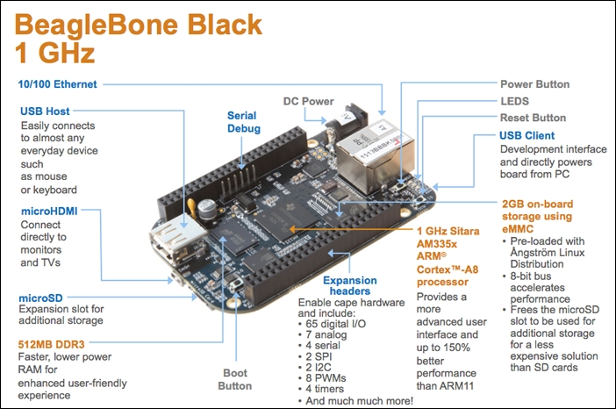
Beagle Bone
BeagleBone Black is a low-cost, community-supported development platform for developers and hobbyists.
The Beaglebone Black is open-source hardware, t's based on the Texas Instruments(TI) Sitara AM335- a SOC application processor with ARM Cortex A8 processor. It comes with a 512 RAM.
It uses python to control the pins.

Slide 45
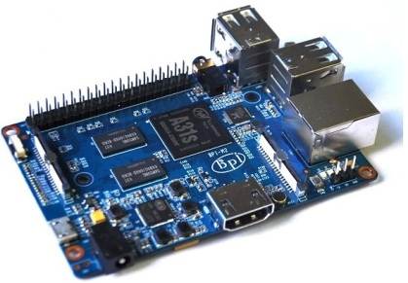
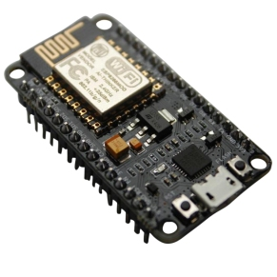
Banana Pi and Node MCU Dev Kit
:
Banana Pi is a single-board computer. Banana Pi targets to be a cheap, small, and flexible enough computer for daily life. Built with ARM Cortex-A7 Dual-core CPU and Mali400MP2 GPU, and open-source software, Banana Pi can serve as a platform to make lots of applications for different purposes.
NodeMCU Development Kit is based on ESP8266 WiFi Chip, it integrates GPIO, PWM, IIC, 1-Wire, and ADC all in one board. You can top it up with NodeMCU firmware to speed up your development process.

Slide 46
Challenges in IOT
Security challenges in IoT :
Lack of encryption
Insufficient testing and updating
Brute forcing and the risk of default passwords
IoT Malware and ransomware
Design challenge in IoT
Battery life is a limitation
Increased cost and time to market
Security of the system

Slide 47
Challenges in IOT
Deployment challenges in IoT:
  Connectivity
  Cross platform capability
  Data collection and processing
  Lack of skillset
Compatibility Challenges
Bandwidth Challenges
Customer Expectation Challenges
https://www.geeksforgeeks.org/challenges-in-internet-of-things-iot/
https://www.coderus.com/iot-challenges-and-opportunities/
https://www.iot-now.com/2020/06/03/103228-5-challenges-still-facing-the-internet-of-things/

Slide 48
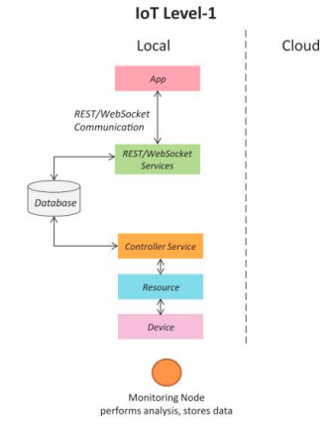
IOT Level-1
A level-1 IoT system has a single node/device that performs sensing and/or actuation, stores data, performs analysis and hosts the application
Level-1 IoT systems are suitable for modeling low- cost and low-complexity solutions where the data involved is not big and the analysis requirements are not computationally intensive.

Slide 49
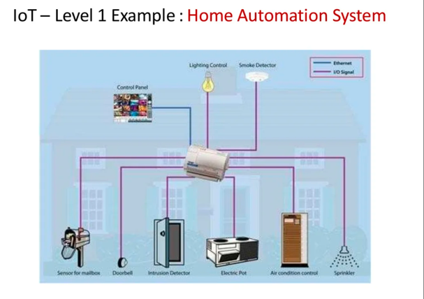

Slide 50
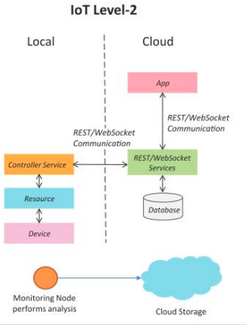
IOT Level-2
A level-2 IoT system has a single node that performs sensing and/or actuation and local analysis.
Data is stored in the cloud and the application is usually cloud-based.
Level-2 IoT systems are suitable for solutions where the data involved is big, however, the primary analysis requirement is not computationally intensive and can be done locally itself.

Slide 51
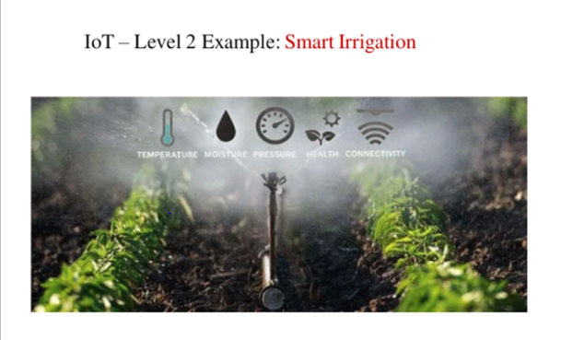

Slide 52
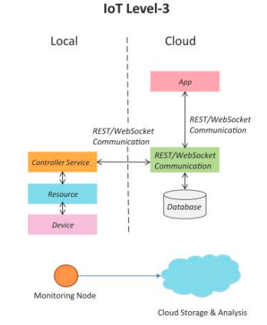
IOT Level-3
A level-3 IoT system has a single node. Data is stored and analyzed in the cloud and application is cloud-based.
Level-3 IoT systems are suitable for solutions where the data involved is big and the analysis requirements are computationally intensive.

Slide 53
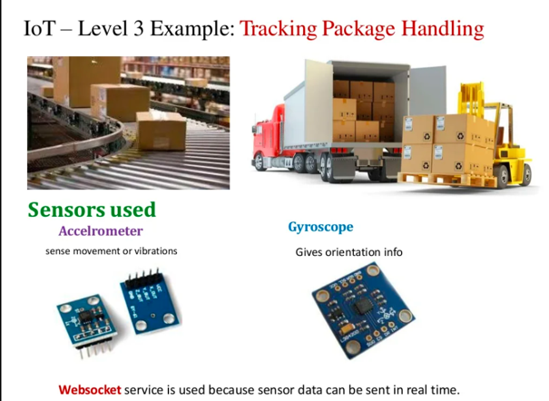

Slide 54
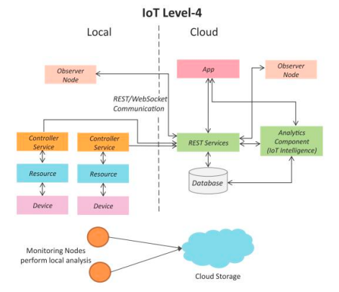
IOT Level-4
A level-4 IoT system has multiple nodes that perform local analysis. Data is stored in the cloud and application is cloud-based.
Level-4 contains local and cloud- based observer nodes which can subscribe to and receive information collected in the cloud from IoT devices.
Level-4 IoT systems are suitable for solutions where multiple nodes are required, the data involved is big and the analysis requirements are computationally intensive.

Slide 55
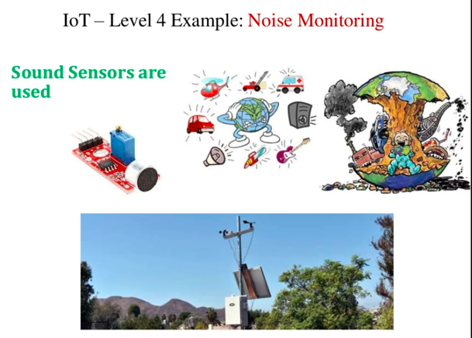

Slide 56
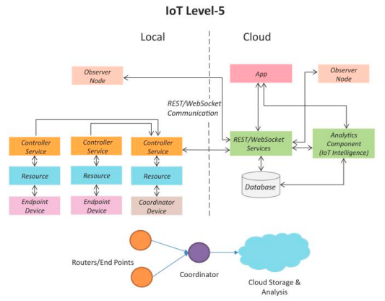
IOT Level-5
A level-5 IoT system has multiple end nodes and one coordinator node.
The end nodes that perform sensing and/or actuation.
Coordinator node collects data from the end nodes and sends it to the cloud.
Data is stored and analyzed in the cloud and the application is cloud-based.
Level-5 IoT systems are suitable for solutions based on wireless sensor networks, in which the data involved is big and the analysis requirements are computationally intensive.

Slide 57
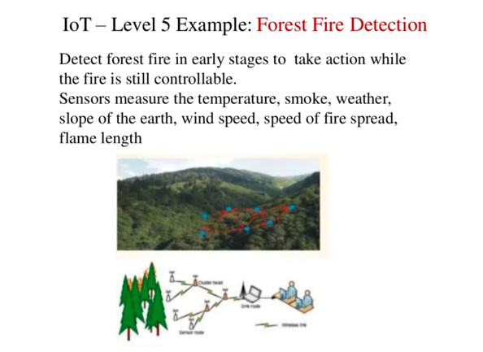

Slide 58
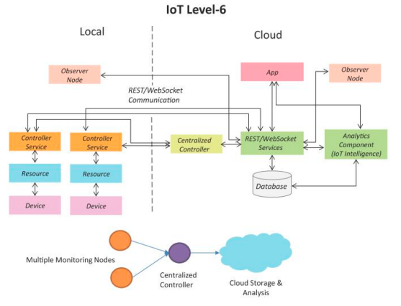
IOT Level-6
A level-6 IoT system has multiple independent end nodes that perform sensing and/or actuation and send data to the cloud.
Data is stored in the cloud and the application is cloud-based.
The analytics component analyzes the data and stores the results in the cloud database.
The results are visualized with the cloud-based application.
The centralized controller is aware of the status of all the end nodes and sends control commands to the nodes.

Slide 59
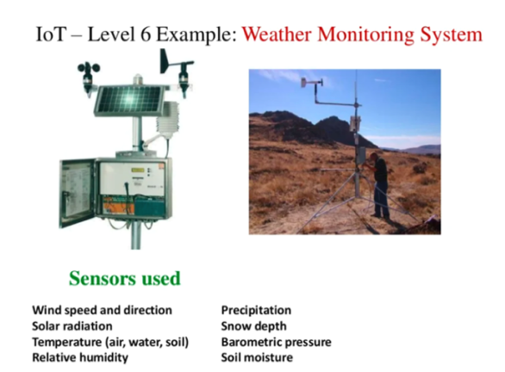

Slide 60
Thank You

