Slide 1
RAJARSHI SHAHU COLLEGE OF ENGINEERING
TATHAWADE, PUNE-33
(An Autonomous Institute Affiliated to Savitribai Phule Pune
University, Pune)
T. Y. B. Tech (E&TC Engineering)
Academic Year – 2024-2025 Semester -VI
[EC3108]: Embedded and Real Time Operating Systems

Slide 2
Teaching Scheme: TH: - 4 Hours/Week
LAB: - 2Hours/Week
Credits TH:4 LAB:1
Examination Scheme:
In Sem. Evaluation :15 Marks
Mid Sem. Exam : 25 Marks
End Sem. Exam : 60 Marks
LAB Evaluation :50 Marks

Slide 3
Course Objective:
This Course will give the insights of architecture, instruction set and programming
aspects of ARM Processor.
It also provides basics of operating systems, terms related to real time operating systems,
features and its applications.
Course Outcome:
After successful completion of the course, students will able to:
CO1: Describe the basic concepts of embedded systems.
CO2: Demonstrate the functional blocks in ARM7 LPC2148 microcontroller.
CO3: Analyze various features of RTOS functions in embedded systems applications.
CO4:State the features and describe the services provided by µC/OS-II.
CO5: Explain tools and drivers used in Embedded Linux.
CO6: Illustrate host and target configuration and applications of embedded software.

Slide 4
COURSE CONTENTS
UNIT-I Introduction to Embedded Systems
07 Hours
Definition of Embedded System
Embedded Systems Vs General Computing Systems
Major Application Areas of E.S.
Purpose of Embedded Systems
Characteristics and Quality Attributes of Embedded Systems
ARM Design
Philosophy
Embedded System models and Development Cycle

Slide 5
Text Books:
T1. Jean J.Labrosse, MicroC OS II, The Real-Time Kernel, 2nd edition, CMP Books.
T2. Christopher Hallinan, “Embedded Linux Primer -A Practical, Real-World Approach ”2nd edition, Prentice Hall.
Reference Books:
R1. Steve Furber, ― ARM System-On-Chip Architecture, Second Edition, Pearson Publisher, 2015.
R2. Embedded Systems: Architecture, Programming and design, Raj Kamal, Second Edition, Tata McGraw Hill publisher, 2010

Slide 6
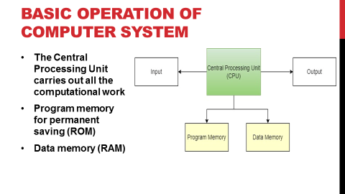
Course Pre-requisites:
Microprocessor & Microcontroller concepts and applications.
Assembly language concepts.
C programming.
Computer architecture and operating system.

Slide 7
Definition of Embedded System (Use Rajkamal)
An Electronic / Electro-mechanical system which is designed to perform a specific function and is a combination of both hardware and firmware (Software)
e.g. Electronic Toys, Mobile Handsets, Washing Machines, Air Conditioners, Automotive Control Units, Set Top Box, DVD Player etc…
Embedded Systems are:
Unique in character and behavior.
With specialized hardware and software.

Slide 8
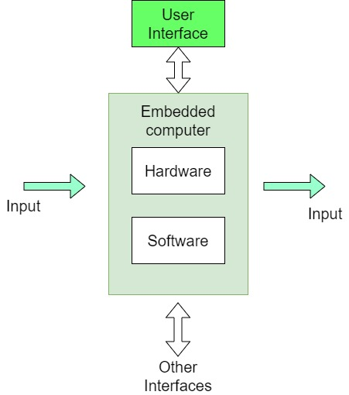
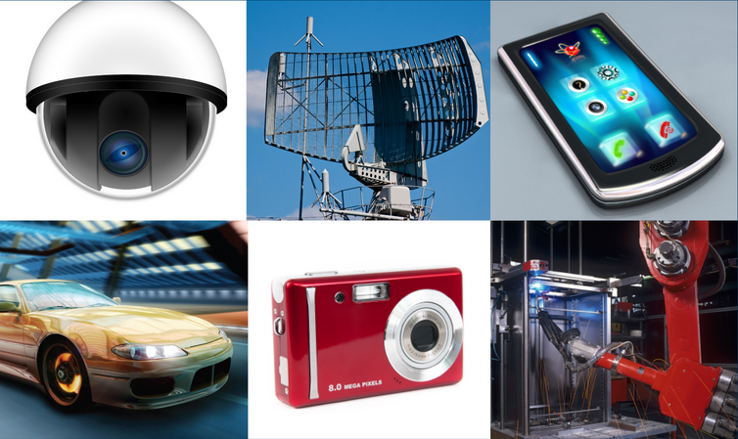
Generally hidden

Slide 9
Major Application Areas of Embedded Systems:
Consumer Electronics: Camcorders, Cameras etc.
Household Appliances: Television, DVD players, washing machine, Fridge, Microwave Oven etc.
Home Automation and Security Systems: Air conditioners, sprinklers, Intruder detection alarms, Closed Circuit Television Cameras, Fire alarms etc.
Automotive Industry: Anti-lock breaking systems (ABS), Engine Control, Ignition Systems,
Automatic Navigation Systems etc.
Telecom: Cellular Telephones, Telephone switches, Handset Multimedia Applications etc.
Computer Peripherals: Printers, Scanners, Fax machines etc.

Slide 10
Computer Networking Systems: Network Routers, Switches, Hubs, Firewalls etc.
Health Care: Different Kinds of Scanners, EEG, ECG Machines etc.
Measurement & Instrumentation: Digital multi meters, Digital CROs, Logic Analyzers PLC systems etc.
Banking & Retail: Automatic Teller Machines (ATM) and Currency counters, Point of Sales (POS)
Card Readers: Barcode, Smart Card Readers, Hand held Devices etc.

Slide 11
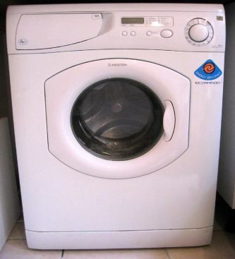
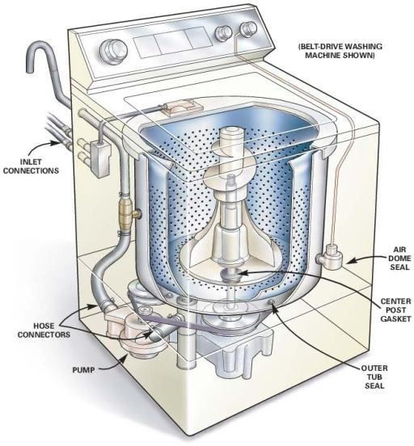
EMBEDDED SYSTEM EXAMPLE
WASHING MACHINE
It is an automatic clothes washing system.
Parts: Status display panel, Switches & Dials, Motor, Power supply & control unit, Inner water level sensor and solenoid valve.
Rules
1.Wash by spinning 2.Rinse
Drying
Wash over by blinking
Each step display the process stage
In case interruption, execute only the remaining
11

Slide 12
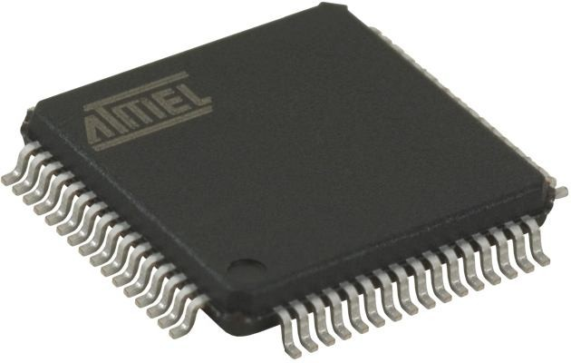
EMBEDDED SYSTEM
Definition: An Embedded System is one that has computer hardware with software embedded in it as
one of its important components.
Its software embeds in
ROM (Read Only Memory). It does not need secondary memories as in a computer
SOFTWARE PROGRAM
#include <16f876a.h>
#use delay (clock=20000000) #byte PORTB=6
main()
{
set_tris_b(0);
portb=255; //decimal
HARDWARE
delay_ms(1000); portb=0x55; delay_ms(1000);
//hexadecimal
portb=0b10101010; //binary delay_ms(500);
}
6

Slide 13
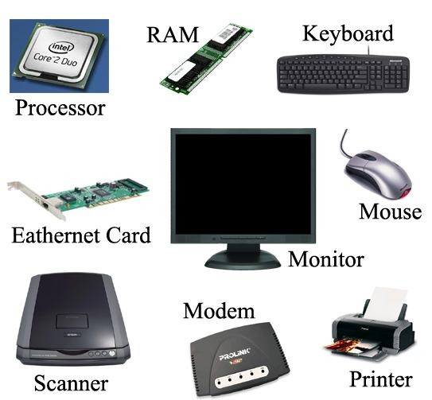
COMPUTER HARDWARE
A Microprocessor
A Large Memory
(Primary and Secondary)
(RAM, ROM and caches)
Input Units
(Keyboard, Mouse, Scanner, etc.)
Output Units
(Monitor, printer, etc.)
Networking Units
(Ethernet Card, Drivers, etc.)
I/O Units
(Modem, Fax cum Modem, etc.)

Slide 14
COMPONENTS OF EMBEDDED SYSTEM
It has Hardware
Processor, Timers, Interrupt controller, I/O Devices, Memories, Ports, etc.
It has main Application Software
Which may perform concurrently the series of tasks or multiple tasks.
It has Real Time Operating System (RTOS)
RTOS defines the way the system work. Which supervise the application software. It sets the rules during the execution of the application program. A small scale embedded system may not need an RTOS.

Slide 15
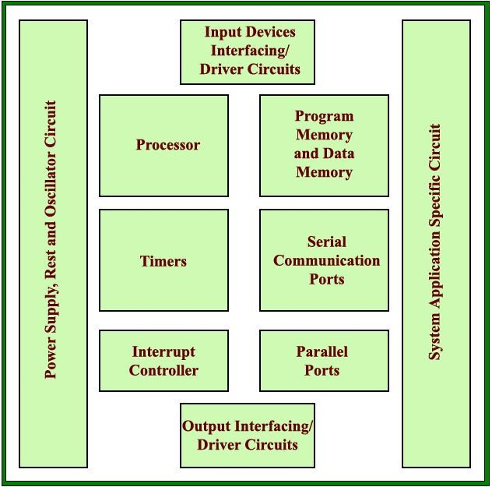
EMBEDDED SYSTEM HARDWARE

Slide 16
Processor technology
The architecture of the computation engine used to implement a system’s desired functionality
Processor does not have to be programmable
– “Processor” not equal to general-purpose processor
Controller
Datapath
Controller
Datapath
Controller
Datapath index total +
Data memory
Control logic and State register
IR |  |  | PC
Register file
General ALU
Control logic and State register
IR |  |  | PC
Registers
Custom ALU
Control logic
State register
Data memory
Program memory
Assembly code
Data memory
Program memory
Assembly code for:
total = 0
for i =1 to …
for:
total = 0
for i =1 to …
General-purpose (“software”)
Application-specific
Single-purpose (“hardware”)

Slide 17
Processor technology
Processors vary in their customization for the problem at
hand
total = 0
for i = 1 to N loop total += M[i]
end loop
Desired functionality
General-purpose processor
Application-specific processor
Single-purpose processor

Slide 18
General-purpose processors
Programmable device used in a variety of applications
  Also known as “microprocessor”
Features
  Program memory
  General datapath with large register file and general ALU
User benefits
  Low time-to-market and NRE costs
  High flexibility
“Pentium” the most well-known, but there are hundreds of others
Controller
Datapath
Control logic and State register
IR |  |  | PC
Register file
General ALU
Program memory
Data memory
Assembly code
for:
total = 0
for i =1 to …
22

Slide 19
Single-purpose processors
Digital circuit designed to execute exactly one program.
– a.k.a. coprocessor, accelerator or peripheral.
Features
Controller
Datapath
Control logic
State register
index
total
+
Contains only the components needed to execute a single program.
No program memory.
Data memory
Benefits
Fast.
Low power.
Small size.

Slide 20
Application-specific processors (ASP)
Programmable processor optimized for a particular class of applications having common characteristics
  Compromise between general-purpose and single-purpose processors
Features
  Program memory
  Optimized datapath
  Special functional units
Benefits
  Some flexibility, good performance, size and power
Controller
Datapath
Control logic and State register
IR |  |  | PC
Registers
Custom ALU
Data memory
Program memory
Assembly code for:
total = 0
for i =1 to …

Slide 21
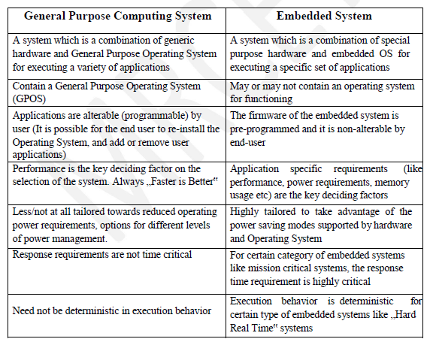
Embedded Systems
Vs
General Computing Systems

Slide 22
Classification of Embedded Systems:
Based on Generation
Based on Complexity & Performance Requirements
Based on deterministic behavior
Based on Triggering

Slide 23
Embedded Systems - Classification based on Generation
First Generation: The early embedded systems built around 8-bit microprocessors 8085 and Z80 and 4-bit Microcontrollers
e.g. Stepper motor control units, Digital Telephone Keypads etc.
Second Generation: Embedded Systems built around 16-bit microprocessors and 8 or 16-bit microcontrollers
eg. SCADA, Data Acquisition Systems etc.
Third Generation: Embedded Systems built around high performance 16/32 bit Microprocessors/controllers, Application Specific Instruction set processors like Digital Signal Processors (DSPs) and Application Specific Integrated Circuits (ASICs). The instruction set is complex and powerful.
e.g. Robotics, Industrial process control, Networking etc.
Fourth Generation: Embedded Systems built around System on Chips (SoC’s), Reconfigurable processors and multicore processors. It brings high performance, tight integration and miniaturization (very small using modern technology) into the embedded device market
e.g. Smart phone devices etc.

Slide 24
2. Embedded Systems - Classification based on Complexity & Performance
Small Scale:
The embedded systems built around low performance and low cost 8 or 16 bit microprocessors/ microcontrollers. It is suitable for simple applications and where performance is not time critical.
It may or may not contain OS.
Medium Scale:
Embedded Systems built around low cost 16 or 32 bit microprocessors / microcontrollers or DSPs.
These are slightly complex in hardware and firmware. It may contain GPOS/RTOS.
Large Scale/Complex:
Embedded Systems built around high performance 32 or 64 bit RISC processors/controllers, RSoC or multi-core processors and PLD (Programmable Logic Device).
It requires complex hardware and software. These system may contain multiple processors/controllers and co-units/hardware accelerators
It contains RTOS for scheduling, prioritization and management.

Slide 25
3. Embedded Systems - Classification Based on deterministic behavior:
It is applicable for Real Time systems. The application/task execution behavior for an embedded system can be either deterministic or non-deterministic
These are classified in to two types
Soft Real time Systems:
Missing a deadline may not be critical and can be tolerated to a certain degree
2. Hard Real time systems:
Missing a program/task execution time deadline can have catastrophic consequences (financial, human loss of life, etc.)

Slide 26
4. Embedded Systems - Classification Based on Triggering:
These are classified into two types
Event Triggered :
Activities within the system (e.g., task run-times) are dynamic and
depend upon occurrence of different events (such as counting persons).
2. Time triggered:
Activities within the system follow a statically computed schedule (i.e., they are allocated time slots during which they can take place) and thus by nature are predictable (such as trafic lights).

Slide 27
Purpose of Embedded Systems
Each Embedded Systems is designed to serve the purpose of any one or a combination of the following tasks.
o Data Collection/Storage/Representation
o Data Communication
o Data (Signal) Processing
o Monitoring
o Control
o Application Specific User Interface

Slide 28
Characteristics and Quality Attributes of Embedded Systems
Characteristics of Embedded systems:
Embedded systems possess certain specific characteristics and these are unique to each Embedded system.
1. Application and domain specific
2. Reactive and Real Time
3. Operates in harsh environments
4. Distributed
5. Small Size and weight
6. Power concerns
7. Single-functioned
8. Complex functionality
9. Tightly-constrained
10. Safety-critical

Slide 29
Application and Domain Specific:-
• Each Embedded System has certain functions to perform and they are developed in such a manner to do the intended functions only.
• They cannot be used for any other purpose.
• e.g. The embedded control units of the microwave oven cannot be replaced with AC’s embedded control unit because the embedded control units of microwave oven and AC are specifically designed to perform certain specific tasks.

Slide 30
2. Reactive and Real Time:-
• E.S are in constant interaction with the real world through sensors and user-defined input devices which are connected to the input port of the system.
• Any changes in the real world are captured by the sensors or input devices in real time and the control algorithm running inside the unit reacts in a designed manner to bring the controlled output variables to the desired level.
• E.S produce changes in output in response to the changes in the input, so they are referred as reactive systems.
• Real Time system operation means the timing behavior of the system should be deterministic i.e. the system should respond to requests in a known amount of time.
e.g. E.S which are mission critical like flight control systems, Antilock Brake Systems (ABS) etc are Real Time systems.

Slide 31
3. Operates in Harsh Environment :–
• The design of E.S should take care of the operating conditions of the area where the system is going to implement.
e.g. If the system needs to be deployed in a high temperature zone, then all the components used in the system should be of high temperature grade.
• Also proper shock absorption techniques should be provided to systems which are going to be commissioned in places subject to high shock.
4. Distributed: –
• It means that embedded systems may be a part of a larger system.
• Many numbers of such distributed embedded systems form a single large embedded control unit.
e.g. Automatic vending machine. It contains a card reader, a vending unit etc. Each of them are independent embedded units but they work together to perform the overall vending function.

Slide 32
5. Small Size and Weight:-
• Product aesthetics (size, weight, shape, style, etc) is an important factor in choosing a product.
• It is convenient to handle a compact device than a bulky product.
6. Power Concerns:-
• Power management is another important factor that needs to be considered in designing embedded systems.
• E.S should be designed in such a way as to minimize the heat dissipation by the system.
7. Single-functioned:-
Dedicated to perform a single function

Slide 33
8. Complex functionality: -
We have to run sophisticated algorithms or multiple algorithms in some applications.
9. Tightly-constrained:-
Low cost, low power, small, fast, etc.
10. Safety-critical:-
Must not endanger human life and the environment

Slide 34
Quality Attributes of Embedded System:
Quality attributes are the non-functional requirements that need to be documented properly in any system design. Quality attributes can be classified as
Operational quality attributes II. Non-operational quality attributes
I. Operational Quality Attributes: The operational quality attributes represent the relevant quality attributes related to the embedded system when it is in the operational mode or online mode.
e.g.
1. Response :-
It is the measure of quickness of the system.
It tells how fast the system is tracking the changes in input variables.
Most of the E.S demands fast response which should be almost real time.
Ex – Flight control application.

Slide 35
2. Throughput :-
It deals with the efficiency of a system.
It can be defined as the rate of production or operation of a defined process over a stated period of time.
The rates can be expressed in terms of products, batches produced or any other meaningful measurements.
e.g. – In case of card reader throughput means how many transactions the reader can perform in a minute or in an hour or in a day.
Throughput is generally measured in terms of “Benchmark”. A Benchmark is a reference point by which something can be measured.
3. Reliability :-
• It is a measure of how much we can rely upon the proper functioning of the system.
• Mean Time Between Failure (MTBF) and Mean Time To Repair (MTTR) are the terms used in determining system reliability.
• MTBF gives the frequency of failures in hours/weeks/months.
• MTTR specifies how long the system is allowed to be out of order following a failure.
• For embedded system with critical application need, it should be of the order of minutes.

Slide 36
4. Maintainability:-
• It deals with support and maintenance to the end user or client in case of technical issues and product failure or on the basis of a routine system checkup.
• Reliability and maintainability are complementary to each other.
• A more reliable system means a system with less corrective maintainability requirements and vice versa.
• Maintainability can be broadly classified into two categories
Scheduled or Periodic maintenance (Preventive maintenance)
2. Corrective maintenance to unexpected failures

Slide 37
5. Security:-
• Confidentiality, Integrity and availability are the three major measures of information security.
• Confidentiality deals with protection of data and application from unauthorized disclosure.
• Integrity deals with the protection of data and application from unauthorized modification.
• Availability deals with protection of data and application from unauthorized users.
6. Safety :-
Safety deals with the possible damages that can happen to the operator, public and the environment due to the breakdown of an Embedded System.
The breakdown of an embedded system may occur due to a hardware failure or a firmware failure.
Safety analysis is a must in product engineering to evaluate the anticipated damages and determine the best course of action to bring down the consequences of damage to an acceptable level.

Slide 38
II. Non-Operational Quality Attributes:
The quality attributes that needs to be addressed for the product not on the basis of operational aspects are
grouped under this category.
1. Testability and Debug-ability:-
• Testability deals with how easily one can test the design, application and by which means it can be done.
• For an E.S testability is applicable to both the embedded hardware and firmware.
• Embedded hardware testing ensures that the peripherals and total hardware functions in the desired manner,
whereas firmware testing ensures that the firmware is functioning in the expected way.
Debug-ability is a means of debugging the product from unexpected behavior in the system
• Debug-ability is two level process
• 1. Hardware level: It is used for finding the issues created by hardware problems.
• 2. Software level: It is employed for finding the errors created by the flaws in the software.

Slide 39
2. Evolvability (The capacity of the system for adaptive evolution) :-
• It is a term which is closely related to Biology.
• It is referred as the non-heritable variation.
• For an embedded system evolvability refers to the ease with which the embedded product can be modified to take advantage of new firmware or hardware technologies.
3. Portability:-
• It is the measure of system independence.
• An embedded product is said to be portable if the product is capable of functioning in various environments, target processors and embedded operating systems.
• “Porting” represents the migration of embedded firmware written for one target processor to a different target processor.

Slide 40
4. Time-to-Prototype and Market :-
• It is the time elapsed between the conceptualization of a product and the time at which the product is ready for selling.
• The commercial embedded product market is highly competitive and time to market the product is critical factor in the success of commercial embedded product.
• There may be multiple players in embedded industry who develop products of the same
category (like mobile phone).
5. Per Unit Cost and Revenue:-
• Cost is a factor which is closely monitored by both end user and product manufacturer.
• Cost is highly sensitive factor for commercial products
• Proper market study and cost benefit analysis should be carried out before taking a decision on the per-unit cost of the embedded product.

Slide 41
Philosophy
(ARM System Developer’s Guide
Designing and Optimizing System Software
By Andrew N. Sloss)

Slide 42
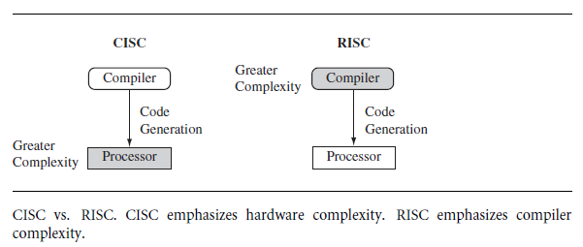
The RISC/CISC design philosophy
The ARM core uses a RISC architecture.
RISC is a design philosophy aimed at delivering simple but powerful instructions that execute within a single cycle at a high clock speed.
The RISC philosophy concentrates on reducing the complexity of instructions performed by the hardware.
Provide greater flexibility and intelligence in software rather than hardware.
A RISC design places greater demands on the compiler.
--------------------------------------------------------
In contrast, the traditional complex instruction set computer (CISC) relies more on the hardware for instruction functionality, and consequently the CISC instructions are more complicated.
Figure illustrates these major differences between
RISC and CISC
ARM- Advanced RISC machine
RISC- Reduced instruction

Slide 43
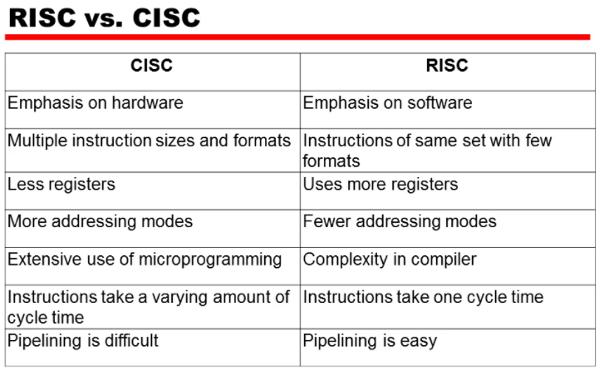

Slide 44
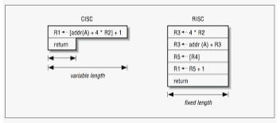
The RISC philosophy is implemented with four major design rules:
Instructions - RISC processors have a reduced number of instruction classes.
These classes provide simple operations that can each execute in a single cycle.
The compiler or programmer synthesizes complicated operations (for example, a divide operation) by combining several simple instructions.
Each instruction is a fixed length to allow the pipeline to fetch future instructions before decoding the current instruction.
In contrast, in CISC processors the instructions are often of variable size and take many cycles to execute.

Slide 45
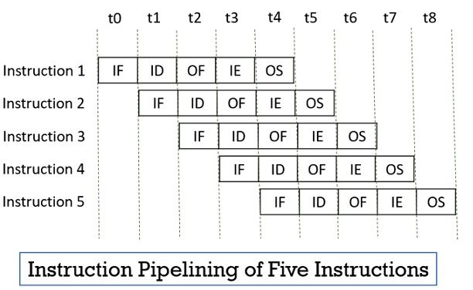
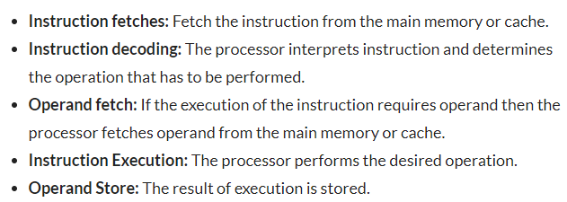
2. Pipelines -The processing of instructions is broken down into smaller units that can be executed in parallel by pipelines.
Ideally the pipeline advances by one step on each cycle for maximum throughput.
Instructions can be decoded in one pipeline stage.

Slide 46
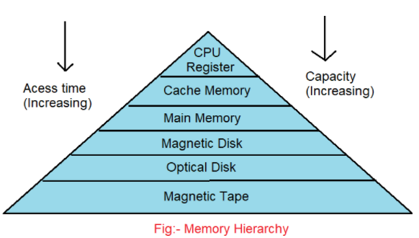
3. Registers - RISC machines have a large general-purpose register set.
Registers act as the fast
local memory store for all
data processing operations.
ALWAYS THINK ABOUT
* CAPACITY
*COST
*SPEED
4. Load-store architecture - The processor operates on data held in registers.
Separate load and store instructions transfer data between the register bank and external memory.
Memory accesses are costly, so separating memory accesses from data processing provides an advantage because you can use data items held in the register bank multiple times without needing multiple memory accesses.
In contrast, with a CISC design the data processing operations can act on memory directly.

Slide 47
These design rules allow a RISC processor to be simpler
and thus the core can operate at higher clock frequencies
In contrast,
The traditional CISC processors are more complex and operate at lower clock frequencies.
But the bottom line is……..
Over the course of two decades, however, the distinction between RISC and CISC has blurred as CISC processors have implemented more RISC concepts.

Slide 48
ARM Design
There are a number of physical features that have driven the ARM processor design.
1. Portable embedded systems require some form of battery power.
The ARM processor has been specifically designed to be small to reduce power consumption and extend battery operation which is essential for applications such as mobile phones and personal digital assistants (PDAs).
---------------------------------------------------------------------------------------------------
2. High code density is another major requirement since embedded systems have limited memory due to cost and/or physical size restrictions.
e.g. for applications with limited on-board memory like mobile phones and mass storage devices.
--------------------------------------------------------------------------------------------------------
3. Embedded systems are price sensitive and use slow and low-cost memory devices.
For high-volume applications like digital cameras, every cent has to be accounted for in the design. The ability to use low-cost memory devices produces substantial savings.

Slide 49
4. Another important requirement is to reduce the area of the die taken up by the embedded processor.
For a single-chip solution, the smaller the area used by the embedded processor, the more available space for specialized peripherals.
This in turn reduces the cost of the design and manufacturing since fewer discrete chips are required for the end product.
-----------------------------------------------------------------------------------------------------
5. ARM has incorporated hardware debug technology within the processor so that software engineers can view what is happening while the processor is executing code.
With greater visibility, software engineers can resolve issues faster, which has a direct effect on the time to market and reduces overall development costs.

Slide 50
6. The ARM core is not a pure RISC architecture because of the constraints of its primary application—the embedded system.
In some sense, the strength of the ARM core is that it does not take the RISC concept too far.
In today’s systems, the key is total effective system performance and power consumption rather than only processor speed

Slide 51
Instruction Set for Embedded Systems
The ARM instruction set differs from the pure RISC definition in several ways that make the ARM instruction set suitable for embedded applications:
■ Variable cycle execution for certain instructions
Not every ARM instruction executes in a single cycle.
For example, load-store-multiple instructions vary in the number
of execution cycles depending upon the number of registers being
transferred.
The transfer can occur on sequential memory addresses, which increases performance since
sequential memory accesses are often faster than random accesses.
Code density is also improved since multiple register transfers are common operations at the start and end of functions.

Slide 52
Inline barrel shifter leading to more complex instructions
The inline barrel shifter is a hardware component that preprocesses one of the input registers before it is used by an instruction.
The ARM arithmetic logic unit has a 32-bit barrel shifter that is capable of shift and rotate operations.
The second operand to many ARM and Thumb data-processing and single register data-transfer instructions can be shifted, before the data-processing or data-transfer is executed, as part of the instruction.
This expands the capability of many instructions to improve core performance and code density.
■ Thumb 16-bit instruction set
ARM enhanced the processor core by adding a second 16-bit instruction set called Thumb that permits the ARM core to execute either 16- or 32-bit instructions.
The 16-bit instructions improve code density by about 30% over 32-bit fixed-length instructions.

Slide 53
■ Conditional execution
An instruction is only executed when a specific condition has been satisfied.
This feature improves performance and code density by reducing branch instructions.
■ Enhanced instructions
The enhanced digital signal processor (DSP) instructions were added to the standard ARM instruction set to support fast 16×16-bit multiplier operations (Max. time consuming instruction).
These instructions allow a faster-performing ARM processor in some cases to replace the traditional combinations of a processor plus a DSP.
(Execution by hardware is faster than execution by software).
These additional features have made the ARM processor one of the most commonly used 32-bit embedded processor cores.
Many of the top semiconductor companies around the world produce products based around the ARM processor.

Slide 54
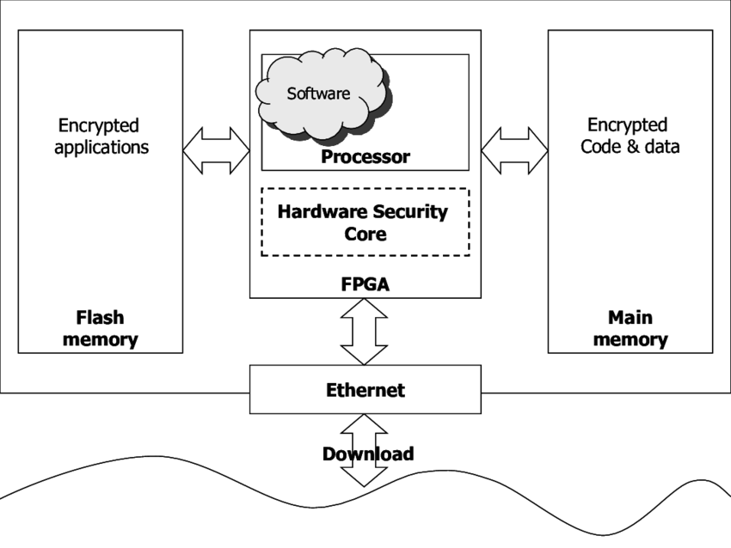
Embedded System models and Development Cycle
The Embedded System’s Model represents the layers in which all components existing within an embedded system design can reside. ...
The hardware, which contains all the physical components located on an embedded systems board.
• The system software, which is the device's application-independent software.
High level model of a typical embedded system

Slide 55
Embedded software development life cycle
Phases include
  planning,
  understanding the requirement,
  development and testing
Stages of embedded system development process
1. Ideation/purpose of the product –
This is the stage where an idea is discussed with all the stakeholders and brain-stormed to conclude if the idea is worth taking to the development stage.
2. Technical specification –
A detailed technical design requirement specification document should be created.
Product specifications should cover the main things like the purpose of the product, block diagram, main features, environmental conditions, manufacturing requirements, etc.

Slide 56
3.Architecting the Solution (detailing)
On a high level, how the design will look like, what are strategies you will use to build a solution, which type of power supply, which type of wired or wireless connectivity you will use, how the firmware design will look like, Mobile App/PC software/cloud-based application design needs to be decided.
Selection of appropriate component for each block or part of the circuit based on various critical parameters like quality, size, features, cost, lead time, EOL, etc.
4. Component section & design finalization
power supply design, Hardware component selection
5. Test Plan - Hardware & Software Testing is very important to check the reliability of the product.
Companies spend a huge amount of time testing their products to check it’s reliability.
It includes hardware design validation, software design validation, production level product testing.
6. Design implementation - This is the core engineering stage of the implementation.
Here the architecture is converted into the design.
For hardware: schematic capture, PCB layout will be done. MCU firmware & software will be developed.

Slide 57
7. PoC / Prototype Development
Building the prototype and test it again for the functionality & the environmental conditions
8.Field Trials
Sometimes the product works well in their lab but has issues in the field.
9.Final Product Improvements
Improvisation of the test procedures you follow during the design validation/ production testing stage to ensure a flawless product comes out of production.
10.Product Release
Various product certifications based on features it has and the countries it will be sold in.
Documentation: Product page on the website, Quick introduction video, Datasheet, User guide, Setting up the Support channel, etc.

Slide 58
Thank you…

