Slide 1
UNIT-III
Introduction to Real Time
Operating System
08Hours

Slide 2
CONTENTS
Introduction to RTOS,
Role of RTOS,
Foreground Back ground system,
Pros and cons. Functionalities of RTOS – Task Management,
I/O management,
Inter Task Communication,
Tasks and task states,
Process and Threads,
Multiprocessing and Multitasking,
Context switching, Inter-task Communication,
Mutual Exclusion,
Preemptive and non-preemptive kernel,
Priority Inversion,
Deadlock,
Semaphores, and shared data,
Message
Queues,
Mailboxes and
Pipes,
Timer functions,
Events,
Memory management,
Interrupt routines in an RTOS environment.

Slide 3
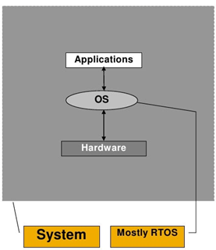
Introduction to Operating System
An OS has three main functions:
(1) manage the computer's resources, such as the CPU, memory, disk drives, and printers
(2) establish a user interface, and
(3) execute and provide services for applications software.
Introduction to Real Time OS (RTOS)
A RTOS is an operating system with two key features:
1. predictability and 2. determinism.
In an RTOS, repeated tasks are performed within
a tight time boundary, while in a GP OS, this is
not necessarily so.
A RTOS is an OS for real-time applications that
processes data and events that have critically
defined time constraints.
An RTOS is a software component that rapidly switches between tasks, giving the impression that multiple programs are being executed at the same time on a single processing core.

Slide 4
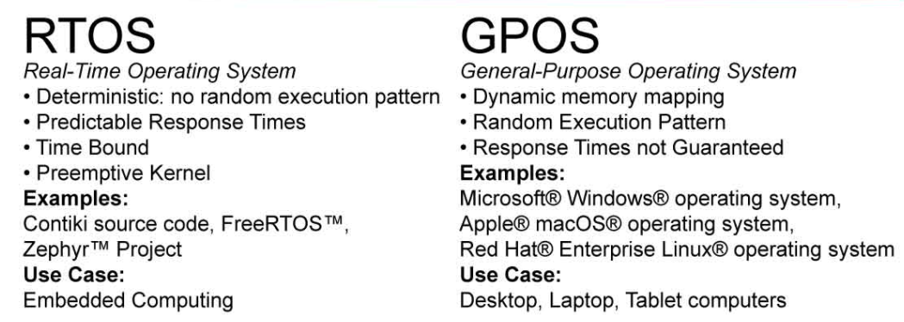
Difference between RTOS and SPOS
Free-RTOS is a class of RTOS that is designed to be small enough so as to run on a microcontroller. Although its use is not limited to microcontroller applications.
Free RTOS therefore provides the core real time scheduling functionality, inter-task communication, timing and synchronization primitives only.

Slide 5
An RTOS is an operating system designed to manage hardware resources of an embedded system.
It creates multiple threads of software execution and a scheduler for managing these threads.
It is a scheduling kernel that creates a multi-tasking and deterministic run-time environment.
The standard OS prioritize executing as much processing as possible in the quickest amount of time while RTOS prioritizes predictable response times.
RTOSes are generally subdivided into “soft” real-time and “hard” real- time systems.
Soft real-time systems operate within a few hundred milliseconds, at the scale of a human reaction.
Hard real-time systems (time constraints), however, provide responses that are predictable within tens of milliseconds or less. Hard Real-Time operating systems guarantee that critical tasks be completed within a range of time.

Slide 6
Examples of the real-time operating systems:
Airline traffic control systems Automotive
Command Control Systems Chemical plants
Airlines reservation system FAX machines
Heart Peacemaker Modems
Network Multimedia Systems Microwave ovens
Robots Scanners etc.

Slide 7
Need of Real-Time Operating System
Concurrency (in parallel)
An RTOS can have multiple tasks simultaneously in memory and can switch between them based on events and priorities.
2. Pre-emption
Pre-emption is the ability of an OS to temporarily suspend a task in order to execute another higher-priority task .
3. Available Ram
An RTOS solution needs ideally a minimum system requirement of 8 kilobytes only.
4. Available Flash
RTOS don’t take up much Flash space, usually on the order of eight to 10 kilobytes.
5. Synchronization Tools
An RTOS has Mutexes that can be used to protect shared resources.
It also contains Semaphores that can be used to signal and synchronize tasks and message queues to transfer data between tasks.

Slide 8
6. Third-Party Software
One of the problems facing developers worldwide today is how to integrate third-party software stacks and tools into their embedded system.
The use of an RTOS makes these components plug-and-play within the software and can dramatically accelerate software development.
7. Ease of Use
Whether a developer just wants to create a rapid prototype or build a robust safety-critical system, an RTOS is useful.
Creating tasks and utilizing RTOS tools is easy and very powerful.

Slide 9
Advantages of RTOS
1. Priority Based Scheduling
Priority Based Scheduling refers to a part in a RTOS called the Scheduler.
The scheduler is responsible for deciding which task should be executing at any particular time.
In general, an RTOS has the ability to suspend and resume tasks throughout a tasks lifetime.
The scheduler uses an algorithm to help it decide which task it should execute at any point in time called the Scheduling Policy .
Even though an RTOS has the ability to suspend tasks before they are complete, tasks also have the ability to suspend themselves at any time.
Tasks can suspend themselves when they want to delay (sleep), themselves for a fixed period of time, or wait (block) for a resource to become available.
Tasks that are sleeping or blocked are not able to execute and thus they will not be allocated any processing time.
e.g. a serial port or an event to occur such a key press on a keyboard.

Slide 10
2.Abstracting Timing Information
An RTOS is responsible for timing and providing Application Programming Interface (API) functions.
An API is a set of commands, functions, protocols and objects that can be used by programmers to create software or interact with an external system.
An API provides Developers with a set of standard commands which can be used to perform a number of common operations, thus removing the need for them to write code from beginning.
This allows Developers to write smaller and neater application code.
3.Maintainability/Extensibility
Abstracting timing dependencies and task based design results in fewer interdependencies between modules.
This makes for easier maintenance.

Slide 11
4. Modularity
An RTOS is a modular operating system which separates the core kernel from middleware, protocols and applications.
This helps development and reduces the memory footprint of the RTOS on the system.
The modularity of a RTOS simplifies a Developers development process.
This is important for developers when they are developing for devices with different capabilities such as Desktop computers.
The modularity of an RTOS allows for the embedded software to be created for specific devices, which reduces the RAM and Flash memory.
5. Promotes Team Development
The task based system provided by RTOS allows for separate designers/teams to work independently on their parts of a project.

Slide 12
6. Easier Testing
The modular task-based development of an RTOS allows for modular task based testing.
7. Code Reuse
A benefit that a modular RTOS provides is that similar applications on similar platforms will lead to the development of a library of standard tasks.
8. Improved Efficiency
An RTOS can be entirely event driven; no processing time is wasted polling for events that have not occurred.
7. Idle Processing
Background or idle processing is performed in the idle task.
This ensures that things such as CPU load measurement, background CRC checking etc will not affect the main processing.
8. Promotes Team Development
The task based system provided by Real Time Operating System allows for separate designers/teams to work independently on their parts of a project.

Slide 13
Disadvantages of RTOS
1. Limited Tasks
Very few tasks run at the same time and their concentration is restricted to few applications to avoid errors.
2. Use Heavy System resources
Sometimes the system resources are not efficient and can be quite expensive.
3.Complex Algorithms
The Algorithms are very complex and can create difficulties for developers when trying to edit the Algorithm.
4. Device driver and interrupt signals
It needs specific device drivers and interrupt signals in order for it to respond to interrupts at its earliest opportunity.
5. Thread Priority
It is not good to set thread priority as these systems are less prone to switching tasks.

Slide 14
Role of RTOS
An RTOS is the main subcategory of embedded systems that focuses on timely task execution.
e.g. ES such as smart home security systems, ATM machines, and airplane’s flight control system use a real-time embedded system where time is a core factor.
It supplements computer hardware complexities.
Almost all RTOSes provide threading, which is the illusion that processors can execute many tasks at the same time.
System software that offers primitive I/O and a little more than threading is referred to as a tiny kernel.
OS operate applications in processes whereby the OS monitors errors in processes, prevents the processes from destroying anything but themselves, and later recovers smoothly once the process terminates unexpectedly.
(Commonly used real-time operating systems include QNX, LynxOS, and OS-9.)

Slide 15
REAL TIME SOFTWARE is ideal for deadline-specific systems.
It ensures that prediction of tasks’ execution durations is done accurately.
However, the margin of error varies from 200 µs to 2 µs based on the hardware in use.
RTOSes are highly responsive and fast.
OS support processes that give programs the illusion that they are running on their own machine.
For embedded systems, a process is a thread with protection that recovers resources once a process terminates unintentionally to prevent resource leaks.
The OS relies on software techniques, hardware memory protection and supervisor/user distinction to prevent process accidents or undue actions.
This action isolates problems affecting the processes, eases debugging and makes fault recovery easier, leading to a more robust system.
The RTOS are the only practical solution for use in ESs

Slide 16
Key Characteristics of an RTOS
1. Real-Time Computing
Real-time computing (RTC) means specific time constraints.
2. Hard Real-Time and Soft Real-Time
Hard RTOS is a type of Operating System where we can predict the deadline.
Soft RTOS is where certain deadlines may be missed.
Soft Real-Time systems are not constrained to extreme rules.
3. Aperiodic and Periodic tasks
Aperiodic task is a process that does not carry out its task in regular time intervals. (No control on ON and OFF timings). (ATM??)
Whereas, Periodic task is a process that has to carry out its task in regular time intervals. (Pace maker??)
4. Determinism
Determinism controls how an OS performs operations at fixed, predetermined times or time intervals.
5. Responsiveness
This is the time that an OS takes to respond once acknowledgement of the interrupt has taken place.

Slide 17
6. User control
User control can influence the scheduling of the tasks.
7. Reliability
Robust OS with respect to software and hardware needs.
8. Fail-Soft operation
The OS requires the ability to recover from failure with little or no loss of capability and data.
9. Real-Time scheduling
For many RT systems, the work-load changes from moment to moment, based on external events. These require dynamic scheduling.
10. Design philosophies
The design philosophies of a RTOS are wrt. to Scheduling
Memory allocation
Inter task communication
Interrupt handlers
Memory allocation
The RTOS kernel needs RAM each time a task, queue, mutex, software timer, semaphore or event group is created.
The RAM can be automatically dynamically allocated from the RTOS .

Slide 18
What Are the Most Popular Real-Time Operating Systems?
Nucleus (Mentor Graphics)
Neutrino (BlackBerry)
PikeOS (Sysgo)
SafeRTOS (Wittenstein)
ThreadX (Microsoft Express Logic)
µC/OS (Micrium) (FOR OUR SYLLABUS)
VxWorks (Wind River)
Zephyr (Linux Foundation)

Slide 19
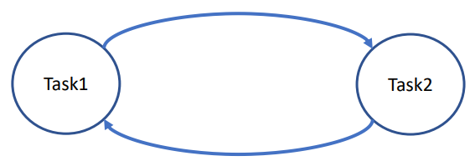
The Kernel is the part of the operating system that is responsible for task management, and inter-task communication and synchronisation.
• It is a mechanism serving to exchange information between tasks
• The basic task model assumes that all tasks are independent, and can be preempted at any point in their execution.
• From a practical point of view this assumption is unrealistic
• Coordinated task interaction is needed in most real-time applications.
• The main concern and challenge is how to minimize time-consuming blocking when concurrent (parallel) tasks are using shared resources.

Slide 20
Foreground - Back ground system
A priority assigned to programs running in a multitasking environment.
1.The foreground contains the applications the user is working on.
A foreground service performs some operation that is noticeable to the user.
e.g. an audio app would use a foreground service to play an audio track.
2. The background contains the applications that are behind the scenes.
e.g. certain operating system functions, printing a document, accessing the network.
When referring to multitasking operating systems, the background is the place an active program is running, but not visible to the user.
Notes:
.

Slide 21
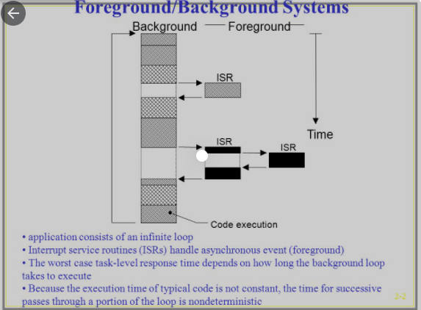
Foreground/background systems are an improvement over the interrupt-only systems in that the polled loop is replaced by code that performs useful processing.
Foreground/background systems are the most common architecture for embedded applications.

Slide 22
Functionalities of RTOS – Task Management
Need of Task Management:
When it comes to teamwork and collaboration, a task management system is key to streamlining your operations and increasing productivity.
With Task management, all tasks, duties, and responsibilities are appropriately aligned and assigned, and everyone is aware of what role they need to play.
Definition of Task Management:
Task management is defined as the process of handling the entire life-cycle of a task, right from planning to tracking to execution..….
It helps teams track the tasks from the beginning, setting deadlines, prioritizing tasks, and assigning them to the right people. It ensures projects stay on track and get completed on time.
The RTOS allows multiple tasks or programs to execute simultaneously based on its priority.
The processor suspends the running task (if any) and executes the high priority task it receives. Task scheduling Unit decides which thread is to be executed.

Slide 23
I/O management by RTOS
One of the important jobs of an OS is to manage various I/O devices including mouse, keyboards, touch pad, disk drives, display adapters, USB devices, Bit-mapped screen, LED, Analog-to-digital converter, On/off switch, network connections, audio I/O, printers etc.
An I/O system is required to take an application I/O request and send it to the physical device, then take whatever response comes back from the device and send it to the application.
I/O devices can be divided into two categories −
Block devices − A block device is one with which the driver communicates by sending entire blocks of data.
For example, Hard disks, USB cameras, Disk-On-Key etc.
Character devices − A character device is one with which the driver communicates by sending and receiving single characters (bytes, octets).
For example, serial ports, parallel ports, sounds cards etc

Slide 24
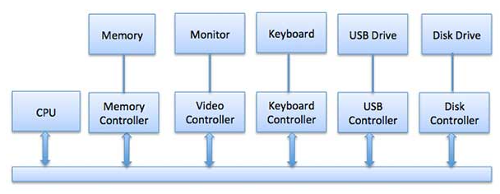
Device drivers
Device drivers are software modules that can be plugged into an OS to handle a particular device.
Operating System takes help from device drivers to handle all I/O devices.
The Device Controller works like an interface between a device and a device driver.
There is always a device controller and a device driver for each device to commu-nicate with the Operating Systems.
A device controller may be able to handle multiple devices.

Slide 25
Inter Task Communication
For inter-task communication OS must have variables or memory areas which are accessible to all the tasks concerned.
The term inter-task communication comprises all mechanisms serving to exchange information among tasks.
Kernel object is used for inter task communication.
Kernel objects uses
1. semaphores
2. message queue,
3. mail box and pipes,
4. Shared Memory, Signal Function and
4. RPC
for inter task communication.

Slide 26
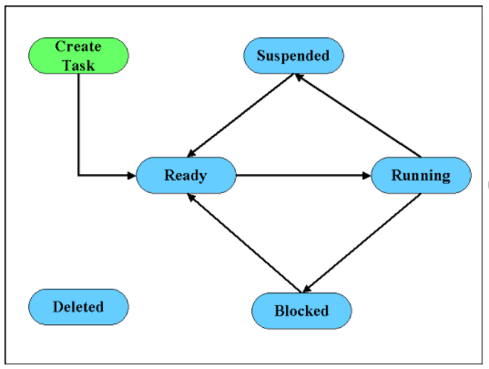
Tasks and task states
A task is also called a thread, is a simple program that thinks it has a CPU all to itself. A task consists of a sequentially executable program under a state-control by OS.
The state information of a task is represented by task state, task structure – its data, objects and resource and task control block.
In the FreeRTOS a task can be in either of four different states viz., Running, Ready, Blocked and Suspended.
Ready state-the task is ready to
run but cannot because a higher priority
task is executing.
2. blocked state-the task has requested a
resource that is not available, has request
-ed to wait until some event occurs, or
has delayed itself for some duration.
3. running state-the task is the highest
priority task and is running.
4.Suspended State – the task that was initially in ready state…but were swapped out of main memory..

Slide 27
Process and Threads
A thread is a scheduling concept, it's a program what the CPU actually 'runs‘.
A thread is a lightweight process that can be managed independently by a scheduler.
The threads within a process have their own context, exactly the same as task in the RTOS.
A process needs at least one thread that the CPU/OS executes.
A process is an active program i.e. a program that is under execution.
The difference being that a thread is running in a virtual address space, whereas a task runs in a physical one.
Context switching time: Processes require more time for context switching as they are more heavy.

Slide 28
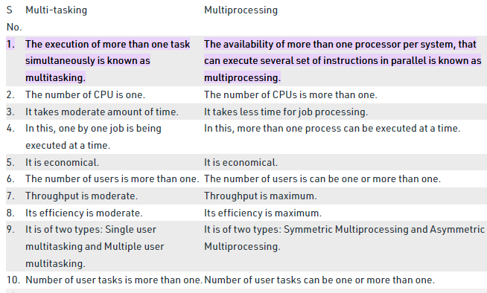
Multiprocessing and Multitasking

Slide 29
Context switching
Def^{n} : Context switching is a process of saving the task state (with the intention for it to be restored at a later point in time) and switching it with another already saved task state.
Context Switching, which consists of stopping one process and starting a new one.
Task context switching guarantees that each task feels that the CPU as its own.
Context switching is used to achieve multitasking i.e. multiprogramming with time-sharing .
Here, the context switching is so fast that the user feels that the CPU is executing more than one task at the same time.

Slide 30
Context switch is a procedure that a computer's CPU follows to change from one task (or process) to another while ensuring that the tasks do not conflict.
For user-friendly multitasking, effective context switching is must.
As a task executes it utilizes the processor / microcontroller registers and accesses RAM and ROM.
These resources together (the processor registers, stack, etc.) comprise the task execution context.
Context Switching involves storing the context or state of a process so that it can be reloaded when required and execution can be resumed from the same point as earlier.
This is a feature of a multitasking operating system and allows a single CPU to be shared by multiple processes.

Slide 31
Context Switching Steps
The steps involved in context switching are as follows −
Save the context of the process that is currently running on the CPU. Update the process control block and other important fields.
Move the process control block of the above process into the relevant queue such as the ready queue, I/O queue etc.
Select a new process for execution.
Update the process control block of the selected process. This includes updating the process state to running.
Update the memory management data structures as required.
Restore the context of the process that was previously running when it is loaded again on the processor. This is done by loading the previous values of the process control block and registers.

Slide 32
Inter task Communication
Synchronization and messaging provides the necessary communication between tasks in one system to tasks in another system.
The event flag is used to synchronize internal activities while message queues and mailboxes are used to send text messages between systems.
The term inter-task communication comprises all mechanisms serving to exchange information among tasks.
Which is the fastest method for inter task communication?
Pipes, message queues, semaphores, Remote Procedure Calls, Sockets, Datagrams, etc.
In a RTOS, tasks generally have direct access to a common memory space, and the fastest way to share data is by sharing memory.
Synchronization and messaging provides the necessary communication between tasks in one system to tasks in another system. The event flag is used to synchronize internal activities while message queues and mailboxes are used to send text messages between systems. Common data areas utilize semaphores.

Slide 33
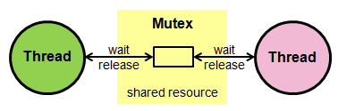
Mutual Exclusion (MUTEX)
Mutex is used in various operating systems for resource management.
Many resources in a microcontroller device can be used repeatedly, but only by one thread at a time (for example communication channels, memory and files).
Mutexes are used to protect access to a shared resource.
Mutexes are used to protect access to a shared resource.
A mutex is created and then passed between the threads (they can acquire and release the mutex).

Slide 34
A mutex is a special version of a semaphore.
Like the semaphore, it is a container for tokens.
But instead of being able to have multiple tokens, a mutex can only carry one (representing the resource).
Thus, a mutex token is binary and bounded.
The advantage of a mutex is that it introduces thread ownership.
When a thread acquires a mutex and becomes its owner, subsequent mutex acquires from that thread will succeed immediately without any latency.
Thus, mutex acquires/releases can be nested.

Slide 35
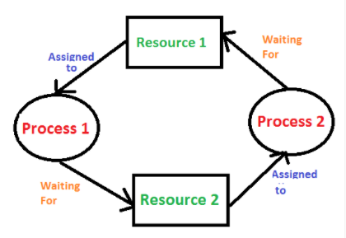
Deadlock
A process in operating system uses resources in the following way:
1) Requests a resource
2) Use the resource
3) Releases the resource
Deadlock is a situation where a set of processes are blocked because each
process is holding a resource and waiting for another resource acquired by
some other process.
In an operating system, a deadlock occurs when a process or thread enters a waiting state because a requested system resource is held by another waiting process, which in turn is waiting for another resource held by another waiting process.

Slide 36
Deadlock can arise if the following four conditions hold simultaneously (Necessary Conditions):
Mutual Exclusion: Two or more resources are non-shareable (Only one process can use at a time)
Hold and Wait: A process is holding at least one resource and waiting for resources.
No Preemption: A resource cannot be taken from a process unless the process releases the resource.
Circular Wait: A set of processes are waiting for each other in circular form.
Methods for handling deadlock
Deadlock prevention or avoidance: The idea is to not let the system into a deadlock state.
Deadlock detection and recovery: Let deadlock occur, then do preemption to handle it once occurred.
Ignore the problem altogether: If deadlock is very rare, then let it happen and reboot the system. This is the approach that both Windows and UNIX take.

Slide 37
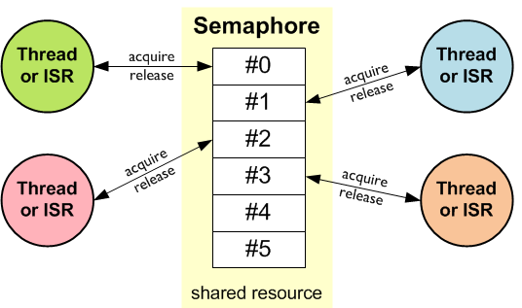
Semaphores and shared data
Most RTOS provides many types of mechanisms for safe communication and synchronization in between tasks and between interrupt routine (ISR-interrupt subroutine) and tasks.
Common types are: Semaphore: a signal between tasks/interrupts that does not carry any additional data.
A semaphore (sometimes called a semaphore token) is a kernel object that one or more threads of execution can acquire or release for the purposes of synchronization or mutual exclusion.
A semaphore is like a key that
allows a task to carry out some
operation or to access a
resource.

Slide 38
Semaphores are used to manage and protect access to shared resources.
Semaphores are very similar to Mutexes.
Whereas a Mutex permits just one thread to access a shared resource at a time, a semaphore can be used to permit a fixed number of threads/ISRs to access a pool of shared resources.
Using semaphores, access to a group of identical peripherals can be managed (for example multiple DMA channels).
Semaphores are typically used in one of two ways: To control access to a shared device between tasks. A printer is a good example. You don't want 2 tasks sending to the printer at once, so you create a binary semaphore to control printer access.
Semaphore is simply a variable that is non-negative and shared between threads. A semaphore is a signaling mechanism, and a thread that is waiting on a semaphore can be signaled by another thread. It uses two atomic operations, 1) Wait, and 2) Signal for the process synchronization

Slide 39
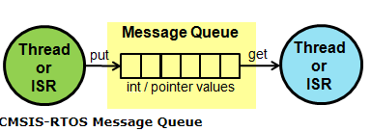
Message
A message queue is a number of buffers of a fixed or maximum size that is controlled by the RTOS and also a queue for tasks that are waiting for messages.
The size and the number of buffers are specified when the message queue is created.
Exchange messages between threads in a FIFO-like operation.
Message passing is another basic communication model between threads.
In the message passing model, one thread sends data explicitly, while another thread receives it.

Slide 40
The operation is more like some kind of I/O rather than a direct access to information to be shared.
In CMSIS-RTOS, this mechanism is called s message queue.
The data is passed from one thread to another in a FIFO-like operation.
Using message queue functions, you can control, send, receive, or wait for messages.
The data to be passed can be of integer or pointer type:

Slide 41
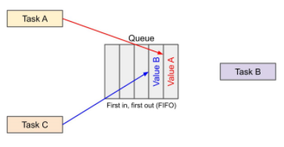
Queues
Most multi-threaded operating systems offer a number of kernel objects that assist in creating thread-safe communications between threads.
Such objects include things like queues, mutexes, and semaphores.
A queue in a real-time operating system (RTOS) is a kernel object that is capable of passing information between tasks without incurring overwrites from other tasks or entering into a race condition.
A queue is a first in, first out (FIFO) system where items are removed from the queue once read.

Slide 42
A queue is a simple FIFO system with atomic reads and writes.
“Atomic operations” are those that cannot be interrupted by other tasks during their execution.
This ensures that another task cannot overwrite our data before it is read by the intended target.
In this example, Task A writes some data to a queue.
No other thread can interrupt Task A during that writing process.
After, Task B can write some other piece of data to the queue.
Task B’s data will appear behind Task A’s data, as the queue is a FIFO system.

Slide 43
Mailboxes
A mailbox is a special memory location that one or more tasks can use to transfer data, or more generally for synchronization.
You typically use a mailbox when there are multiple threads reading and writing data and you need the atomic test-and-set operation of semaphore to know when the mailbox is full or empty.
A queue is just a data structure. But a mailbox is a higher-level concept that is built around a combination of queues and semaphores.
Mailboxes are similar to queue. Ccapacity of mailboxes are usually fixed after initialization.
Some RTOS allows only a single message in the mailbox. Some RTOS allows prioritization of message.
A mailbox is a built-in class around a queue that uses semaphores to control access to the ends of a queue.

Slide 44
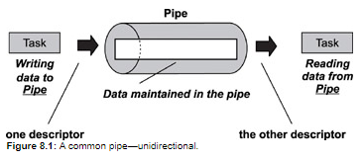
Pipes
Message queues, mailboxes, and pipes are services that are provided by RTOSs that enable tasks to communicate with each other.
Tasks need to communicate with each other in order to coordinate activities and to share data.
Pipes are kernel objects that provide unstructured data exchange and facilitate synchronization among tasks. In a traditional implementation, a pipe is a unidirectional data exchange facility, as shown in Figure 8.1.
Two descriptors, one for each end of the pipe (one end for reading and one for writing), are returned when the pipe is created. Data is written via one descriptor and read via the other. The data remains in the pipe as an unstructured byte stream. Data is read from the pipe in FIFO order.

Slide 45
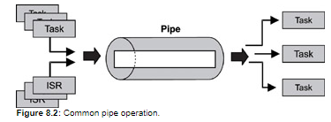
A pipe provides a simple data flow facility so that the reader becomes blocked when the pipe is empty, and the writer becomes blocked when the pipe is full.
Typically, a pipe is used to exchange data between a data-producing task and a data-consuming task, as shown in Figure 8.2.
It is also permissible to have several writers for the pipe with multiple readers on it.
Note that a pipe is conceptually similar to a message queue but with significant differences.
For example, unlike a message queue, a pipe does not store multiple messages. Instead, the data that it stores is not structured, but consists of a stream of bytes.
Also, the data in a pipe cannot be prioritized; the data flow is strictly first-in, first-out FIFO. Finally, as is described below, pipes support the powerful select operation, and message queues do not.

Slide 46
Timer functions
Hardware timers are used for timing and counting operations, allowing the processor to carry on with some other process while the timer process runs.
Soft timers are software events that are scheduled through a software facility. A soft-timer facility allows for efficiently scheduling of non-high-precision software events.

Slide 47
Events
Event bits are used to indicate if an event has occurred or not.
Event bits are often referred to as event flags.
e.g. an application may:
1.Define a bit (or flag) that means "A message has been received and is ready for processing" when it is set to 1,
and
"there are no messages waiting to be processed" when it is set to 0.
Define a bit (or flag) that means "The application has queued a message that is ready to be sent to a network" when it is set to 1,
and
"there are no messages queued ready to be sent to the network" when it is set to 0.
Define a bit (or flag) that means "It is time to send a heartbeat message onto a network" when it is set to 1,
And
"it is not yet time to send another heartbeat message" when it is set to 0.

Slide 48
Event Groups
An event group is a set of event bits.
Individual event bits within an event group are referenced by a bit number.
The event bit that means "A message has been received and is ready for processing" might be bit number 0 within an event group.
The event bit that means "The application has queued a message that is ready to be sent to a network" might be bit number 1 within the same event group.
The event bit that means "It is time to send a heartbeat message onto a network" might be bit number 2 within the same event group.

Slide 49
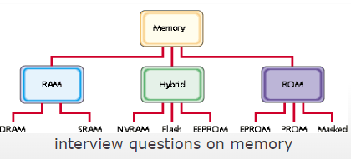
Memory management
Memory management is the process of controlling and coordinating computer memory, assigning portions called blocks to various running programs to optimize overall system performance.
An RTOS may provide memory management for several reasons: Memory mapping hardware can protect the memory spaces of the processes when outside programs are run on the embedded system. Memory management can allow a program to use a large virtual address space

Slide 50
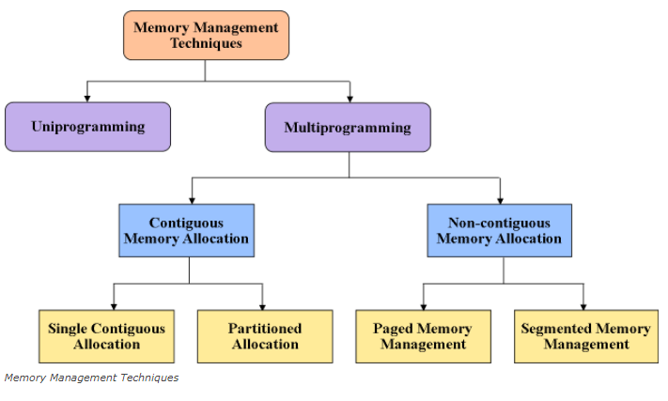

Slide 51
Interrupt routines in an RTOS environment
RTOS provides various functions for interrupt and event handling,
viz., Defining interrupt handler,
creation and deletion of ISR,
referencing the state of an ISR,
enabling and disabling of an interrupt, etc.
It also restricts:
interrupts from occurring when modifying a data structure,
minimise interrupt latencies due to disabling of interrupts when RTOS is performing critical operations,
minimises interrupt response times.

Slide 52
Interrupt routines in an RTOS environment
Interrupt routines in RTOS must follow two rules that do not apply to task code:
An interrupt routine must not call any RTOS functions that might block. could block the highest priority task. ...
An interrupt routine must not call any RTOS function that might cause the RTOS to switch tasks.
Time-based scheduling used like round-robin scheduling.
Interrupt latency: The time elapsed between execution of the last instruction of the interrupted task and the first instruction in the interrupt handler.

Slide 53
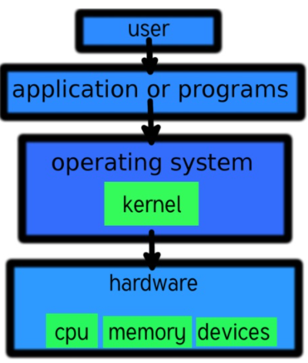
Preemptive and non-preemptive kernel
The preemptive kernel allows a process in execution in the kernel mode to be interrupted by some other process.
A nonpreemptive kernel does not allow a process in execution in the kernel mode to be interrupted by some other process.

Slide 54
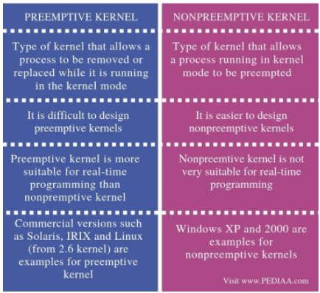

Slide 55
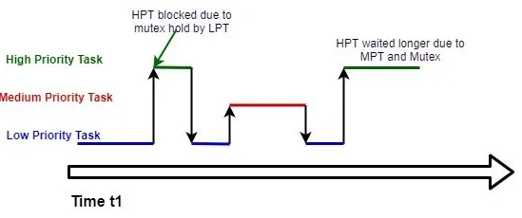
Priority Inversion
Priority inversion is the condition in which a high priority task needs to wait for a low priority task to release a resource between the medium priority task and a low priority task.
For example, the low priority task holds a mutex that the high priority task must wait for to continue executing.
Priority Inversion can occur within embedded systems when using an RTOS configured for priority based, preemptive scheduling.
Priority Inversion is a term used to describe a situation when a higher priority task cannot execute because it is waiting for a low priority task to complete.

Slide 56
UNIT III …….ENDS THANK YOU

