Slide 1
Unit 3
Wireless Technologies and IP based protocols supporting IoT
Mrs.D.K.Magdum

Slide 2
Internet Protocol
IP is a connectionless, unreliable, best-effort delivery protocol.
IP accepts whatever data is passed down to it from the upper layers and forwards the data in the form of IP Packets.
All the nodes are identified using an IP address.
Packets are delivered from the source to the destination using IP address
IP address is for the INTERFACE of a host. Multiple interfaces mean multiple IP addresses, i.e., routers.
32 bit IP address in dotted-decimal notation for ease of reading, i.e., 193.140.195.66
IP address is divided into a network number and a host number.

Slide 3
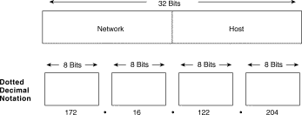
IP Address

Slide 4
Introduction
The IP address is an identifier that is applied to each device connected to an IP network.
Internet Protocol Version 6 (IPv6) is a newer version of the network layer protocol that is designed to coexist (but not directly interwork) with IPv4.
IPv6 is a connectionless datagram protocol used primarily for addressing and routing packets between hosts. Connectionless means that a session is not established before exchanging data.
The acknowledgment of packets delivered and the recovery of lost packets is done by a higher-layer protocol, such as TCP.
IPv6 offers the potential of achieving scalability, reachability, end-to-end interworking, quality of service (QoS), and commercial grade robustness that is needed for contemporary and emerging web services, data services, mobile video, and Internet of things (IoT) applications.

Slide 5
Features of IPv6
The number of IPv6 addresses is 1028 times larger than the number of IPv4 addresses. So there are more than enough IPv6 addresses to allow for Internet devices to expand for a very long time.
IPv6 also adds improvements in areas such as routing and network configuration.
IPv6 has extensive automatic configuration (autoconfiguration) mechanisms and reduces the IT burden, making configuration essentially plug-and-play.
The expectation is that IPv6 can make IP devices less expensive, more powerful, and even consume less power; the power issue is not only important for environmental reasons but also improves operability (e.g., longer battery life in portable devices, such as mobile phones).

Slide 6
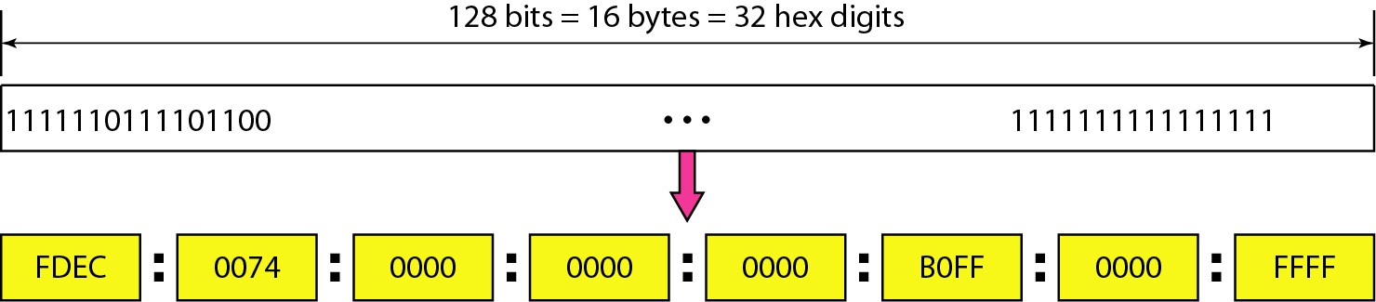
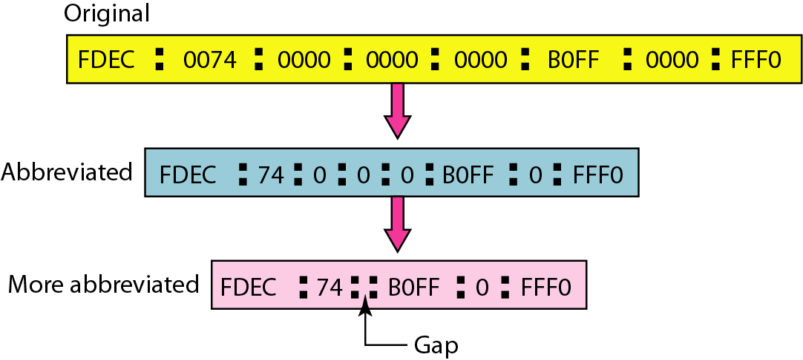
IPv6 Address
An IPv6 address is 128 bits long (16-byte).
Hexadecimal Colon Notation
Abbreviation

Slide 7
Types of IPv6 addresses
Unicast: “send to this one specific address”
  Address of a single interface
  Delivery to single interface
Multicast: “send to every member of this specific group”
  Address of a set of interfaces
  Delivery to all interfaces in the set
Anycast: “send to any one member of this specific group.”
  “send to the closest member of this specific group.”
  Address of a set of interfaces
  Delivery to a single interface in the set
No more broadcast addresses : “send this information/content to the entire universe of users in the address space.”
https://www.youtube.com/watch?v=LU9Dz6WF40A

Slide 8
Advantages of IPv6
Scalability and expanded addressing capabilities: IPv6 has 128-bit addresses versus 32-bit IPv4 addresses.
  With IPv6, the theoretical number of available IP addresses is 2¹²⁸ space
“Plug-and-play”: IPv6 includes a “plug-and-play” mechanism that facilitates the connection of equipment to the network. The requisite configuration is automatic.
IPv6 makes it easy for nodes to have multiple IPv6 addresses on the same network interface. This can create the opportunity for users to establish communities of interest (COI) networks on top of other physical IPv6 networks.
Security: IPv6 includes security in its specifications such as payload encryption and authentication of the source of the communication. It calls for end-to-end security, with built-in, strong IP-layer encryption and authentication

Slide 9
continued
It follows that IPv6 network architectures can easily adapt to an end-to-end security model where the end hosts have the responsibility of providing the security services necessary to protect any data traffic between them
Optimized protocol: IPv6 embodies IPv4 best practices but removes unused or obsolete IPv4 characteristics. This results in a better-optimized IP.
Real-time applications: To provide better support for real-time traffic (e.g., VoIP, IPTV), IPv6 includes “labeled flows” in its specifications. By means of this mechanism, routers can recognize the end-to-end flow to which transmitted packets belong.
Mobility: IPv6 includes more efficient and robust mobility mechanisms (enhanced support for mobile IP, mobile computing devices, and mobile video).
Extensibility: IPv6 has been designed to be extensible and offers support for new options and extensions.

Slide 10
Difference between IPv4 and IPv6
Parameters | IPv4 | IPv6
Size of IP address | IPv4 is a 32-Bit IP Address. | IPv6 is 128 Bit IP Address.
Addressing method | IPv4 is a numeric address, and its binary bits are separated by a dot (.) | IPv6 is an alphanumeric address whose binary bits are separated by a colon (:). It also contains hexadecimal.
Example | 12.244.233.165 | 2001:0db8:0000:0000:0000:ff00:0042:7879
Number of classes | IPv4 offers five different classes of IP Address. Class A to E. | lPv6 allows storing an unlimited number of IP Address.
Configuration | You have to configure a newly installed system before it can communicate with other systems. | In IPv6, the configuration is optional, depending upon on functions needed.
Network Configuration | Networks need to be configured either manually or with DHCP. | IPv6 support autoconfiguration capabilities.

Slide 11
IPv6 Low Wireless
Personal Area Network
(6LoWPAN)

Slide 12
Introduction
The Internet Engineering Task Force (IETF) 6LoWPAN Working Group was formed in 2004 to design an adaptation layer for IPv6 when running over 802.15.4 low-power and lossy networks (LowPAN or LLN).
6LoWPAN is designed to work on top of 802.15.4 networks and is the latest version of IPv6.
Allows for the smallest devices with limited processing ability to transmit information wirelessly using an internet protocol
Allows low power devices to connect to the internet
It allows the smallest devices with limited processing ability to transmit information wirelessly using internet protocol.
6LoWPAN can be used for IoT smart grid applications, smart home applications, M2M applications and many other different, similar applications.

Slide 13
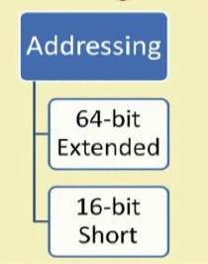
continued
So, for addressing in 6LoWPAN, there are two types of addresses that are used
  16 bit short address which is for PAN specific communication. That means, it is assigned by the PAN coordinator for communicating within the PAN, the personal area network
  64 bit extended address which is used for global unique connectivity, global unique addressing throughout the network.

Slide 14
Features
6LoWPAN system is a low –power wireless mesh network where every node has its own IPv6 address allowing it to connect directly to the internet.
Designed for low power and Lossy IOT networks.
Supports 64 and 16 bit addressing
Useful for low power link layers
Unicast, multicast and broadcast support
Support for IP routing Allows direct connection between nodes
Supplementary adaptation layer is included

Slide 15
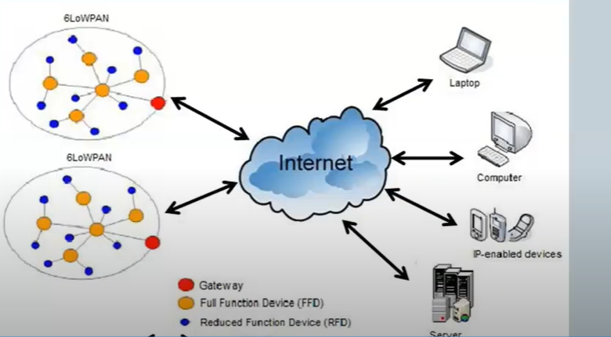
Architecture of 6LoWPAN

Slide 16
Message Queue Telemetry
Transport
MQTT

Slide 17
Introduction
ISO standard
It is a publish subscribe-based lightweight messaging protocol for use in conjunction with the TCP/IP protocol.
MQTT is called a lightweight protocol because all its messages have a small code footprint. Each message consists of a fixed header 2 bytes an optional variable header, a message payload that is limited to 256 megabytes (MB) of information, and quality of service (QoS) level.
MQTT was introduced by IBM in 1999 and standardized by OASIS in 2003.
Designed to provide connectivity between applications and middle-wares on one side and networks and communication on the other side
Designed for remote connections, limited bandwidth, and small code footprint

Slide 18
MQTT Components- Publisher, Subscriber, broker
The MQTT protocol surrounds two subjects: a client and a broker.
An MQTT broker is a server, while the clients are connected devices.
When a device -- or client -- wants to send data to a server -- or broker-- it is called a publish. When the operation is reversed, it is called a subscribe.
If the connection from a subscribing client to a broker is broken, then the broker will buffer messages and push them out to the subscriber when it is back online.
If the connection from the publishing client to the broker is disconnected without notice, then the broker can close the connection and send subscribers a cached message with instructions from the publisher.

Slide 19
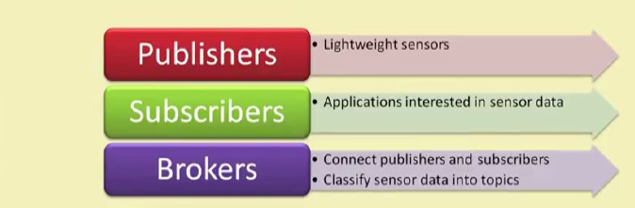
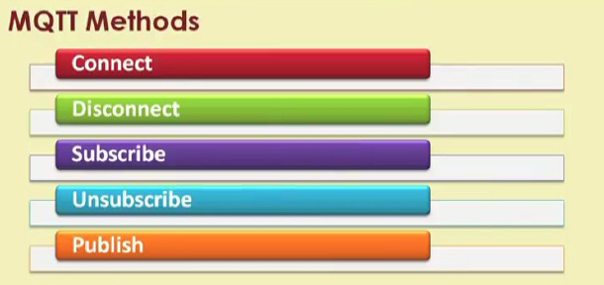
MQTT Components and Methods

Slide 20
MQTT Methods
The connect method helps to connect with the server, helps to connect this device with the server. Then, the disconnect is the opposite. Whenever it is no longer required to be to remain connected, the disconnect method helps in disconnecting from the server from TCP IP service offerings and so on.
Subscribe which is basically subscribing to the services and unsubscribing is the opposite that whenever it is no longer required to continue with getting the different data offerings, the data services, and so on.
Publish method which is basically publishing data, for maybe publishing the data from the different sensors or different devices to the broker for it to be fetched by the different application clients.
During the communication phase, a client can perform publish, subscribe, unsubscribe and ping operations.

Slide 21
Communication
The protocol uses a publish/ subscribe architecture(HTTP uses a request/response paradigm).
Publish/ subscribe is an event driven and enables the messages to be published to clients.
The central communication point is MQTT broker, which is in charge of dispatching all messages between the senders and the rightful receivers.
Each client that publishes the message to the broker includes a topic into the message. Topic is the routing information for the broker.
Each client that wants to receive messages subscribes to a certain topic and the broken delivers all messages with the matching topic to the client.
Therefore the clients don’t have to know each other. They only communicate over the topic.

Slide 22
MQTT Topics
A topic is a simple string that can have more hierarchy levels, which are separated by a slash.
A sample topic for sending temperature data of the living room could be house/living-room/temperature.
On one hand the client(e.g., mobile device) can subscribe to the exact topic or on the other hand , it can use a wildcard.
The subscription to house/+/temperature would result in all messages sent to the previously mentioned topic house/living-room/temperature as well as any topic with an arbitrary value in the place of living room, such as house/kitchen/temperature.
The plus sign is a single wild card and only allows arbitrary values for one hierarchy.

Slide 23
continued
If more than one level needs to be subscribed, such as, the entire sub-tree, there is also a multilevel wildcard(#).
It allows to subscribe to all underlying hierarchy levels.
For example house/# is subscribing to all topics beginning with house.

Slide 24
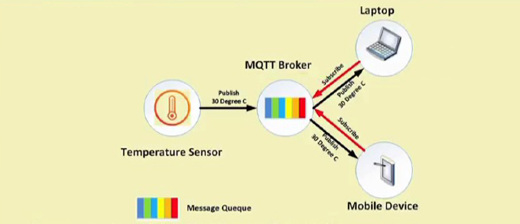
Example

Slide 25
Advantages of MQTT
efficient data transmission and quick to implement due to its being a lightweight protocol.
Low network usage, due to minimized data packets
Efficient distribution of data
Successful implementation of remote sensing and control
fast and efficient message delivery
Age of small amounts of power, which is good for the connected devices and reduction of network bandwidth

Slide 26
Applications of MQTT
Facebook currently uses MQTT for its Messenger app, not only because the protocol conserves battery power during mobile phone-to-phone messaging, but also because the protocol enables messages to be delivered efficiently in milliseconds (ms), despite inconsistent internet connections across the globe.
Most major cloud services providers, including Amazon Web Services (AWS), Google Cloud, IBM Cloud and Microsoft Azure, support MQTT.
MQTT is well suited to applications using M2M and IoT devices for purposes such as real-time analytics, preventative maintenance and monitoring in environments, including smart homes, healthcare, logistics, industry and manufacturing.
.

Slide 27
Constrained Application
Protocol
CoAP

Slide 28
Introduction
CoAP is developed by IETF(Internet Engineering Task Force)
Developed to enable smart devices to connect to the internet
Lightweight protocol and end to end communication.
Web transfer protocol for use with constrained nodes and networks(limited energy or power supply, limited computational resources, limited communication resource, limited bandwidth environment and so on).
CoAP is a session layer protocol(lies between the transport layer and the application layer). However, we can also contribute as an application layer protocol as well.
Designed for Machine to Machine applications such as smart energy and building automation.

Slide 29
continued
Based on Request-Response model between end-points(the source and the destination).
Client server interaction is asynchronous over a datagram oriented transport protocol such as UDP (User datagram Protocol)
It is built over UDP instead of TCP

Slide 30
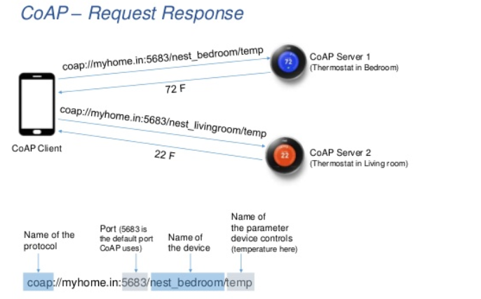

Slide 31
UDP
UDP (User Datagram Protocol) is a communications protocol that is primarily used for establishing low-latency and loss-tolerating connections between applications on the internet.
a communications protocol that facilitates the exchange of messages between computing devices in a network.
It speeds up transmissions by enabling the transfer of data before an agreement is provided by the receiving party.
TCP is a connection-oriented protocol and UDP is a connection-less protocol. TCP establishes a connection between a sender and receiver before data can be sent. UDP does not establish a connection before sending data.

Slide 32
UDP
TCP is best suited to be used for applications that require high reliability where timing is less of a concern.
  World Wide Web (HTTP, HTTPS)
  Secure Shell (SSH)
  File Transfer Protocol (FTP)
  Email (SMTP, IMAP/POP)
UDP is best suited for applications that require speed and efficiency.
  Streaming videos
  Online games
  Live broadcasts
  Domain Name System (DNS)
  Voice over Internet Protocol (VoIP)
  Trivial File Transfer Protocol (TFTP)

Slide 33
continued
CoAP architecture is basically divided into two main sub-layers,
messaging sub-layer: responsible for reliability and duplication of messages
request response sub-layer: responsible for communication in terms of sending a request and getting a response back.
CoAP has 4 messaging modes
Confirmable
Non-Confirmable
Piggyback
Separate

Slide 34
Messaging Modes
Confirmable message(CON): Some messages require an acknowledgement, these messages are called confirmable. When no packets are lost, each confirmable message obtains exactly one return message of type acknowledgement. It is reliable message. It retransmits until acknowledgement arrives with the same message ID.
Non- Confirmable message (NON): Some other messages do not require an acknowledgement . This is for the messages that are repeated regularly for application requirements, such as repeated reading from sensor.
Piggyback message which is used for a client server direct communication where the server sends its response directly after receiving the message ie., within the acknowledgement message. Client can send request with CON/NON. Ack shall be immediately received with corresponding token number and message. If not available, the failure code can be embedded as apart of ack.

Slide 35
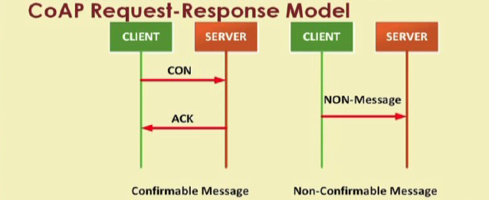
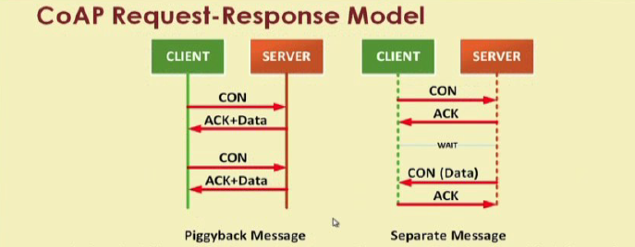

Slide 36
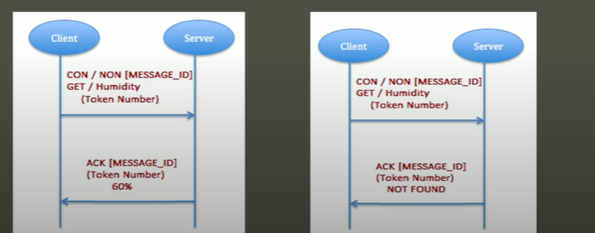
Piggyback

Slide 37
continued
Separate : it is used when the server response comes in a message separate from the acknowledgement and that basically may take some time to be sent to the server.
Separate message, we have a message being sent and acknowledgement being received and there is a wait period after which the data is going to be sent separately from the server to the client and corresponding to that the client is going to send an acknowledgement back to the server.

Slide 38
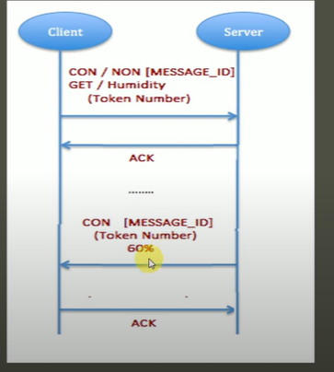
Separate response
When the CON type message is sent to the server from the client and in case , the server is unable to respond immediately, an empty ACK will be reverted
After some time , when the server can send the response, it shall send a CON message with data. ACK shall be sent back from the client.

Slide 39
Comparison of MQTT and CoAP
 | MQTT | CoAP
Base Protocol | TCP | UDP
Communication Node | Many to Many(M:N) | One to One(1:1)
Power consumption | Higher than CoAP | Lower than MQTT
Model | Publish Subscribe | Request/ Response

Slide 40
Advanced Message Queuing Protoco (AMQP)
The AMQP world on a high level is composed of producers, consumers, brokers, exchanges, bindings, and queues.
Producer publishes messages to exchanges.
Exchanges then distribute messages among queues using bindings (rules) and at the end, the broker delivers the message to the corresponding consumer(s).
Producer/Consumer – Producers and consumers are essentially just clients
Binding
Bindings define the routing rules and relationship between an exchange and message queues. In order to make routing rules, a queue has to be bound to the exchanger. Every binding may have an optional key that is used to filter messages in the exchange.
Depending on attributes a message will be dropped or returned back in case the message is not routed to any queue.

Slide 41
Continued
Exchange
Exchanges receive messages from producers and then route the messages to the queues that are bound to exchanges using one of these routing algorithms:
Direct(Send the msg as it is) – the routing algorithm behind a direct exchange is simple – a message goes to the queues whose binding key exactly matches the routing key of the message.
Fan-out(duplicate) – no routing key needed, each queue or exchange bound to this type of exchange will get a copy of the message.
Header(route based on the header) – in this algorithm each massage has a combination of key-value pairs namely header that is transmitted along with a message. In other words, a header is used to filter messages. Header exchanges ignore the routing key.
Topic(pattern) – combines direct and fan-out algorithms. The messages are routed to the queues by pattern matching. For instance, the messages with keys ‘news. Sport’ and ‘news. auto’ will be routed to the queue ‘news.*’.

Slide 42
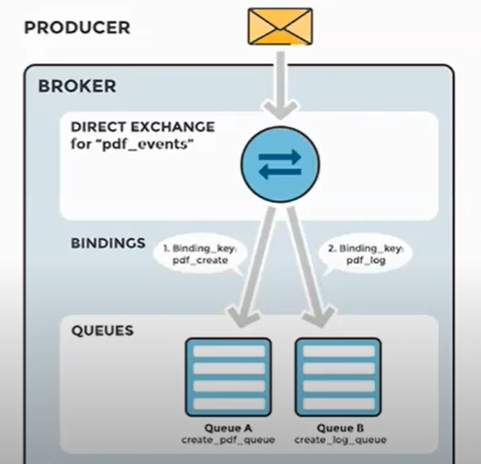
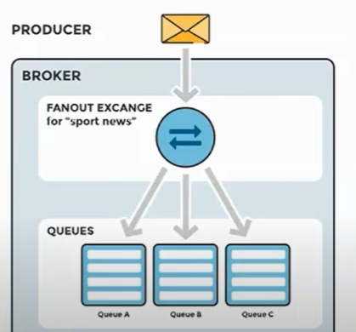
Direct Exchange
Fanout Exchange

Slide 43
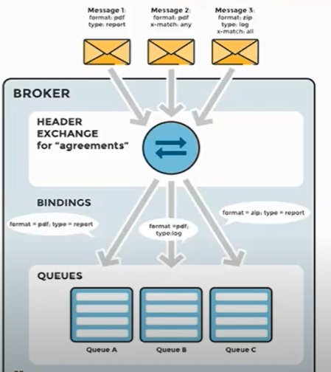
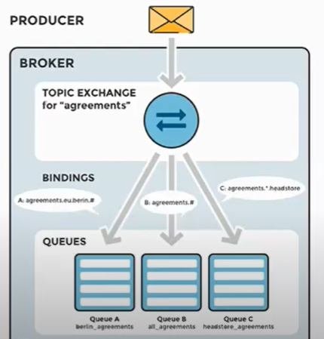
Header Exchange
Topic Exchange

Slide 44
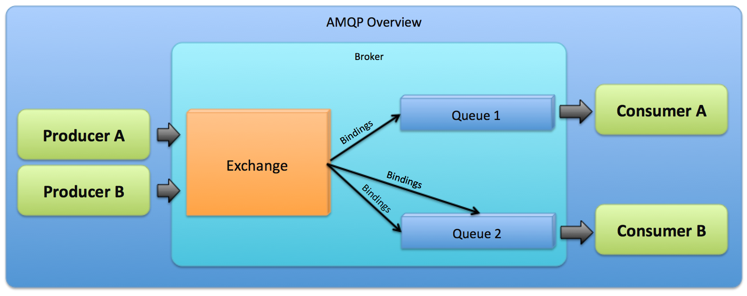
Continued
Queue
The purpose of the queues is to store messages that are consumed by applications. The queues can durable, exclusive (meaning it will be deleted when the connection is closed), auto-deletable (the queue will be deleted when all consumers are unsubscribed), and can have names.

Slide 45
Example of AMQP- Analogy to Email
An AMQP message is analogous to an email message.
A message queue is like a mailbox.
A consumer is like a mail client that fetches and deletes email.
A exchange is like a MTA (mail transfer agent) that inspects email and decides, on the basis of routing keys and tables, how to send the email to one or more mailboxes.
A routing key corresponds to an email To: or Cc: or Bcc: address, without the server information.
Each exchange instance is like a separate MTA process, handling some email sub-domain, or particular type of email traffic.
A binding is like an entry in a MTA routing table.
The power of AMQP comes from our ability to create queues (mailboxes), exchanges (MTA processes), and bindings (routing entries), at runtime, and to chain these together from "to" address to mailbox name.

Slide 46
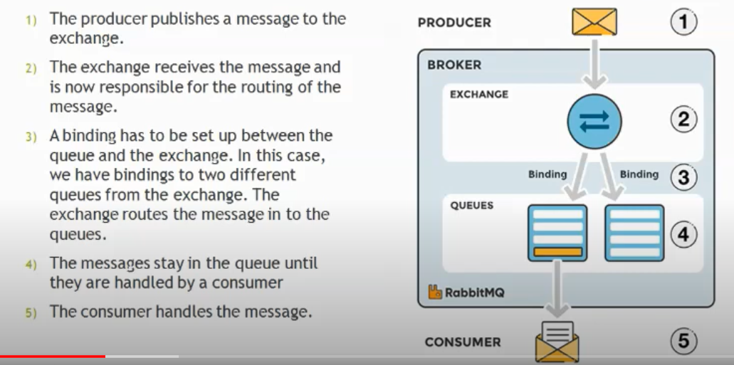
AMQP- Standard RabbitMQ message flow

Slide 47
RPL- Routing protocol for low power and lossy Networks
RPL is an IPv6 Routing Protocol for Low Power and Lossy Networks that uses an optimized route for transmitting traffic from or to a central collector node called a root or sink node.
Low power and lossy network(LLN) are resource constraints.
Routers are usually limited in terms of processing power, battery, memory and their interconnects are characterized by unstable links with high loss rates, low data rates, and low packet delivery rates
RPL supports three traffic flows: Traffic patterns would be Peer to Peer transfer(P2P), communication from a central server to multiple nodes on the LLN, Point to multipoint(P2MP) or Multipoint to point(MP2P)
RPL is a distance vector routing protocol(Distance-vector routing protocols measure the distance by the number of routers a packet has to pass, one router counts as one hop).

Slide 48
Continued
Distance-vector protocols are based on calculating the Direction and Distance to any link in a network.
  "Direction" usually means the next-hop address and the exit interface.
  "Distance" is a measure of the cost to reach a certain node.
The least cost route between any two nodes is the route with minimum distance.
Each node maintains a vector (table) of minimum distance to every node.
The cost of reaching a destination is calculated using various route metrics
The protocol was designed to be highly adaptive to network conditions and to provide alternate routes, whenever default routes are inaccessible.
Contains thousands of nodes.
Multiple concurrent instances of RPL may operate in a given network, each RPL instance is characterized by a unique RPL instance ID

Slide 49
Continued
RPL topology is organized as a Directed Acyclic Graph (DAG) divided into one or more Destination Oriented Acyclic DAGs (DODAGs).
The RPL routing protocol builds one or more destination oriented direct acyclic graphs (DODAG).
Each DODAG is a directed graph with no cycles and with a single root node

Slide 50
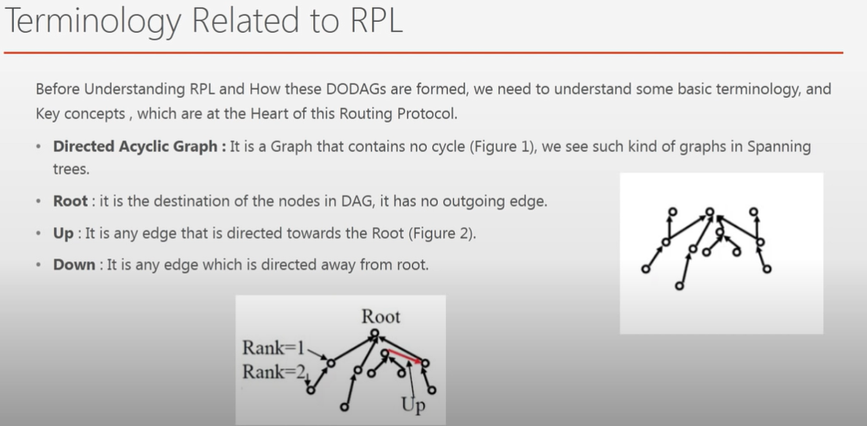

Slide 51
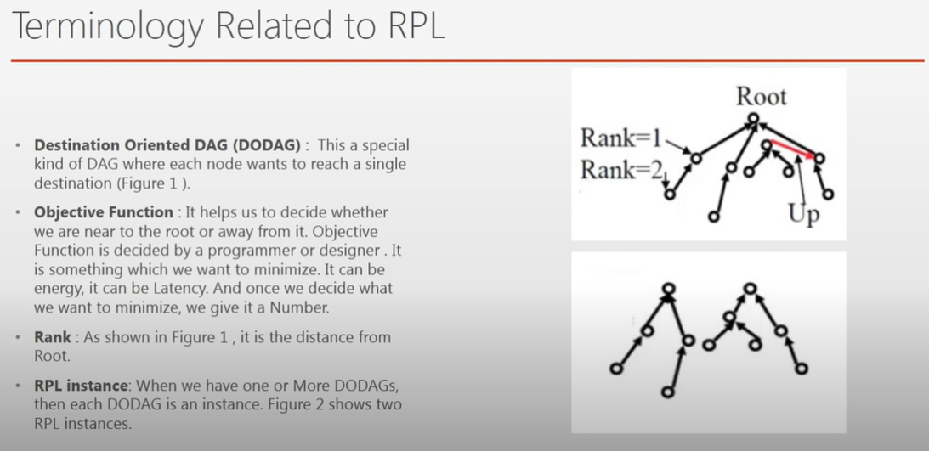
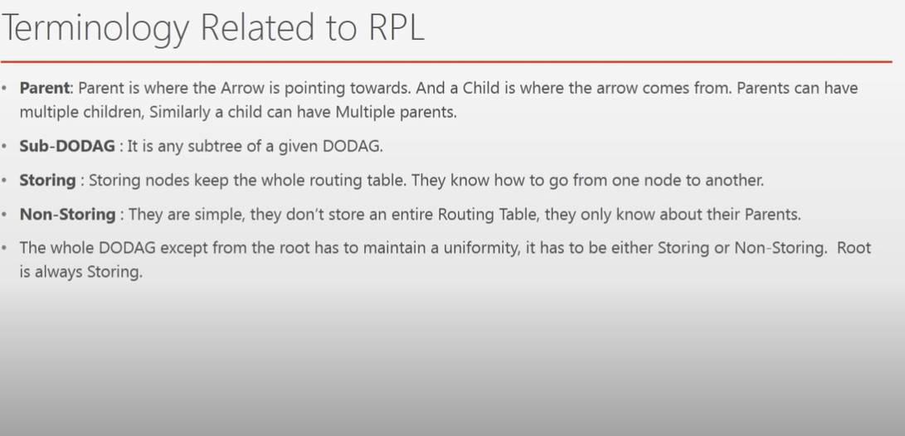

Slide 52
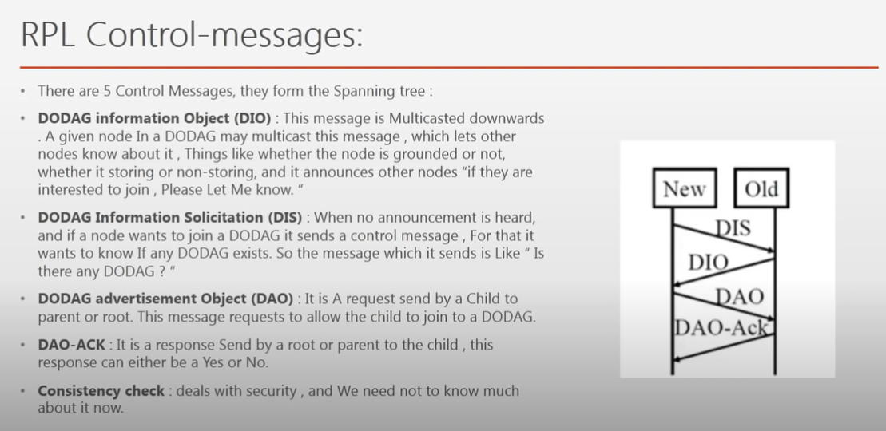

Slide 53
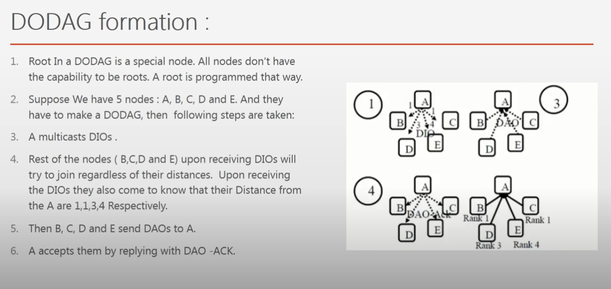

Slide 54
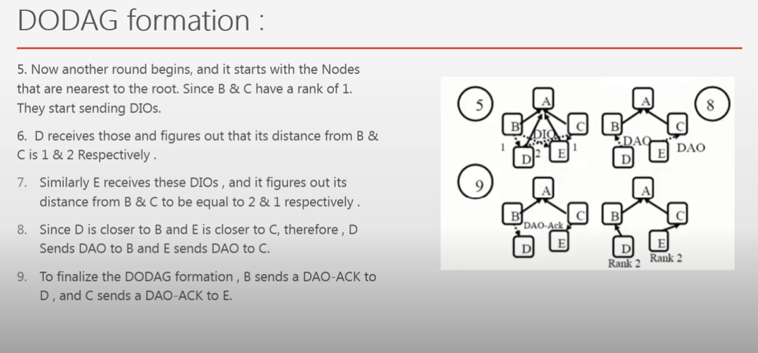

Slide 55
REST Protocol
Representational State Transfer

Slide 56
Introduction
REST is a software architectural style that defines the set of rules to be used for creating web services.
Web services that follow the REST architectural style are known as RESTful web services.
It allows requesting systems to access and manipulate web resources by using a uniform and predefined set of rules.
Interaction in REST-based systems happens through Internet’s Hypertext Transfer Protocol (HTTP).
REST technology is generally preferred to the more robust Simple Object Access Protocol (SOAP) technology because
  REST uses less bandwidth,
  simple and flexible making it more suitable for internet usage.

Slide 57
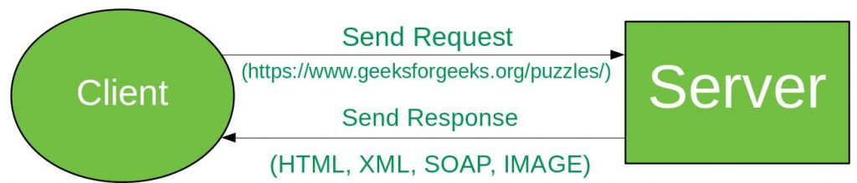
continued
A Restful system consists of a:
  client who requests resources.
  server who has the resources.
Working:
A request is sent from client to server in the form of web URL as HTTP GET or POST or PUT or DELETE request.
After that, a response comes back from the server in the form of a resource which can be anything like HTML, XML, Image, or JSON.
But now JSON is the most popular format being used in Web Services.

Slide 58
REST
There are six architectural constraints that make any web service
Uniform Interface: It suggests that there should be a uniform way of interacting with a given server irrespective of device or type of application (website, mobile app).
Client-Server: The REST application should have a client-server architecture. A Client is someone who is requesting resources and is not concerned with data storage and a server is someone who holds the resources and is not concerned with the user interface or user state.
Cacheable: Every response should include whether the response is cacheable or not and for how much duration responses can be cached at the client-side. The client will return the data from its cache for any subsequent request and there would be no need to send the request again to the server.
Stateless: It means that the necessary state to handle the request is contained within the request itself and the server would not store anything related to the session. In REST, the client must include all information for the server to fulfill the request whether as a part of query params, headers or URI

Slide 59
HTTP Methods
The PUT, GET, POST and DELETE methods are typically used in REST based architectures. The following table gives an explanation of these operations:
HTTP Method | CRUD Operation | Description
POST | INSERT(CREATE) | Adds to an existing resource
PUT | UPDATE | Overrides existing resource
GET | SELECT(READ) | Fetches a resource. The resource is never changed via a request(Fetch the data from server)
DELETE | DELETE | Deletes a resource

Slide 60
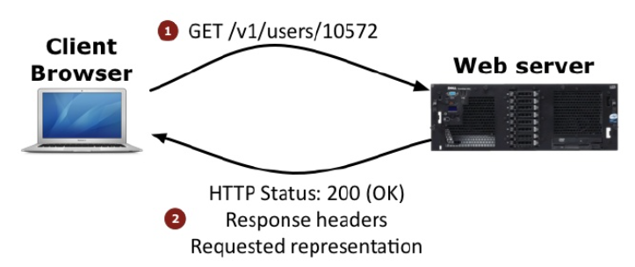
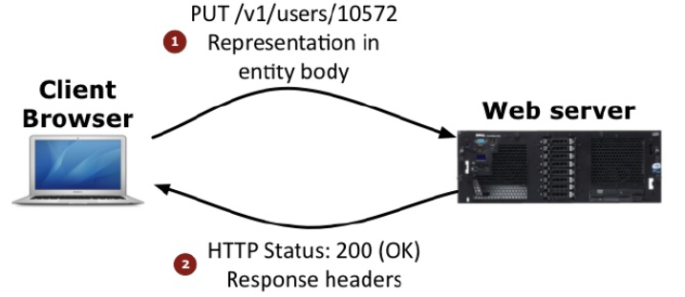
GET and PUT

Slide 61
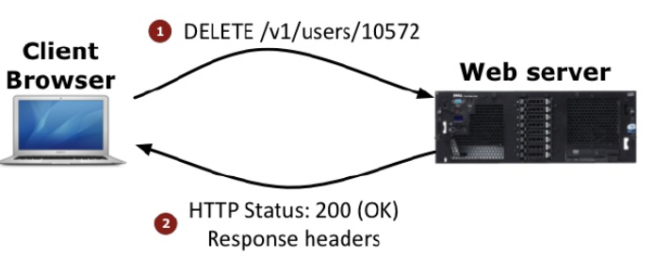
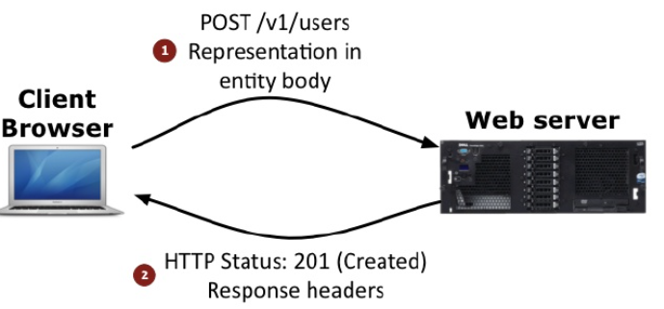
DELETE and POST

Slide 62
